Slide 1
Algorithms for Aerosol Removal in Coronal Images
Curtis Walker – UCAR/SOARS
Scott Sewell – NCAR/HAO
Steve Tomczyk – NCAR/HAO

Slide 2
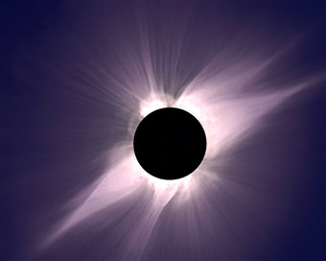
Solar Corona (Not A Beer)
Sun’s “Atmosphere”
1 million degree Kelvin plasma
Can only be seen during total solar eclipse
May be viewed with coronagraphs outside of eclipse
Emits massive quantities of energy

Slide 3
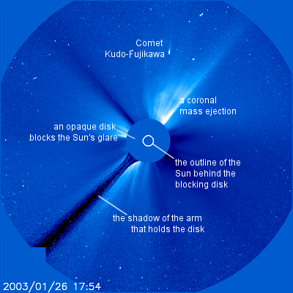
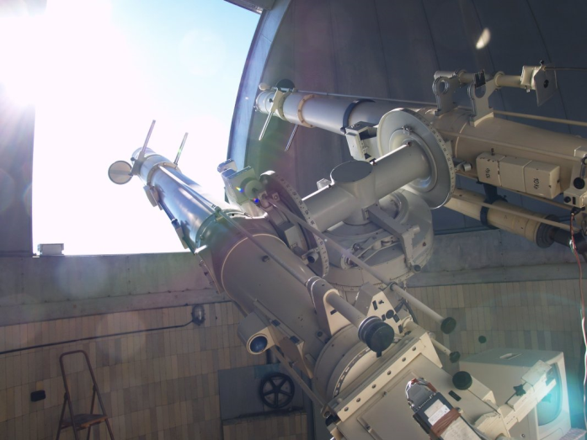
Solar Coronagraph
(An Over-Glamorized Camera)
Instrumentation that produces a false eclipse of the sun allowing coronal observation
Ground-based and satellite-based varieties

Slide 4

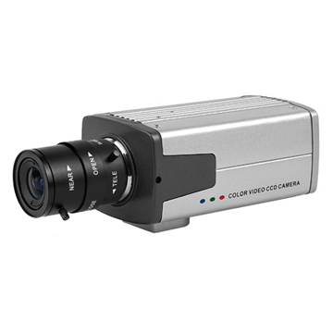

CCD Vs. CMOS Vs. sCMOS
(Say Cheese! Or Sunspot!!)
CCD
CMOS/sCMOS
Charge coupled-device
Converts photons into electrons which become the image signal
(Scientific) Complementary metal-oxide-semiconductor
Greater efficiency

Slide 5
Image Defects
Dark Current
Flat Field Bias
Aerosols!!!!!! ☹

Slide 6
AVI MOVIE

Slide 7
Algorithms/Methods/Processing
Thresholding three times according to a Median Array, a Mean Array, and a Minimum Array
?

Slide 8
Results 1

Slide 9
Results 2

Slide 10
References & Acknowledgements

Slide 11
For the time being these are my concerns and observations:
How much educational (corona and coronagraph) information is necessary since our audience is not solar physict?
There should be some slide towards the beginning that explains what I am doing and why…?
I question the necessity of CCD vs. CMOS discussion…?
I certainly already feel the time crunch…?

