Slide 1
Image Processing Algorithms for Aerosol Removal in Solar Coronal Images
Curtis Walker – UCAR/SUNY Oneonta
Scott Sewell – NCAR/HAO
Steve Tomczyk – NCAR/HAO

Slide 2
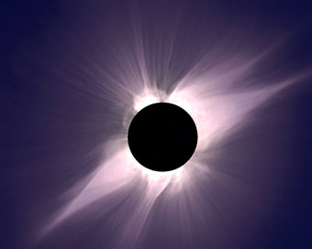
Solar Corona
Sun’s “Atmosphere”
1 million degree Kelvin plasma
Can only be seen during total solar eclipse
May be viewed with coronagraphs outside of eclipse
Emits massive quantities of energy
Origin of the Solar Wind
Image Courtesy of Google Images

Slide 3
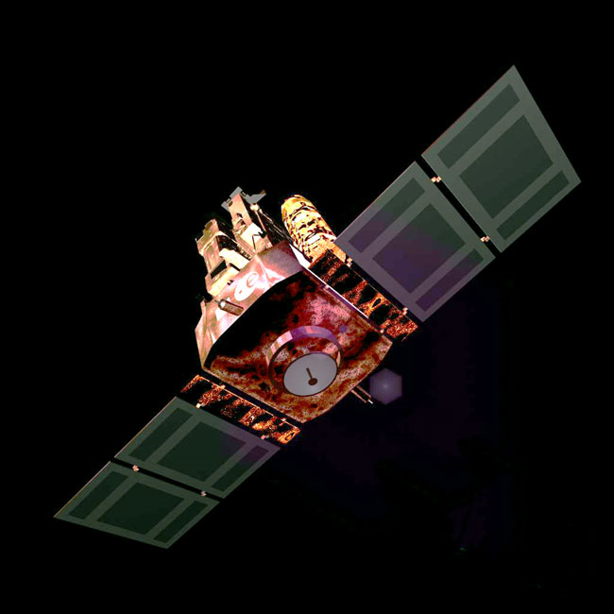
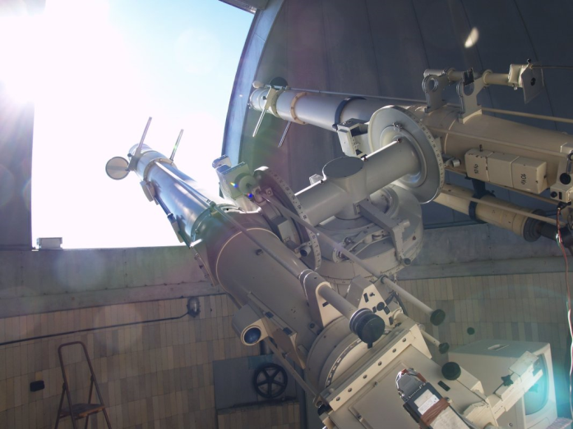
Solar Coronagraph
Instrumentation that produces a false eclipse of the sun allowing coronal observation
Ground-based and satellite-based varieties
Images Courtesy of Google Images

Slide 4
Image Processing
Dark Frame Corrections
Flat Field Corrections
Aerosol Removal

Slide 5
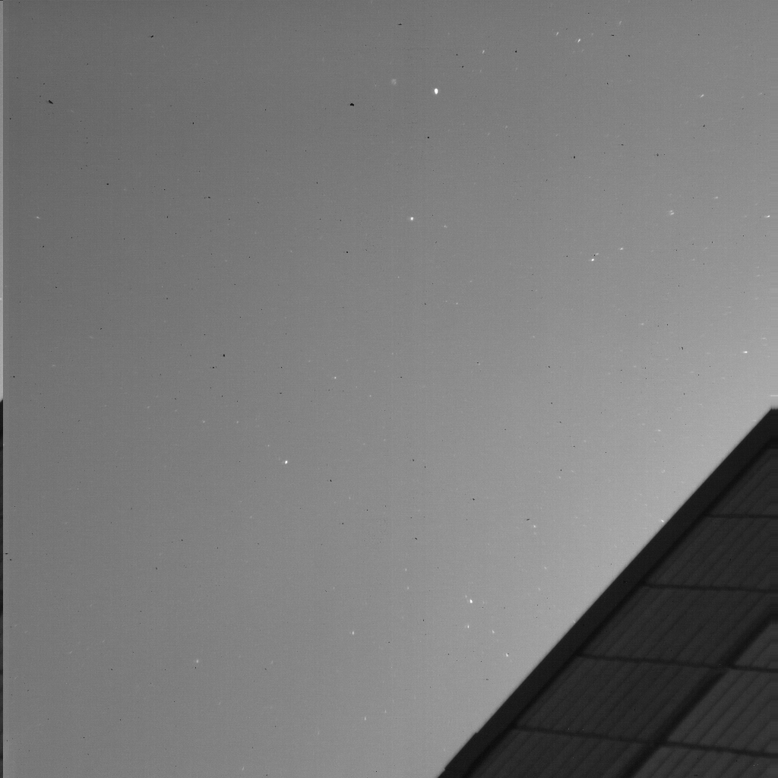
What Do Aerosols Look Like?

Slide 6
How Do We Correct For Aerosols?
Thresholding the images by three different techniques
Median Array
Mean Array
Minimum Array

Slide 7
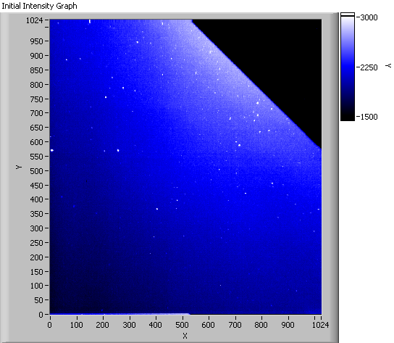
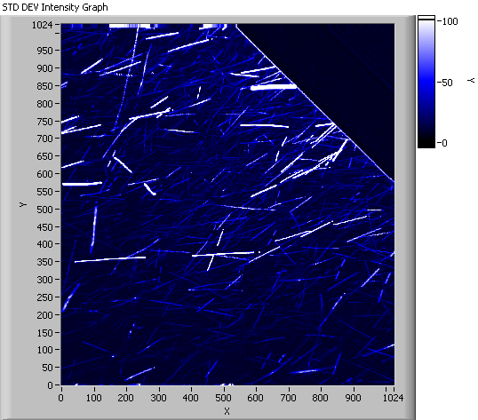
Initial Image Vs. Standard Deviation

Slide 8
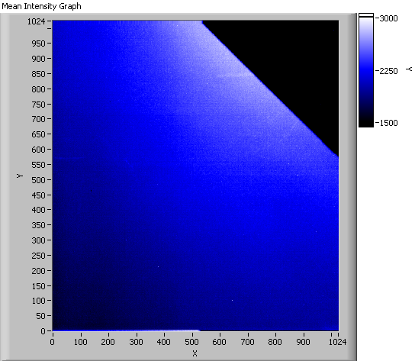
Initial Image Vs. Mean

Slide 9

Initial Image Vs. Median

Slide 10
Conclusions & Future Work
We have successfully removed aerosols from an image utilizing one technique
We will still attempt other techniques for comparison

Slide 11
Acknowledgements
Scott Sewell NCAR/HAO
Steve Tomczyk NCAR/HAO
Amy Stevermer UCAR/COMET
Theresa Aguilar UCAR/Texas Tech

Slide 12
For the time being these are my concerns and observations:
How much educational (corona and coronagraph) information is necessary since our audience is not solar physict?
There should be some slide towards the beginning that explains what I am doing and why…?
I question the necessity of CCD vs. CMOS discussion…?
I certainly already feel the time crunch…?

Slide 13

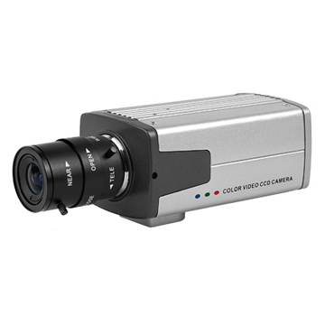

CCD Vs. CMOS Vs. sCMOS
(Say Cheese! Or Sunspot!!)
CCD
CMOS/sCMOS
Charge coupled-device
Converts photons into electrons which become the image signal
(Scientific) Complementary metal-oxide-semiconductor
Greater efficiency

