Slide 1
Image Processing Algorithms for Aerosol Removal in Solar Coronal Images
Curtis Walker – UCAR/SUNY Oneonta
Scott Sewell – NCAR/HAO
Steve Tomczyk – NCAR/HAO

Slide 2
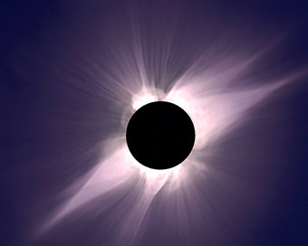
Solar Corona
Sun’s “Atmosphere”
~10⁶ K plasma
Origin of the Solar Wind
Emits massive quantities of energy
Can only be seen during total solar eclipse
May be viewed with coronagraphs outside of eclipse
Total solar eclipse, July 11, 1991, observed at Hawaii.
Photo Credit: S. Koutcmy, IAP-CNRS (France)

Slide 3
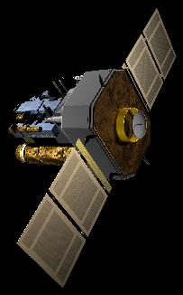
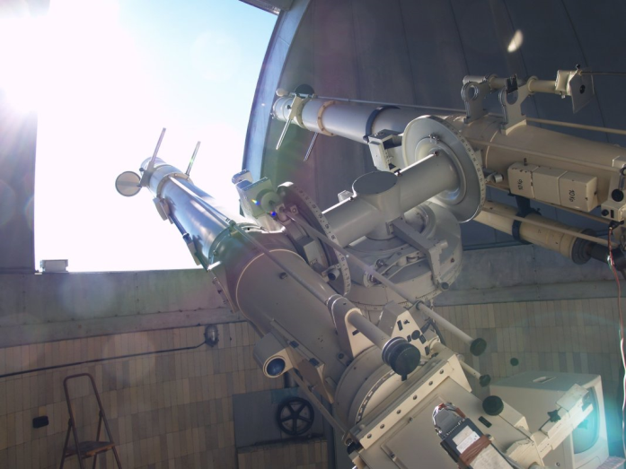
Solar Coronagraph
Instrumentation that produces a false eclipse of the sun allowing coronal observation
Ground-based and satellite-based varieties
LASCO Satellite
Photo Credit: NASA SOHO
Zeiss Coronagraph at Lomnicky Peak Observatory in Slovakia
Photo Credit: Steve Tomczyk

Slide 4
Image Processing
Dark Frame Corrections
Flat Field Corrections
Aerosol Removal

Slide 5
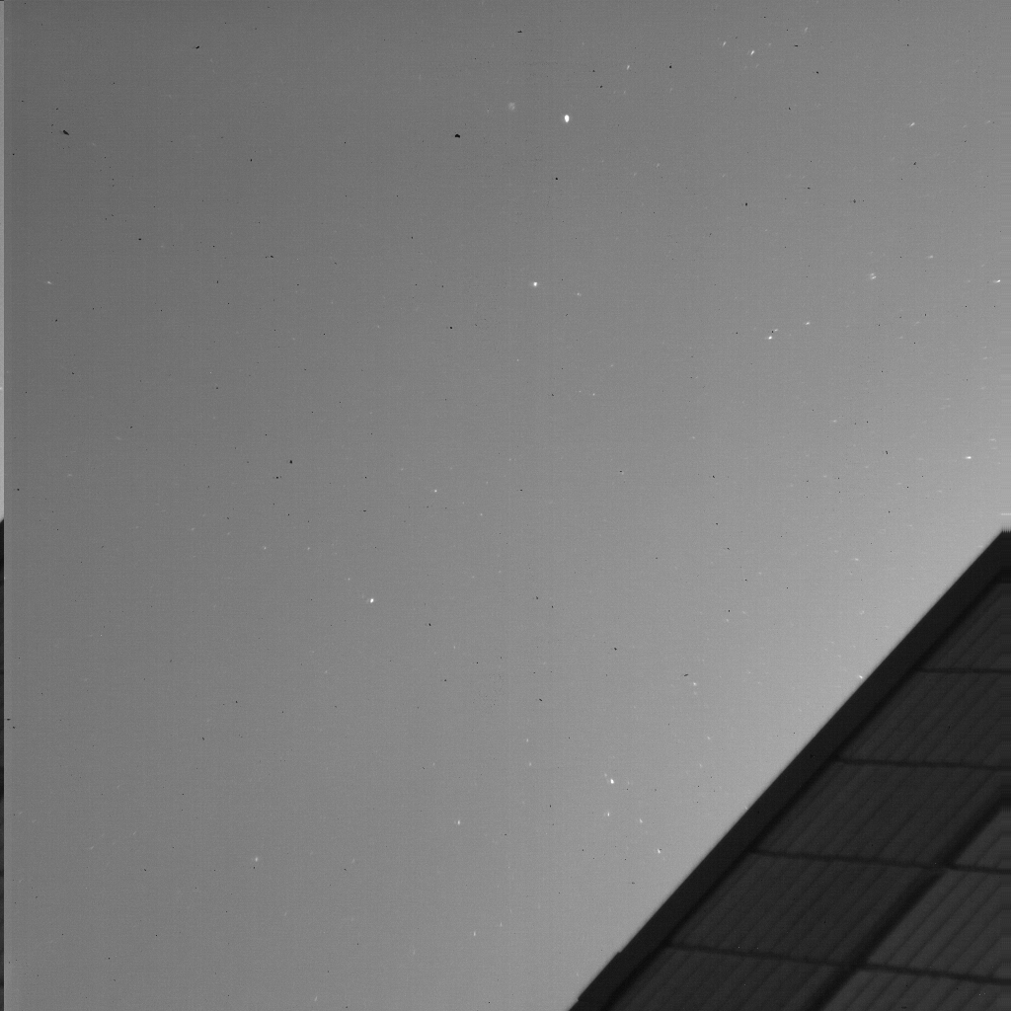
What Do Aerosols Look Like?

Slide 6
How Do We Correct For Aerosols?
Three techniques for image thresholds
  Median Array
  Mean Array
  Minimum Array
A series of 120 images containing atmospheric aerosols were obtained in Boulder, CO on June 16, 2010 and were limited by the above thresholds.

Slide 7
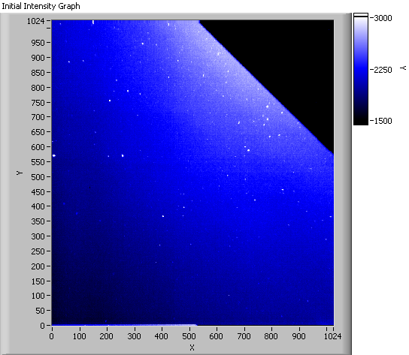
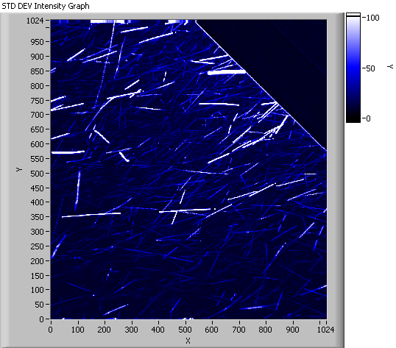
Initial Image Vs. Standard Deviation
Final image processed of 120 images.
Standard Deviation of all pixels (1024 x 1024) in all 120 images.

Slide 8
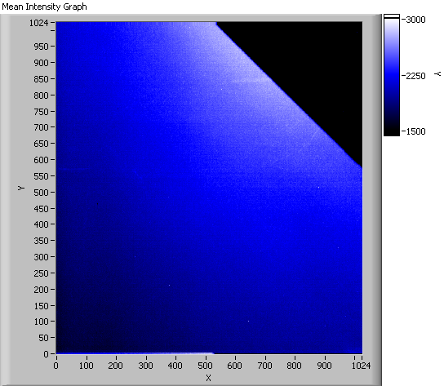
Initial Image Vs. Mean
Mean threshold of all pixels in all 120 images. Note the aerosol streaks near the building and at left.
Final image processed of 120 images.

Slide 9

Initial Image Vs. Median
Median threshold of all pixels in all 120 images. Note that this is the best result.
Final image processed of 120 images.

Slide 10
Conclusions & Future Work
We have successfully removed aerosols from an image utilizing the mean and median array thresholds
We will still attempt the minimum array threshold and other techniques for comparison

