Slide 1
Image Processing Algorithms for Aerosol Removal in Solar Coronal Images
Curtis Walker – UCAR/SUNY Oneonta
Scott Sewell – NCAR/HAO
Steve Tomczyk – NCAR/HAO

Slide 2
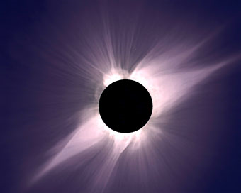
Solar Corona
Sun’s “Atmosphere”
~10⁶ K plasma
Origin of the Solar Wind
Emits massive quantities of energy
Can only be seen during total solar eclipse
May be viewed with coronagraphs outside of eclipse
Total solar eclipse, July 11, 1991, observed at Hawaii.
Photo Credit: S. Koutcmy, IAP-CNRS (France)

Slide 3
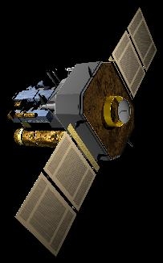
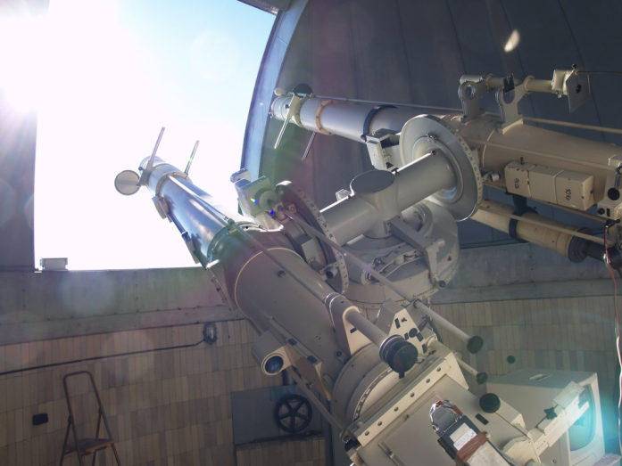
Solar Coronagraph
Instrumentation that produces a false eclipse of the sun allowing coronal observation
Ground-based and satellite-based varieties
LASCO Satellite
Photo Credit: NASA SOHO
Zeiss Coronagraph at Lomnicky Peak Observatory in Slovakia
Photo Credit: Steve Tomczyk

Slide 4
Image Processing
Dark Frame Corrections
Flat Field Corrections
Aerosol Removal

Slide 5
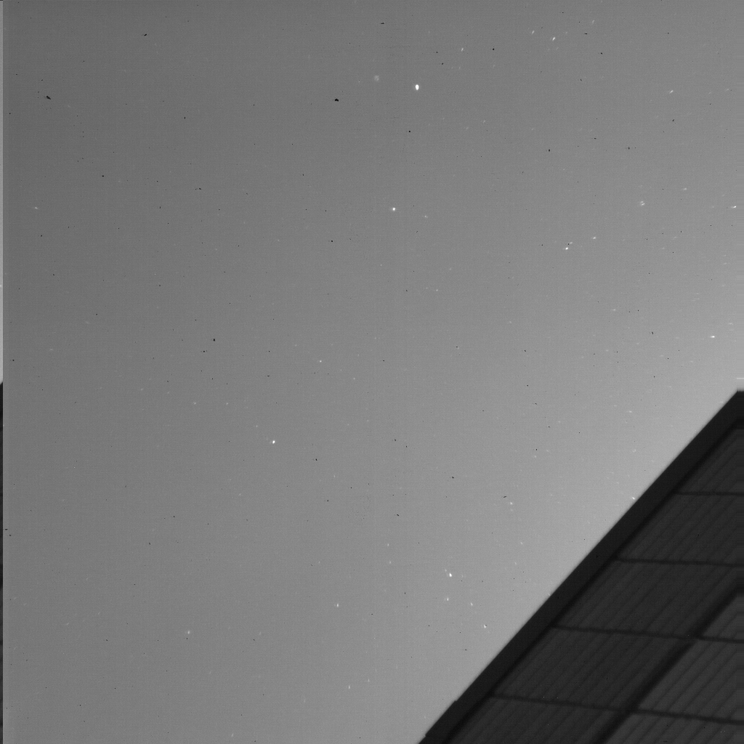
What Do Aerosols Look Like?

Slide 6
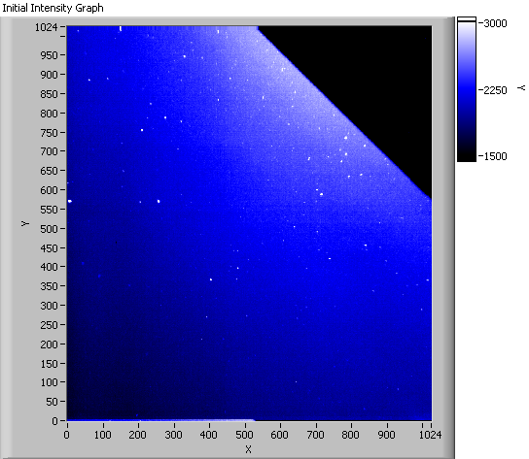
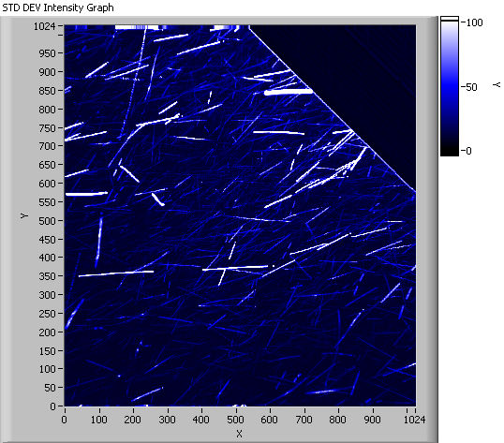
Measurement of Aerosol Motion
Final image processed of 120 images.
The white tracks represent aerosol trajectories over ~1s.

Slide 7
How Do We Correct For Aerosols?
Three techniques for image thresholds
  Mean Threshold
  Median Threshold
  Minimum Threshold
A series of 120 images containing atmospheric aerosols were obtained in Boulder, CO on June 16, 2010.
The mean and median images were calculated.

Slide 8
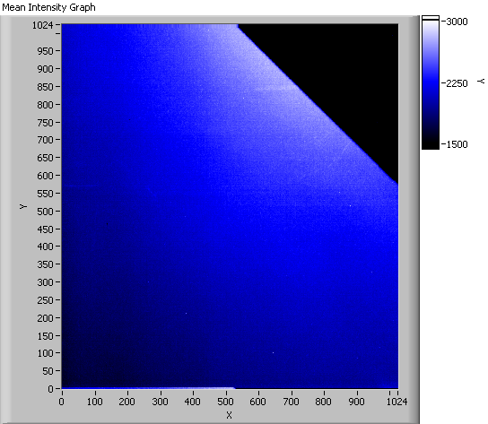

Mean and Median Images
Mean image of all 120 images.
Note the aerosol streaks near the building and at left.
Median image of all 120 images.
Note that this is the best result.

Slide 9
Conclusions & Future Work
We have obtained the necessary images (mean and median) to apply subsequent thresholding techniques.
We will investigate optimizing these algorithms for real-time usage.

