Slide 1
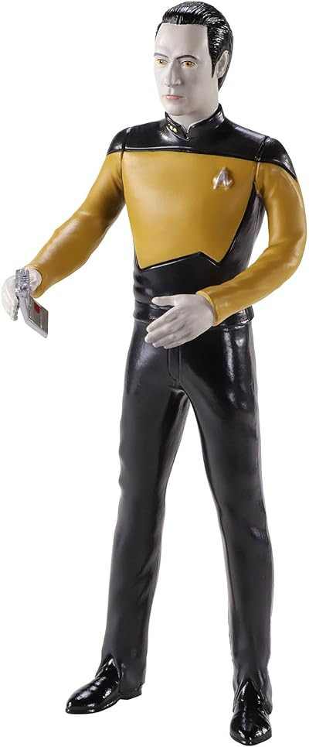
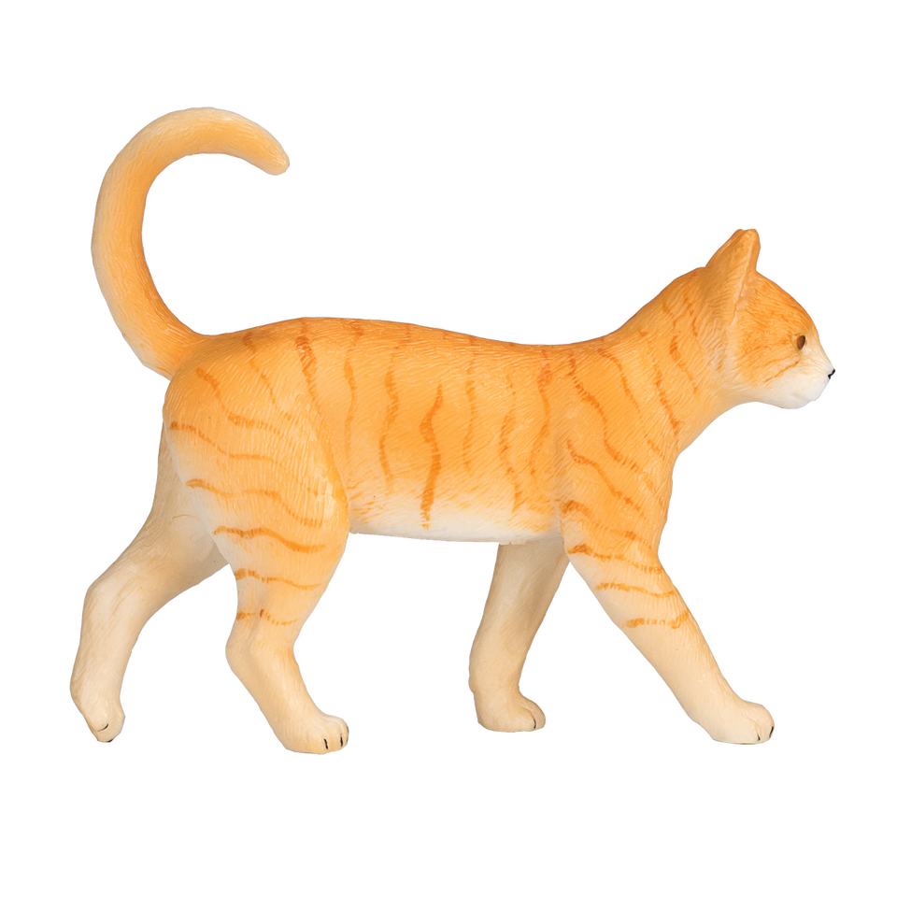
Towards a new ObsSpace data model
Phil Underwood, Stephen Herbener,
& Patrick Nichols

Slide 2
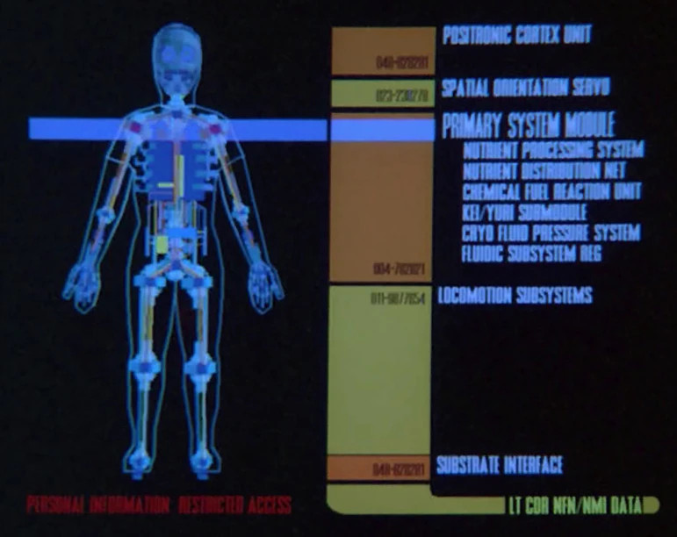
Contents
The context for this work
A summary of the current design
A summary of the integration plan

Slide 3
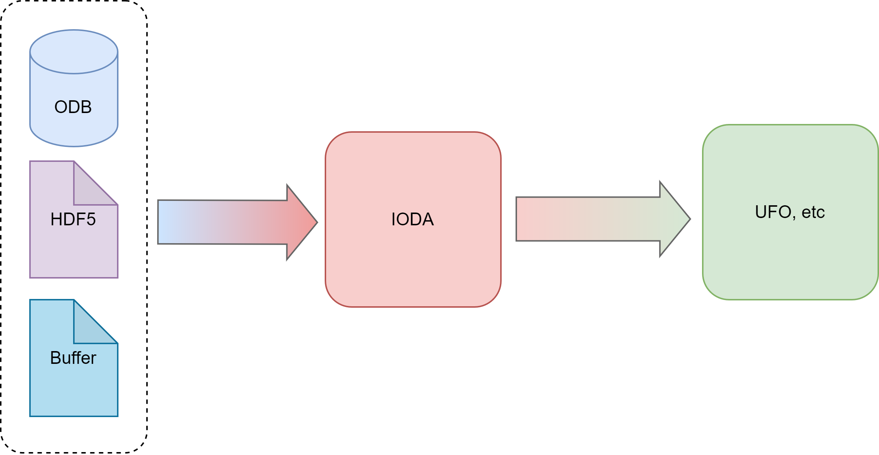
The Context
Object instantiation and population in memory
Observational
Data Sources on persistent storage
Observational Operators, and data processing

Slide 4

The Context
Object instantiation and population in memory
Observational
Data Sources on persistent storage
Observational Operators, and data processing

Slide 5
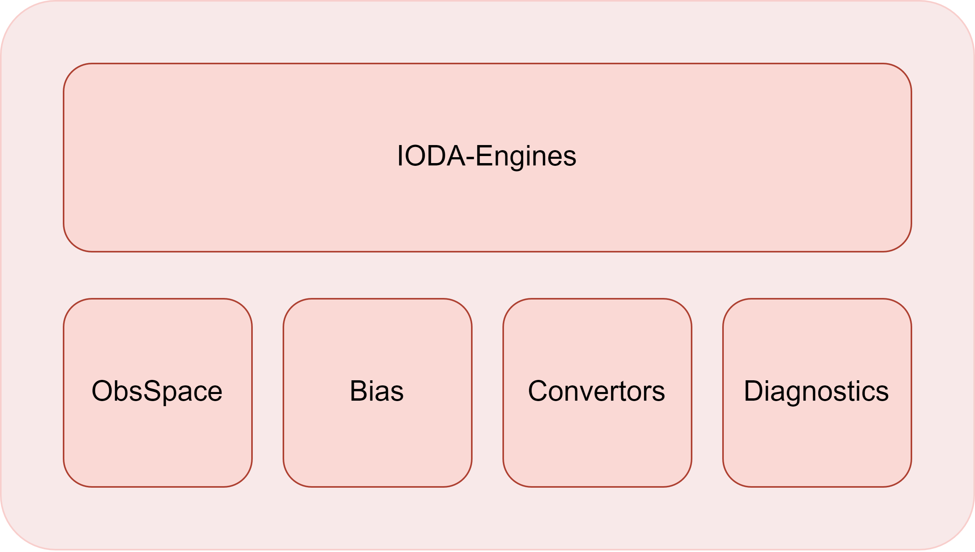
Closer
https://jointcenterforsatellitedataassimilation-jedi-docs.readthedocs-hosted.com/en/latest/inside/jedi-components/ioda/introduction.html

Slide 6
Closer

Slide 7
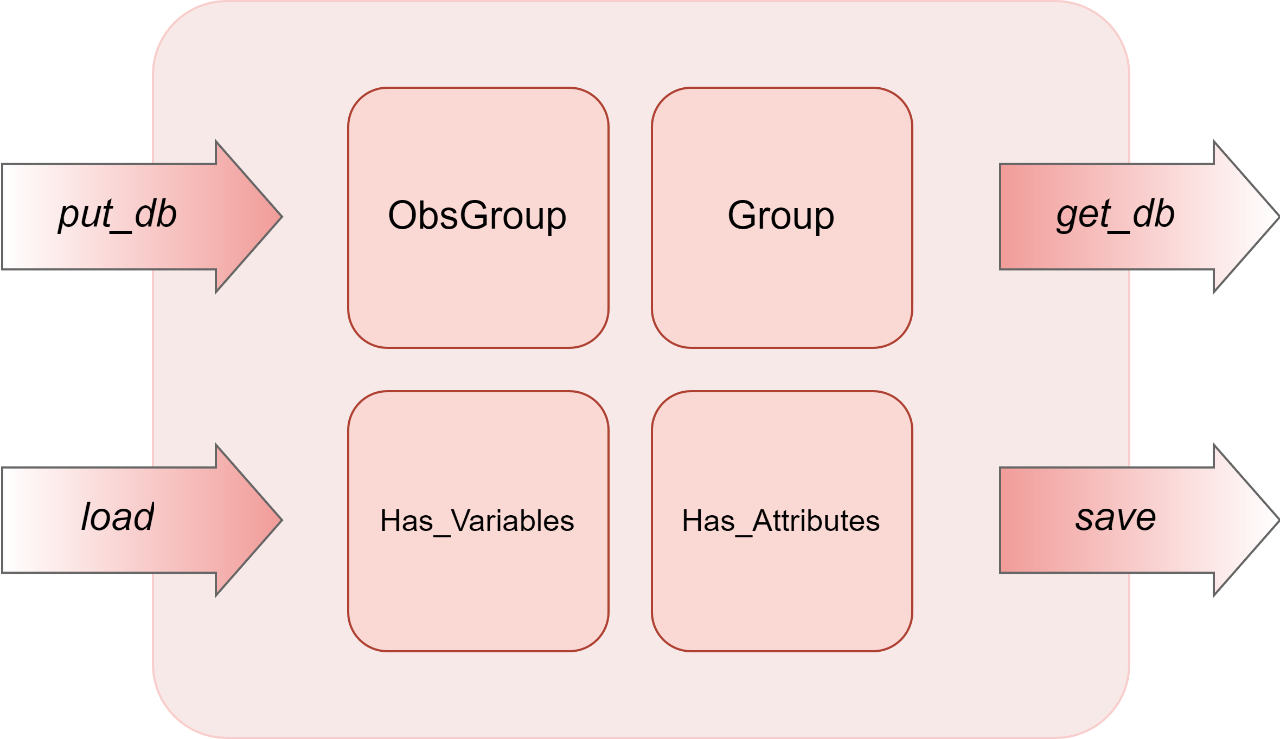
Current ObsSpace Data Model

Slide 8
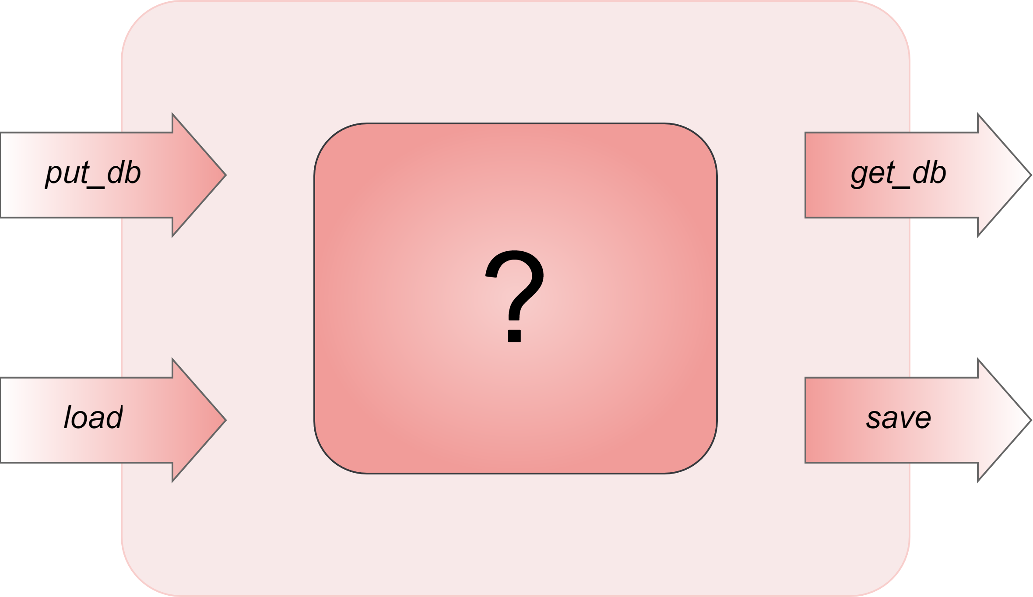
New ObsSpace Data Model

Slide 9
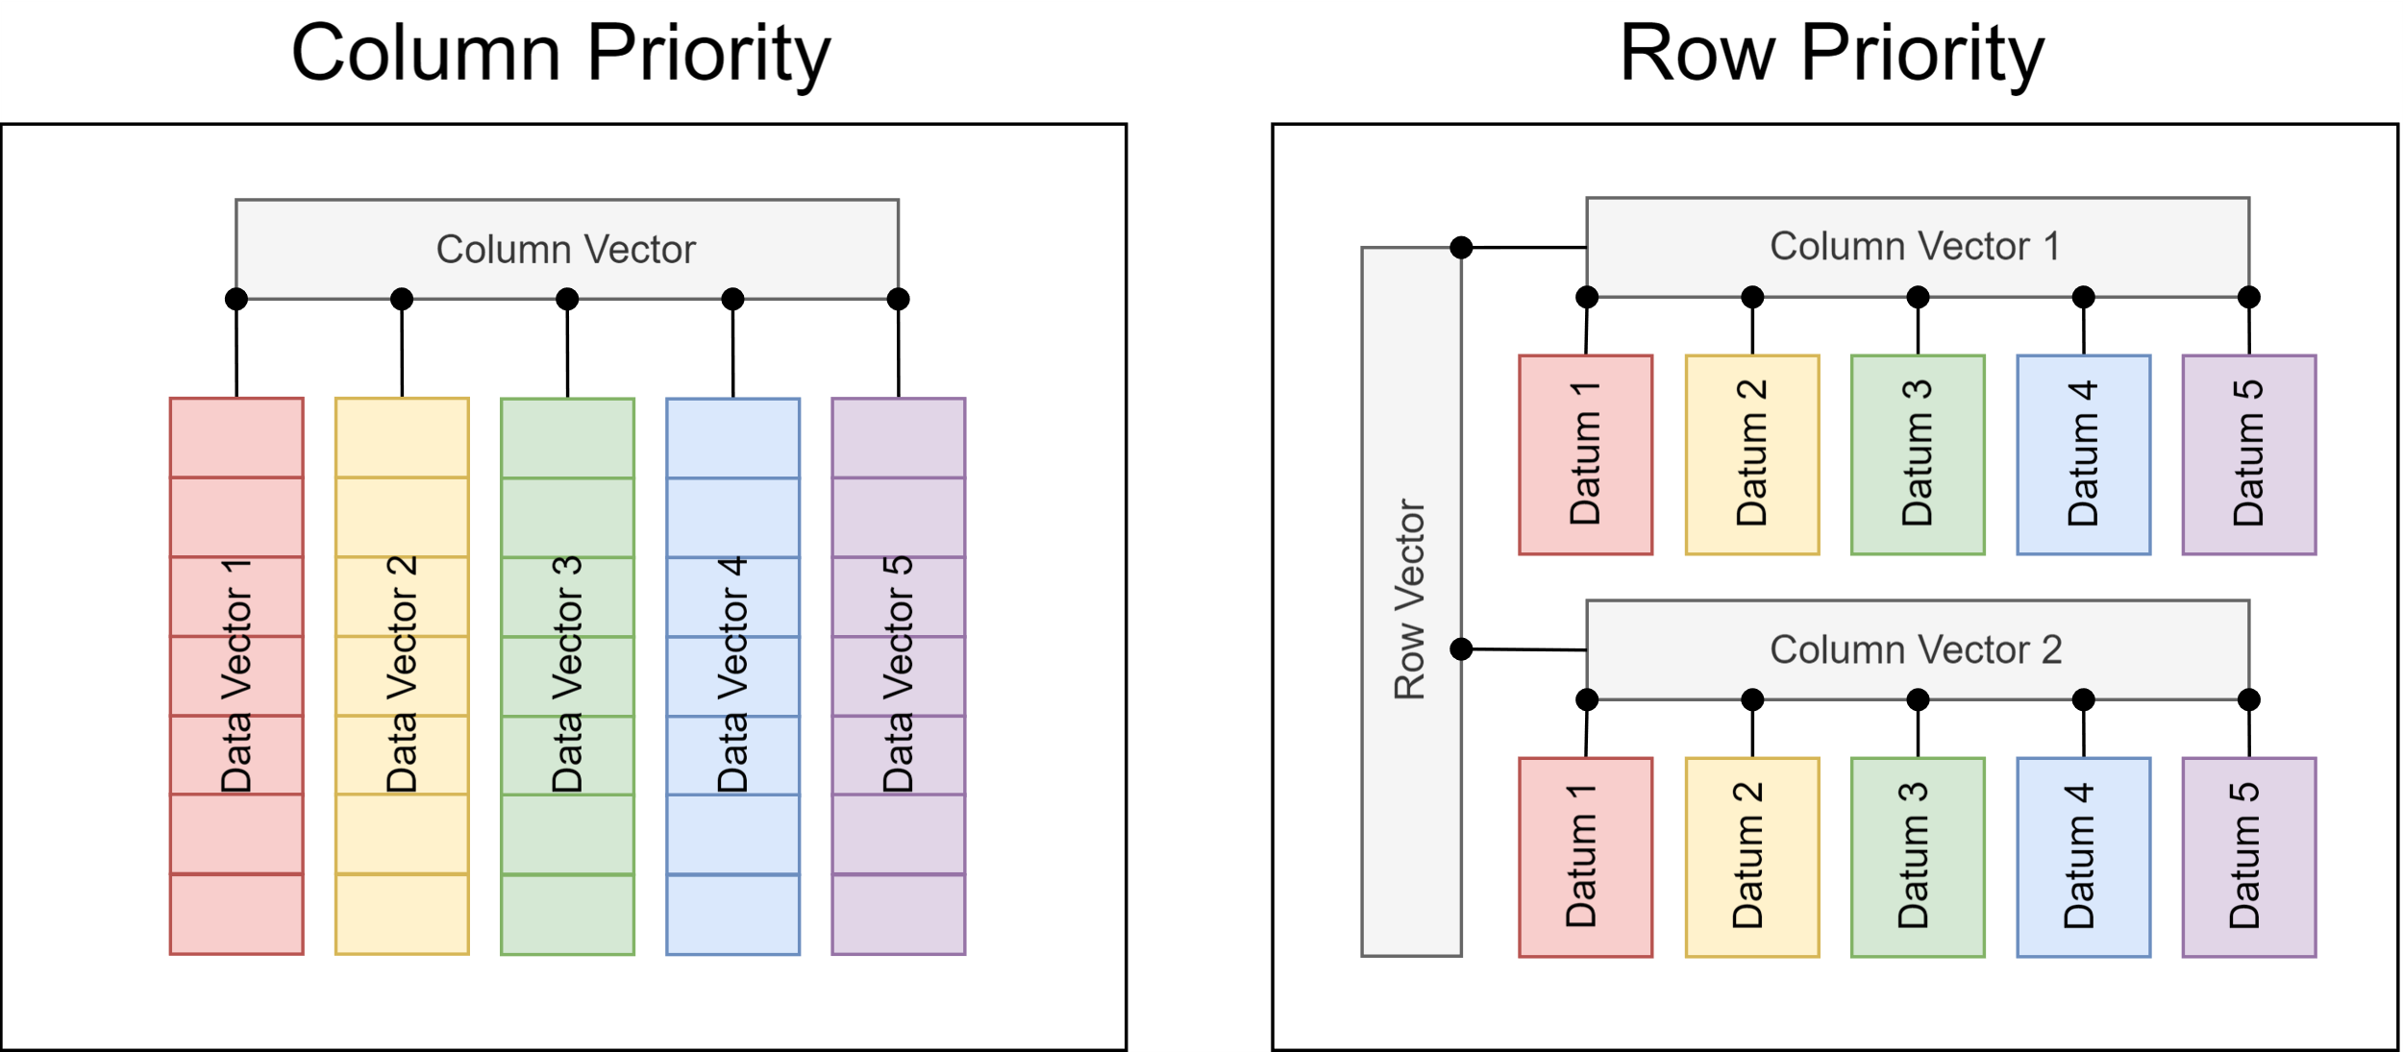
Two Data Containers…

Slide 10
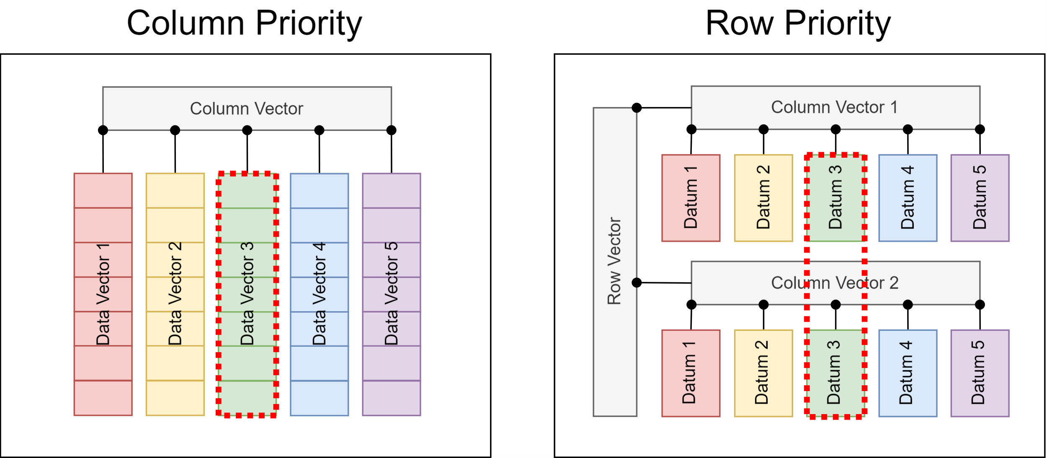
Column-Based Operation
Occurs once, on the target column
Occurs as many times as there are rows

Slide 11
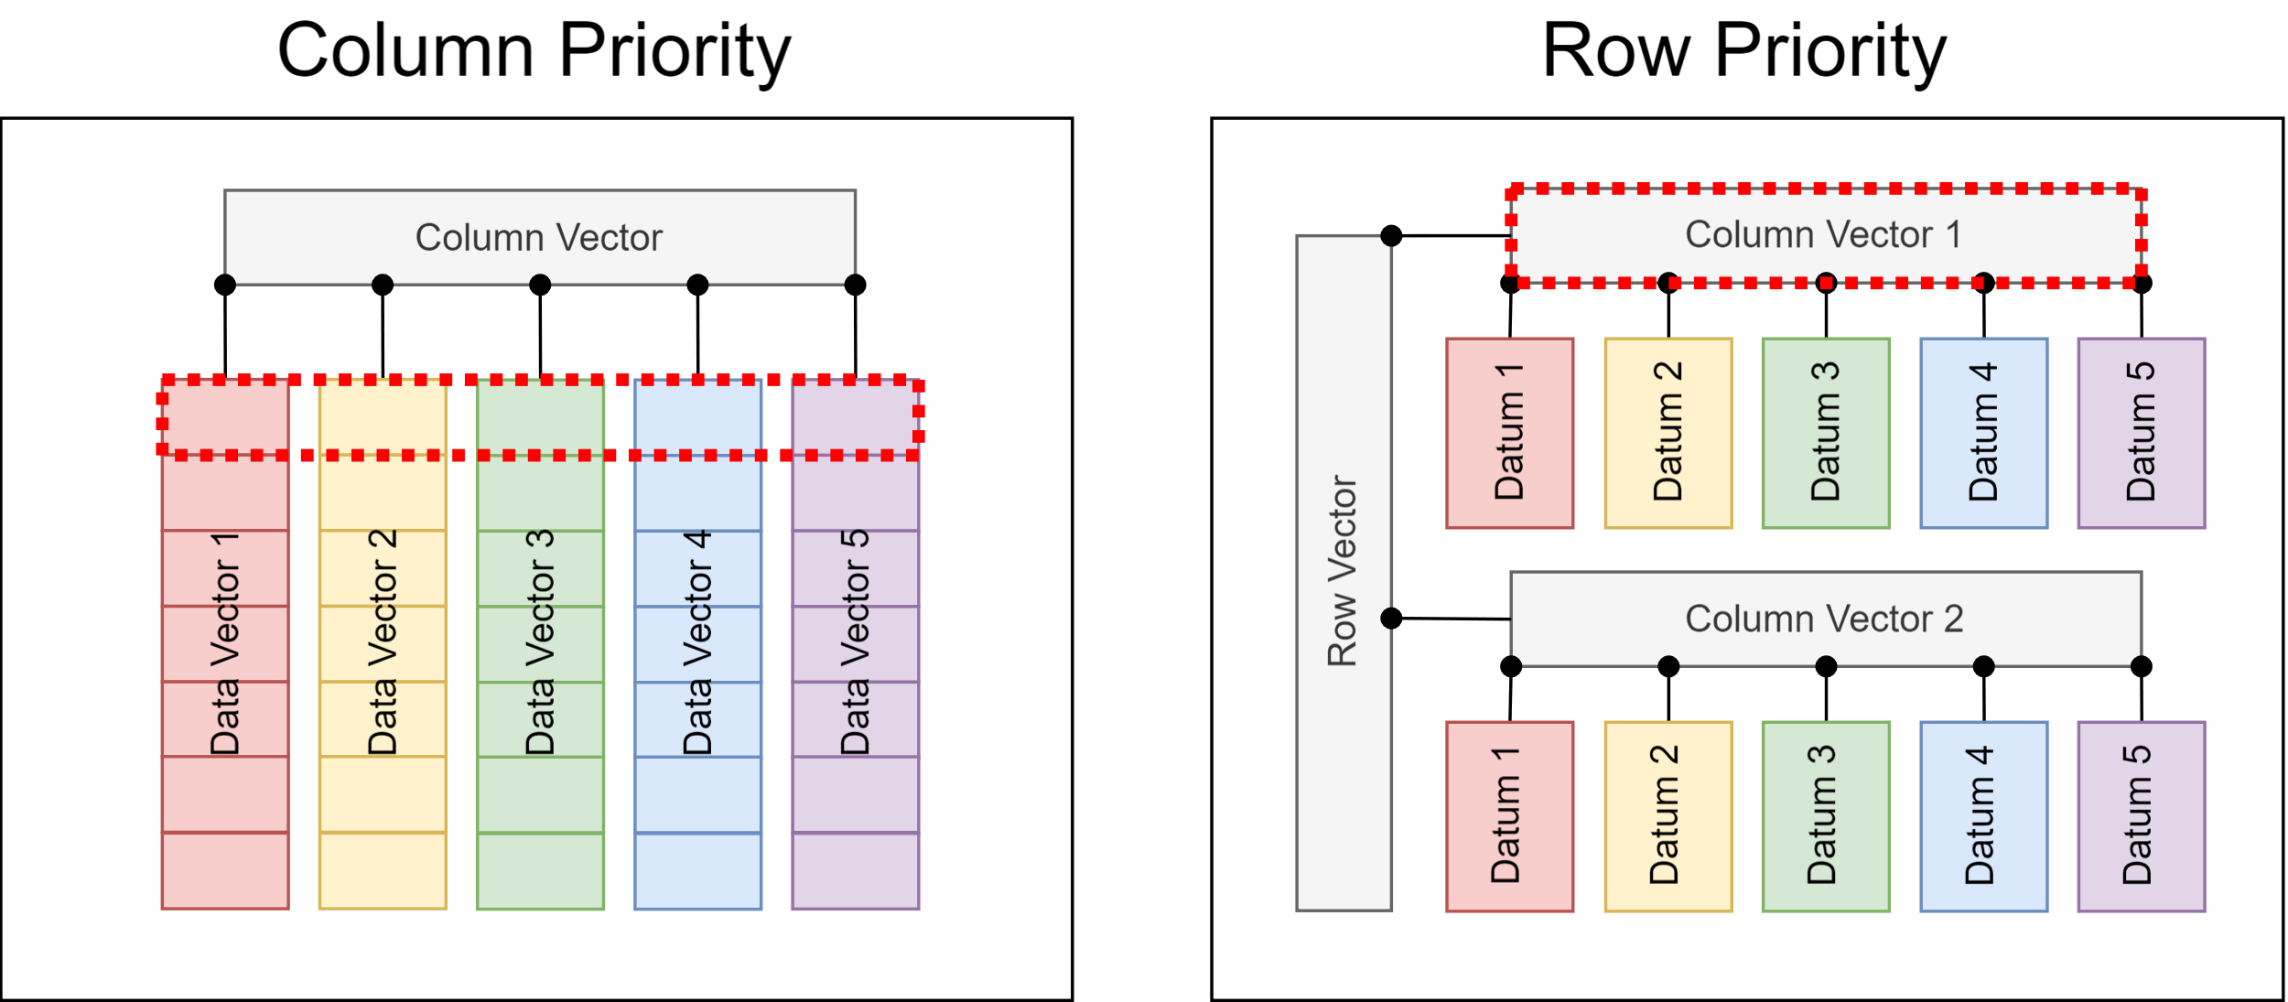
Row-Based Operation
Occurs as many times as there are columns
Occurs once, on the target row

Slide 12
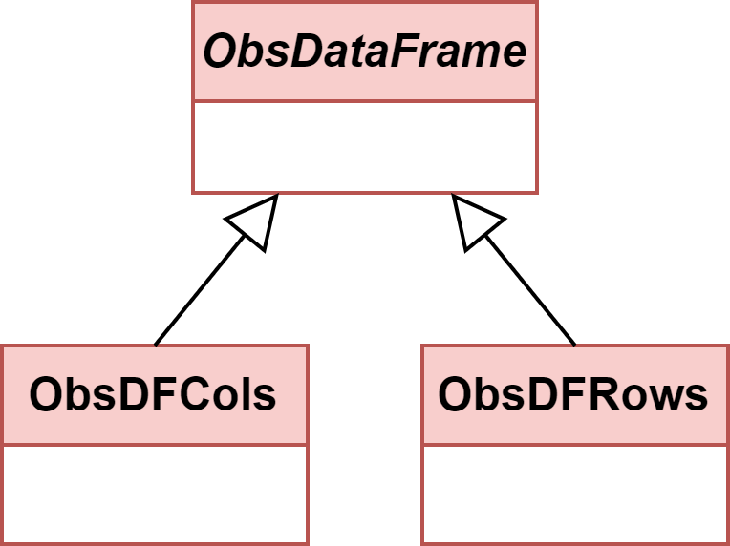
No Need To Choose
Pros and cons to either approach
Column-priority will be good for current use-cases
Row-priority will be better for new flexible features
Each will use a common base-class and interface specification
Data types chosen for interoperability with Fortran

Slide 13
Flexible New Features
Read column
Write column
Write row
Remove column
Remove row
Sort rows
Slice rows
lat | lon | statId | channel | temp | time
-65 | 120 | 00001 | 10 | -10.231 | 1710460225
-66 | 121 | 00001 | 10 | -15.68 | 1710460225
-67 | 122 | 00002 | 11 | -15.54 | 1710460225
-68 | 123 | 00001 | 11 | -14.98 | 1710460225
-69 | 124 | 00004 | 12 | -16.123 | 1710460226
-70 | 125 | 00002 | 12 | -19.11 | 1710460226
-71 | 126 | 00005 | 11 | -22.3324 | 1710460226
-72 | 127 | 00005 | 15 | -22.667 | 1710460226
-73 | 128 | 00009 | 11 | -25.6568 | 1710460226

Slide 14
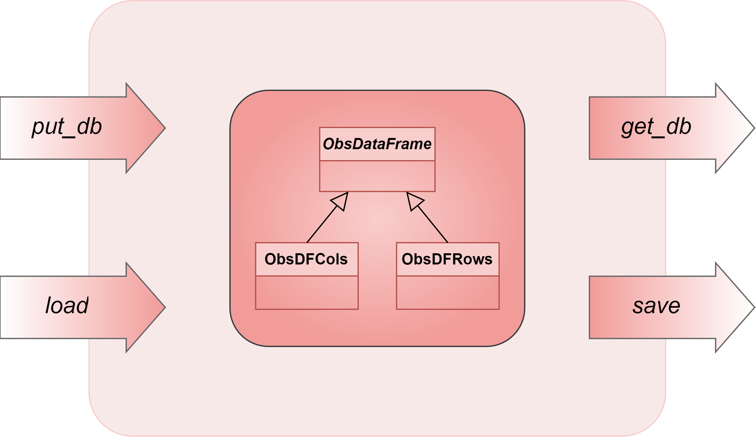
Integration
New code will be wrapped
All current functions will be validated
Scope work to remove wrapper
New functionality will be exposed

Slide 15
Integration Path
Requirements
Design + Interface (Prototype Code)
Move Prototype into Ioda Repository
Swap in New ObsSpace Container
Optimization/New Features
Today

Slide 16

Questions?

