Slide 1
Welcome to the National Center for Atmospheric Research
Kyle Ham
Education and Outreach
July 8, 2010

Slide 2
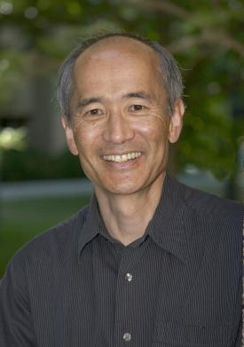
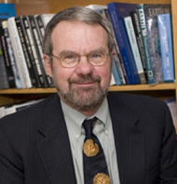
Faces and names to know
Dr. Rick Anthes
UCAR President
Dr. Roger Wakimoto
NCAR Director

Slide 3
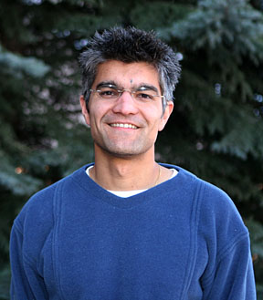


Faces and names to know
Dr. Raj Pandya
E&O Deputy Director
CBP Director
Rebecca Haacker-Santos
SOARS Coordinator
Nancy Wade
HR
Your Supervisor

Slide 4
Important Dates
Date and Time | Location | Details
July 8, 2010 9 am – 1:30 pm | ML Damon | Project details are presented. Meet SOARS proteges
July 15, 2010 9 am – 1:30 pm | ML Chapman | Time to work on Posters
July 15, 2010 3:15 pm – 4:00 pm | Meet in CG1 Lobby | UMC meeting (Optional)
July 22, 2010 9:00 am – 1:30 pm | ML Chapman | Time to work on Posters and Essay
July 30, 2010 9:00 am – 1:30 pm | CTTC, CG2 Meet in CG2 Lobby | Complete Poster rough draft, work on Essay
August 4, 2010 9:00 am – 3:00 pm (as needed) | CTTC, CG2 | Poster completed, Essay completed
August 5, 2010 Afternoon | CG1 Center Auditorium | Poster Session
Notes:
Printed versions of this.

Slide 5

UCAR
Founded in 1960 by the university community to create, operate, and manage NCAR on behalf of NSF and the universities
Notes:
5

Slide 6
UCAR at a Glance
A consortium of 75 North American universities (started with 14 universities)
50 years; ~1500 Staff ~240 PhD Scientists
Research, computational and observational facilities, huge data sets, high-end numerical models of the sun, atmosphere, oceans, coupled climate system.
Notes:
1500 number includes NCAR and UCAR staff.

Slide 7
The UCAR mission
To serve and provide leadership to the atmospheric science and related communities through research, computing and observational facilities, and education programs that contribute to the betterment of life on Earth.

Slide 8
NCAR’s Research Topics
atmospheric chemistry—such as the chemical structure of healthy and polluted air
climate—including temperature, rainfall, winds, and extreme events over decades or centuries, from prehistoric times to the present and into the future
weather ingredients—such as cloud physics, storm structure, and other keys to improved weather forecasting
weather hazards to transportation—including detection and warning systems for turbulence and icing in the air and on the ground
interactions between the Sun and Earth—including solar weather
computer science innovation—for understanding and visualizing the whole Earth system
the role of humanity in both creating change and responding to weather and climate
Notes:
NCAR’s research projects are collaborations between NCAR scientists and university researchers

Slide 9
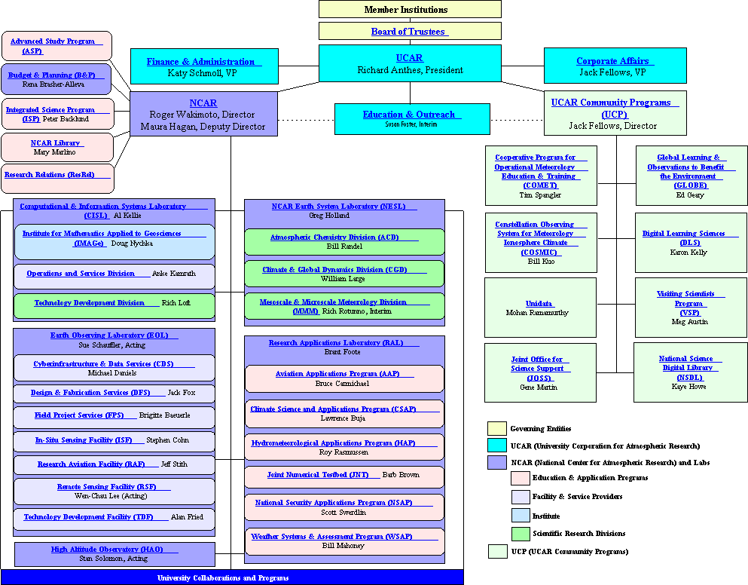

Slide 10
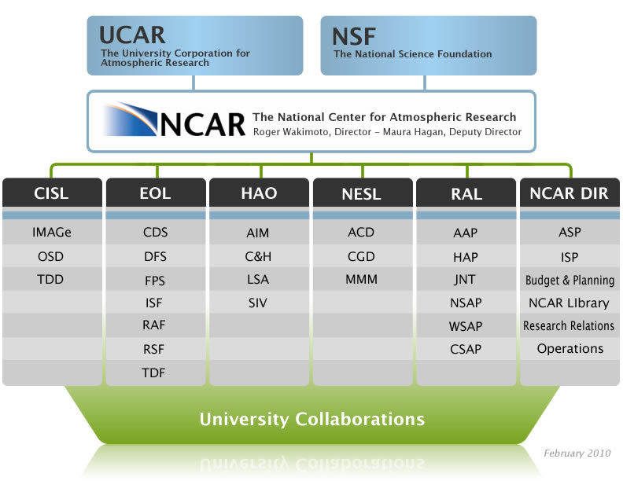
Notes:
The acronyms across the top are important (black background). Also ACD, CGD, and MMM are key.

Slide 11
Esteban and Santiago’s groups
FMS = Facilities Management and Sustainability
  www.fin.ucar.edu/fms
DLS = Digital Learning Sciences
  www.dlsciences.org
Notes:
Everyone should visit their group’s website to learn more about their work.

Slide 12
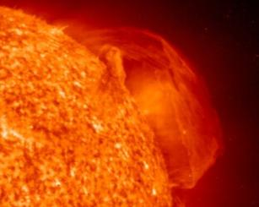
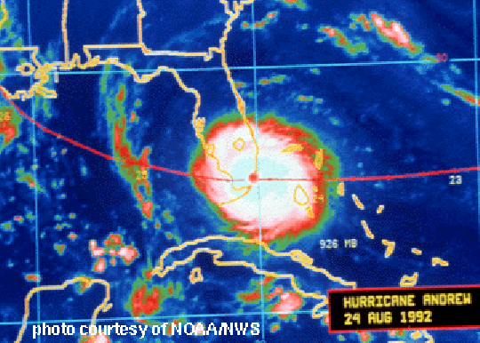
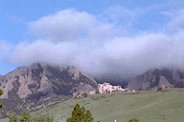
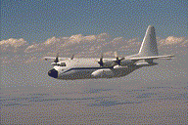
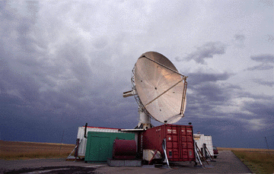
National Center for Atmospheric Research (NCAR)
National Science Foundation funded Center, ~1000 staff, 50 year history
Earth System Sciences: Computational and Observational Science and facilities for Weather, Climate, Chemistry, Space Weather, Society-Environment Interactions
NCAR serves the international community by providing major observing and modeling facilities, which have been developed in collaboration with community members
Notes:
12
12

Slide 13
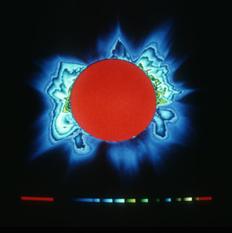
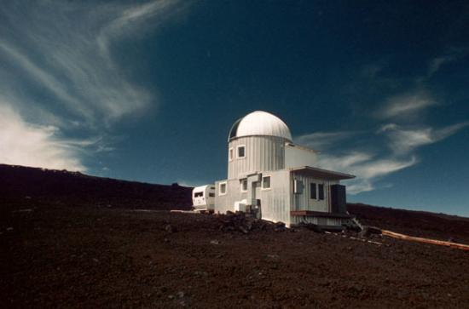
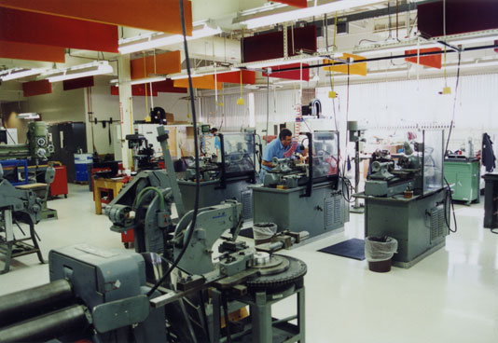
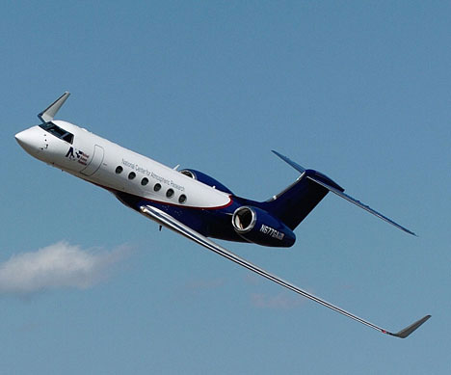
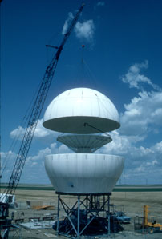
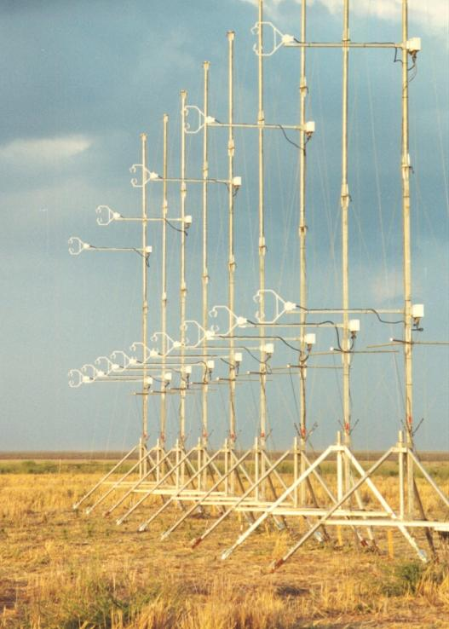
Earth Observing System Facilities
Notes:
13
13
Shows a small sample of UCAR equipment. Machine shop, HAO observatory at Mauna Loa, Mobile Radar, Gulfstream V,

Slide 14
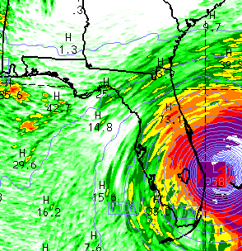
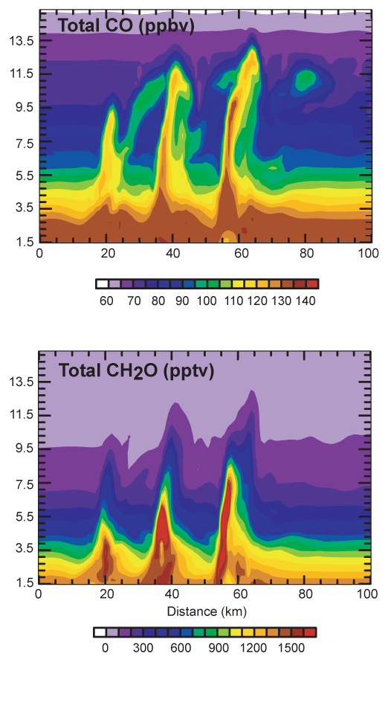
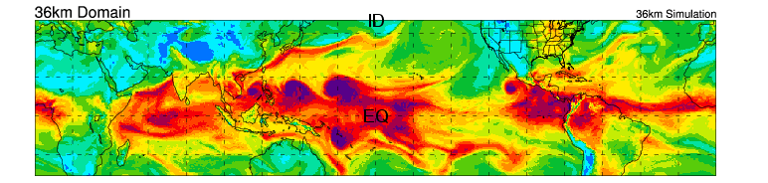
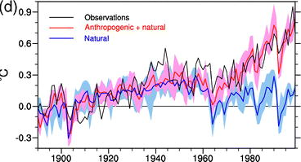
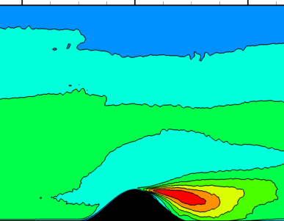
Advanced Community Models: CCSM, CAM, NRCM, WRF
Hurricanes
Chemistry
Regional Climate
Greenhouse Gases
1970
Boundary Layer
Global Warming
“Natural” Forcing
Notes:
14
14

Slide 15
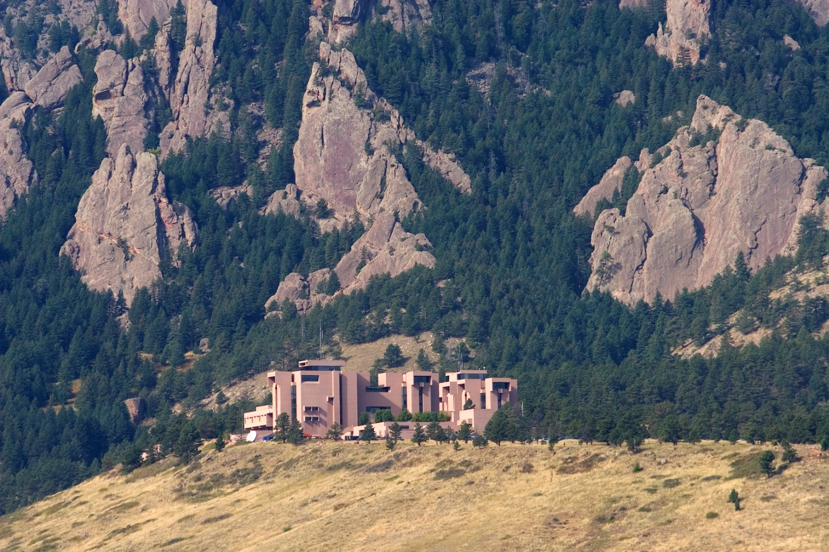
NCAR Mesa Laboratory
Notes:
15
Currently houses supercomputers, CGD, (me), Director’s Office, UCAR President’s office, Social Scientists.

Slide 16
NCAR Mesa Laboratory
Offices of: Kyle Ham (ML 135), Roger Wakimoto, Rick Anthes
Scientific home for: CGD and CISL mostly
Important Rooms for us: Damon Room and Chapman Room (both on second floor)
Open to the public almost every day of the year. Free access to museum and trails.
Notes:
16

Slide 17
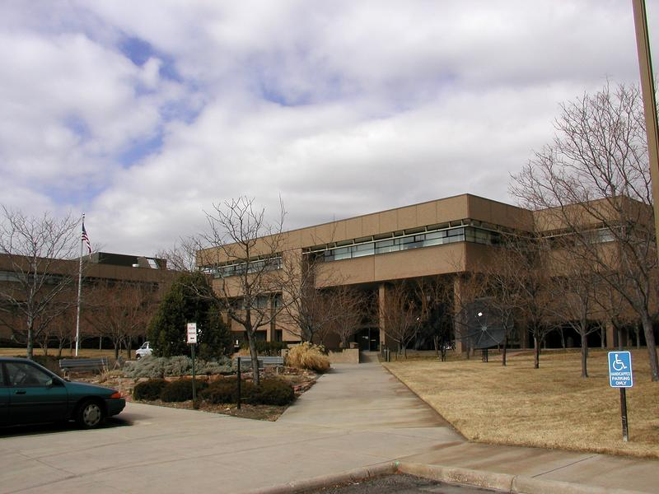
Foothills Campus
Notes:
17
ACD, MMM, some EOL and RAL, some UCP programs. Communications.

Slide 18
Foothills Campus
FL0: Chemistry
FL1: EOL and RAL
FL2: Rebecca and Raj’s Office, Main Entrance and Lobby, Cafeteria
FL3: MMM and others
FL4: UCP, Communications, and others. Separate from other 4 buildings.
Notes:
18

Slide 19
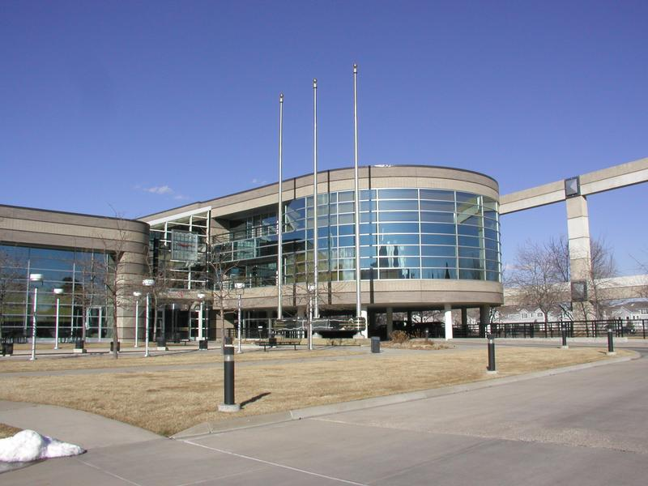
Center Green
Notes:
19
HAO, Education and Outreach, UCAR administrative offices, some other UCP programs probably.

Slide 20
Center Green
CG1: HAO, Main Lobby and Front Desk, UMC meeting is here. (pictured to left)
CG2: CTTC (July 29 and Aug 4 workspace)
CG4: HR, Where Orientation was, Nancy Wade’s office is here
Notes:
20

Slide 21
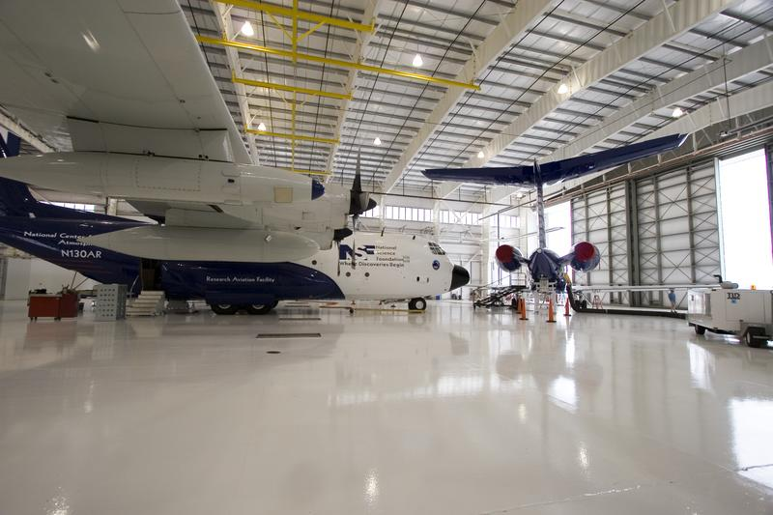
Research Aviation Facility
Notes:
21
Planes. EOL staff mostly

Slide 22
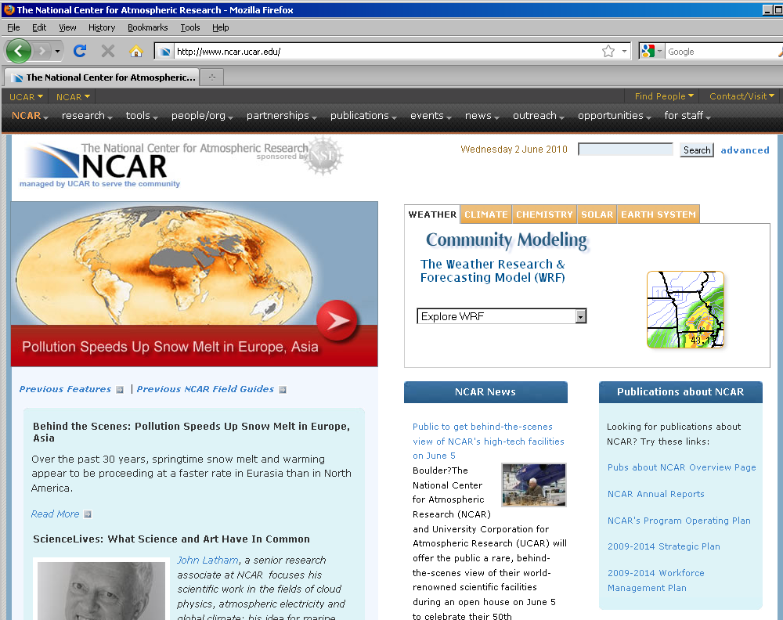
Notes:
NCAR’s website. Main website is ucar.edu

Slide 23
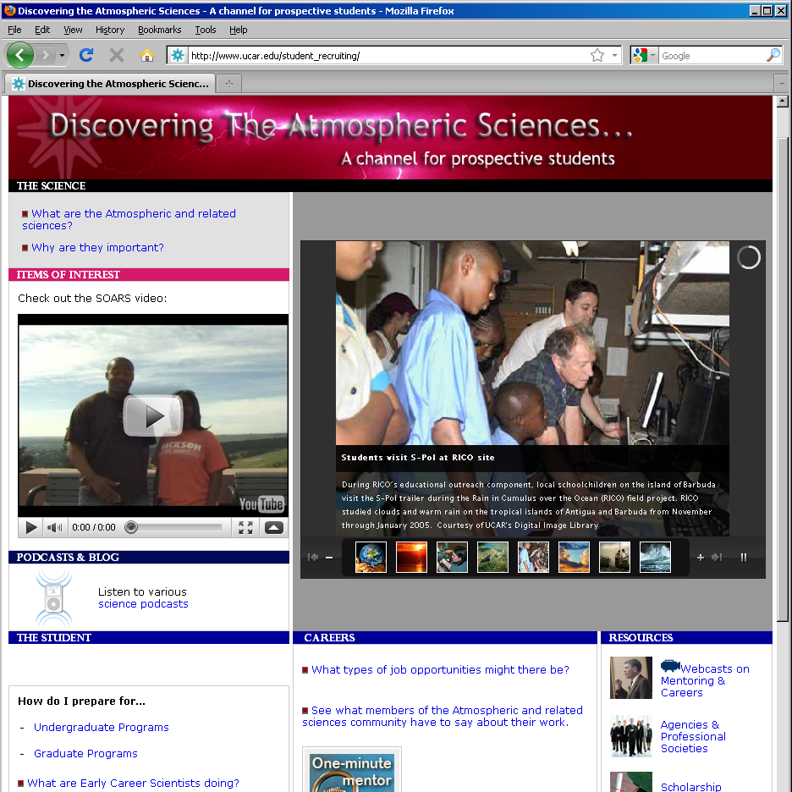
www.ucar.edu/student_recruiting
Notes:
Great resource. When looking at this site, remember that at NCAR we employ people in all different fields, not just Atmospheric Science

Slide 24
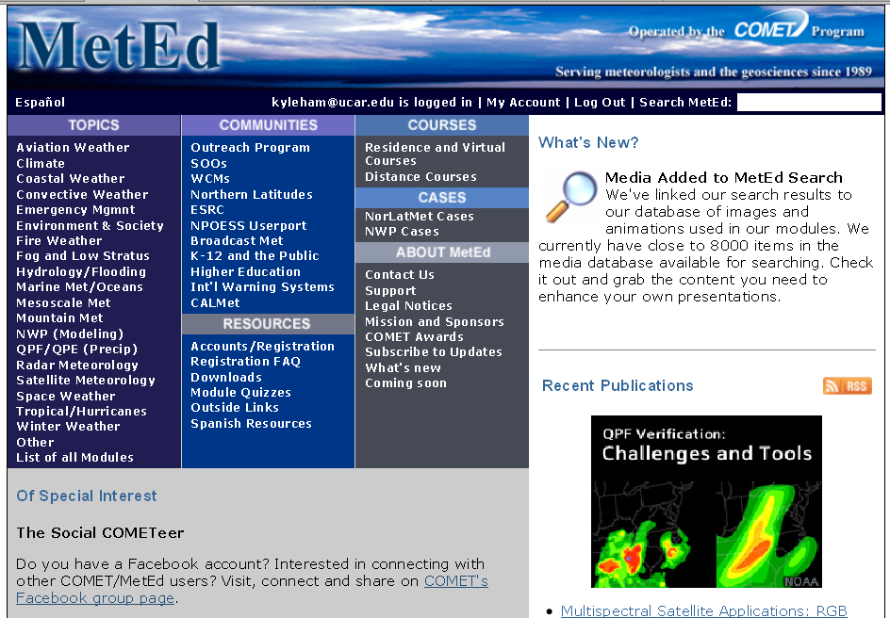
http://www.meted.ucar.edu/
Notes:
This website has free, interactive modules. It does require registration, but then you get updates on new modules being posted. Modules cover climate change, solar research, operational meteorology. Some modules are quite advanced, but others would be fine for a high schooler.

Slide 25
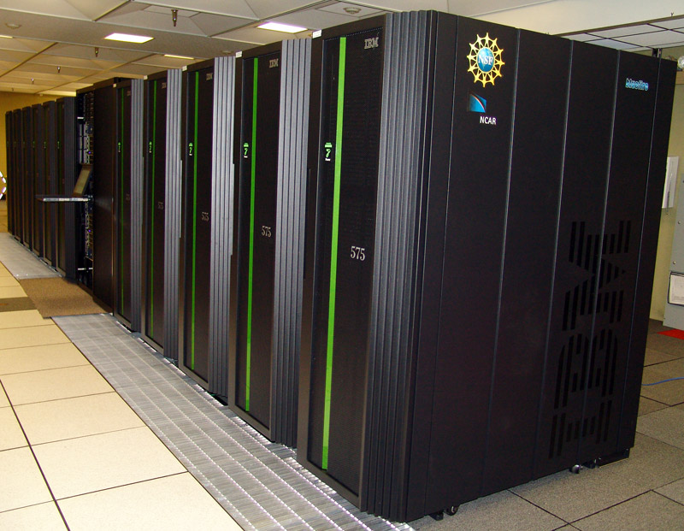

Supercomputing
Notes:
A little over 2 years old now. NCAR’s Machine Room has been in use for over 30 years, so we’ll soon open our new supercomputing center in Cheyenne, WY.

Slide 26
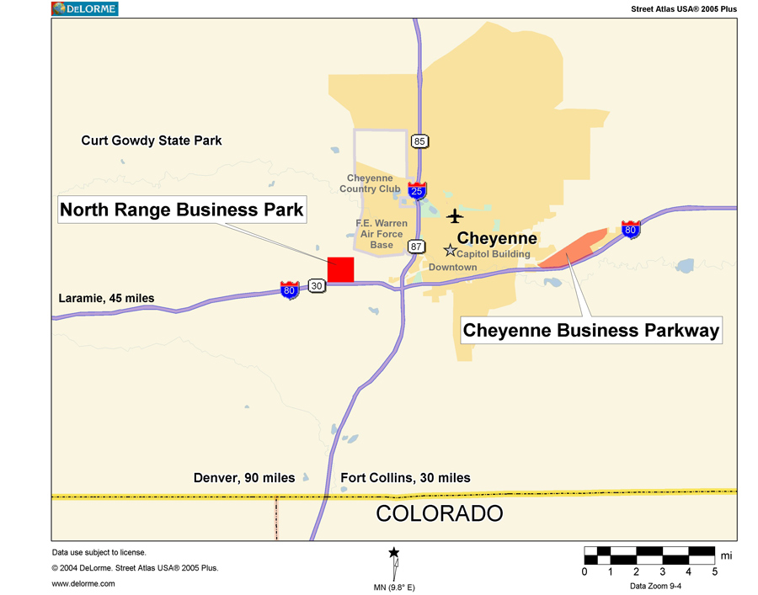
NCAR-Wyoming
Supercomputing Center
Cheyenne, WY
www.cisl.ucar.edu/nwsc/

Slide 27
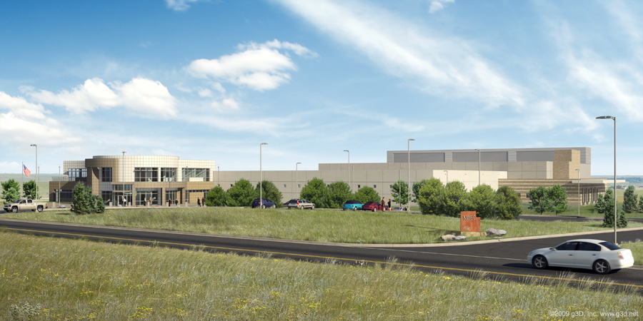
NCAR-Wyoming
Supercomputing Center
GROUND BREAKING WAS JUNE 15!
http://www2.ucar.edu/magazine/features/breaking-ground-groundbreaking-center
http://www.cisl.ucar.edu/nwsc/
Notes:
Groundbreaking June 15, with a proposed opening day in Spring 2012. Likely to be the most efficient supercomputing center in the world. Will be LEED Gold Certified (energy efficiency).
Facility is estimated to cost $70-100 million

Slide 28
Questions?

