Slide 1




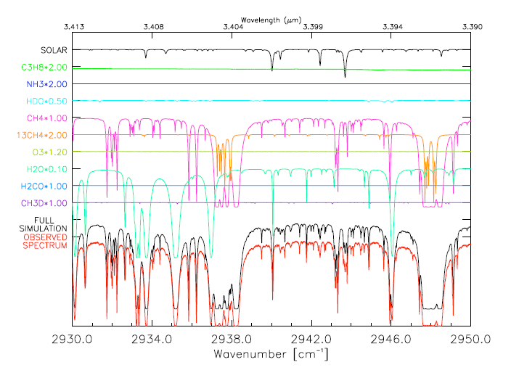
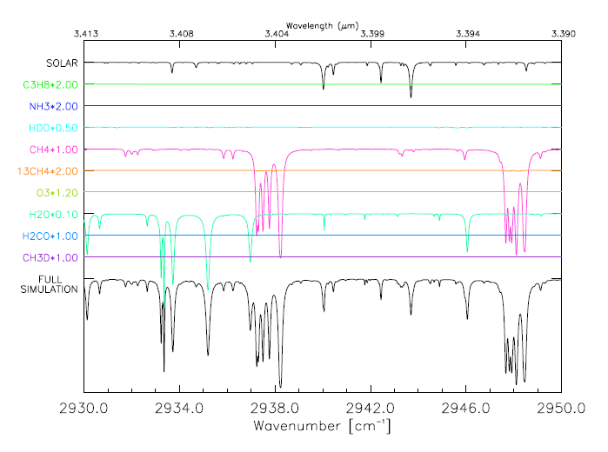
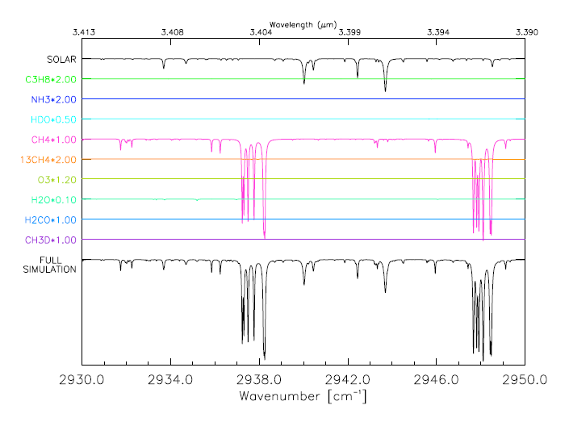
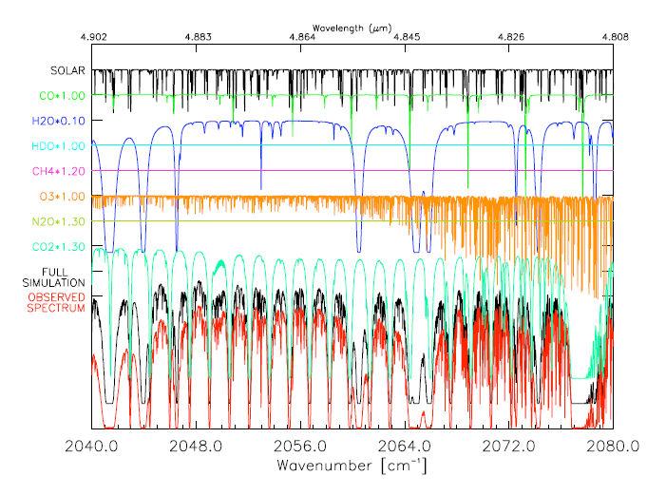
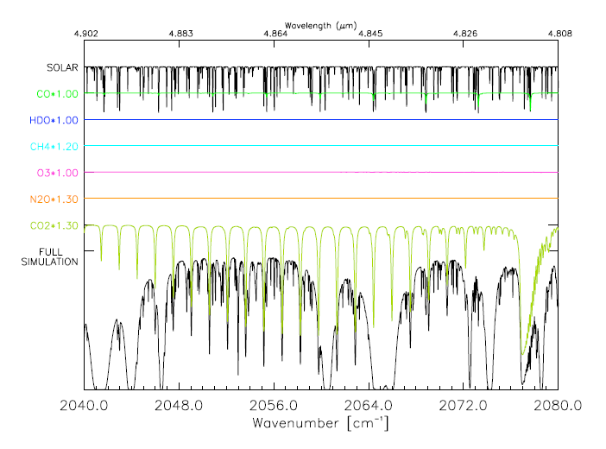
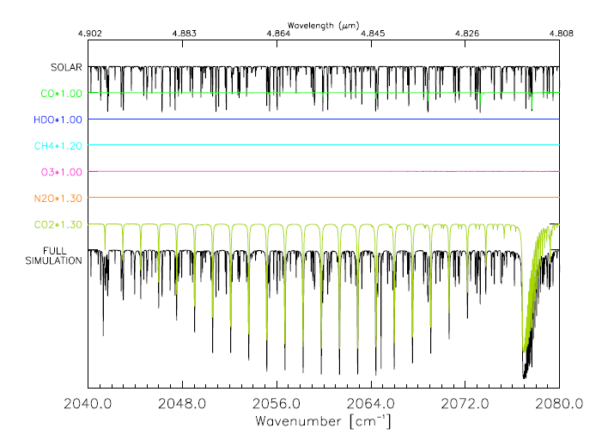
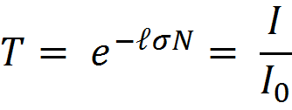
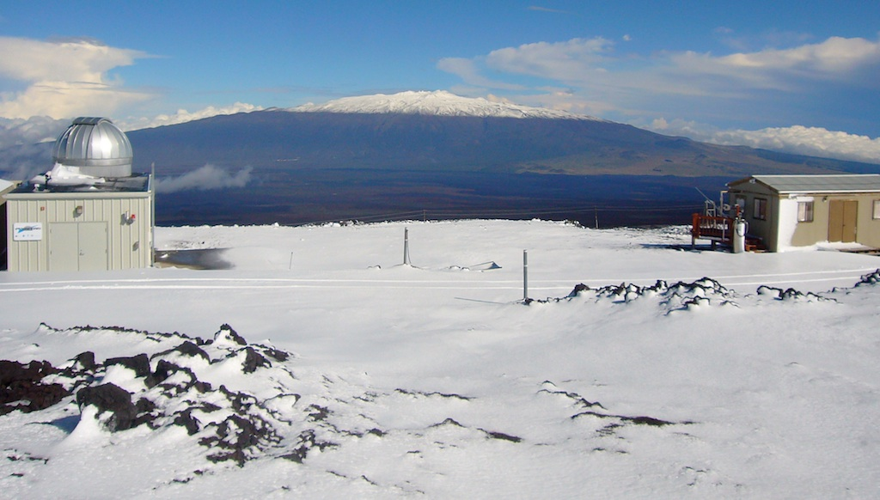
Altitude resolved mid-IR transmission of H₂O, CH₄ and CO₂ at Mauna Loa
Alumni
2010
Anika Guha Atmospheric Chemistry Division, NCAR/UCAR High School Internship 2010
James Hannigan Atmospheric Chemistry Division, NCAR
Introduction
The most prevalent greenhouse gases with the largest percent of greenhouse effect in our atmosphere are water vapor, carbon dioxide and methane. Of these three, water has received the least attention because it is so highly variable and is the least affected by human industrial activity. That said, it is the strongest greenhouse gas and accounts for about two thirds of the global greenhouse effect. Since its concentration is strongly affected by atmospheric temperature, changes in its greenhouse contribution are a second order effect.
This project compares the presence of these gases in various layers of the troposphere and their infrared transmission and absorption. Measurements of these gases are made using infrared spectroscopy from Mauna Loa Observatory in Hawaii. These measurements sample the entire atmosphere from the ground to the top of the atmosphere by observing the sun as a mid-IR source of radiation. In this work we have modeled the absorption of water vapor, methane and carbon dioxide in each layer so that we can better understand the measured spectra and the contributions of these gases to radiative forcing as a function of altitude in the atmosphere.
Layer # | Base Altitude | Top Altitude | H2O/CH4 | CO2
1 | 3.40 | 4.08 | Figure 3 | Figure 6
2 | 4.08 | 4.80 | - | -
3 | 4.80 | 5.55 | - | -
10 | 10.72 | 11.70 | Figure 4 | Figure 7
20 | 22.10 | 23.44 | - | -
Full | 3.40 | 106.00 | Figure 2 | Figure 5
Highlighted in purple are the layers for which the spectra are plotted in Figs 2-4 for H₂O & CH₄, and Figs 5-7 for CO₂. Altitudes listed here are in kilometers
Figure 1
Figure 8
Figure 9
Figure 10
Discussion
From a comparison of water vapor spectra to those of methane and carbon dioxide, it is apparent that the distribution of heating will be primarily in the lowest part of the atmosphere. Water vapor accounts for the largest percentage of the greenhouse effect but is heavily concentrated in the first 6 kilometers of the atmosphere.
Water is an intricate molecule and a ubiquitous absorber in the mid IR. Even in this narrow region, water has complex spectra. Figures 2-4 show that there is very little energy absorbed by water above approximately 6 km, in stark contrast to other greenhouse gases such as CO₂ where the change in amount and absorption per layer of the atmosphere is more gradual.
As the atmosphere warms due to greenhouse gases, heating may allow more water to remain in the atmosphere before being rained out, causing water vapor to extend into the upper levels of the atmosphere. Even if only small amounts of water vapor extend into the upper layers of the troposphere or lower stratosphere, there will be important implications for the global heat balance and future climate.
One large effect of this change could be a difference in circulation due to a redistribution of thermal energy. This change could also lead to changes in the tropopause height and/or the water content in the stratosphere.
Further effects we might expect to see include changes in the fractional cover and height of clouds, which would in turn have an as yet uncertain effect on model predictions.
Figure 2: Full simulation for H₂O and CH₄, huge overall presence of both gases.
Figure 3: Layer 1 for H₂O and CH₄, their absorptions are prominent at this altitude.
Figure 4: Layer 10 for H₂O and CH₄,
H₂O is almost non existent yet CH₄ absorptions appear only slightly less than those in layer 1.
Methods
To determine where H₂O, CH₄ and CO₂ are in the atmosphere, we look at where these gases absorb infrared radiation by dividing the atmosphere into distinct layers with defined temperature, pressure and gas concentrations. Using Beer’s law, we can determine the transmission of the various gases as a function of frequency
Where T is the transmission, I is the intensity, σ is the cross-section of light absorption as a function of gas temperature and pressure, ł is the path length and N is the density of absorbing particles as a product of the mixing ratio and the airmass.
We use standard mixing ratios of the gases, the airmass, the temperature and pressure at the various altitudes in Mauna Loa (Figure 1). We modeled the greenhouse effect by gas and altitude with absorption spectra calculated by a solar transmission model. To model the absorption and transmission of the gases by altitude, we chose a frequency range in the mid- IR and created simulations of the transmission by layer. By taking the ratio of the absorption of the individual layer and the sum of all layers, we were able to find relative absorptions. We could then graph and compare both the spectra and relative absorptions of these gases throughout the troposphere (Figures 8-10). We modeled H₂O and CH₄ in the same region, 2930-2950cm (Figures 2-4), and CO₂ in the region 2040-2080 cm⁻¹.
Figure 5: Full Simulation for CO_{2,}
Large presence of CO_{2,} as well as O₃.
Figure 6: Layer 1 for CO₂
Absorptions for CO_{2,} are prominent but O₃ is barely visible.
Figure 7: Layer 10 for CO₂ absorptions for CO_{2,} appear similar to those in layer 1, O₃ is still not visibly present.
Results
The trend in the concentrations of each of these three gases is unique when compared to the others. Figure 1 shows where these gases are in the atmosphere whereas Figures 2-7 show how these gases affect the climate budget. Water vapor is most prevalent in the first 6 kilometers of the atmosphere, predominantly the first 4 kilometers (Figure 3), and then drops off suddenly. By 22 kilometers, we see very little water vapor (Figure 4). Methane and carbon dioxide, however, show a much gentler decline as the altitude increases (Figures 6 and 7). The amount of methane appears almost constant until 13 kilometers. Carbon dioxide shows similar trends to methane, yet diminishes in amount even more gradually.
Note how although ozone (O₃) is apparent in the full simulation (Figure 5), it is not visibly apparent in any of the spectra for the first 12 kilometers (Figures 6 and 7) but is present in much higher levels in the atmosphere. This is to be expected since the ozone layer is located in the stratosphere.
Acknowledgements
This was performed under the auspices of the High School Internship and Research Opportunities (HIRO) program with funding from the university Corporation for Atmospheric Research (UCAR).
Many thanks to James Hannigan and Rebecca Batchelor in the Atmospheric Chemistry Division for all their help, guidance and expertise.
Photo of where the Fourier Transform Interferometer is located in Mauna Loa
NCAR is sponsored by the National Science Foundation. This work was supported by NASA.

