Slide 1

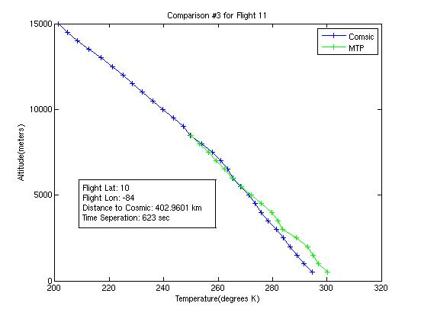
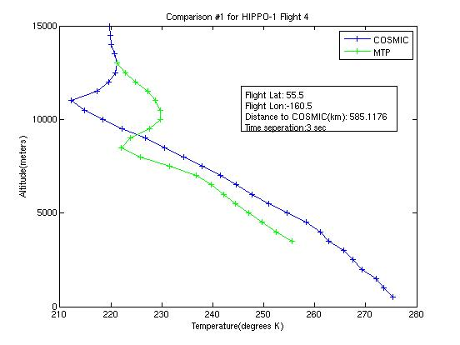
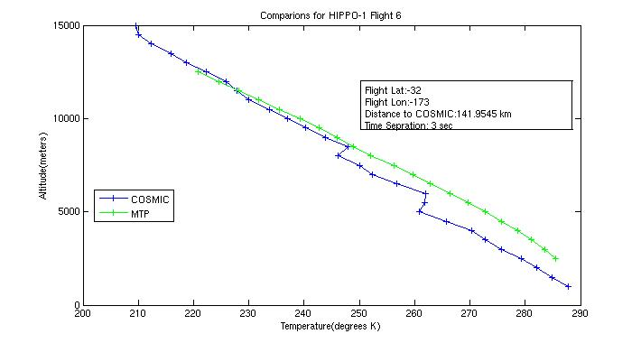
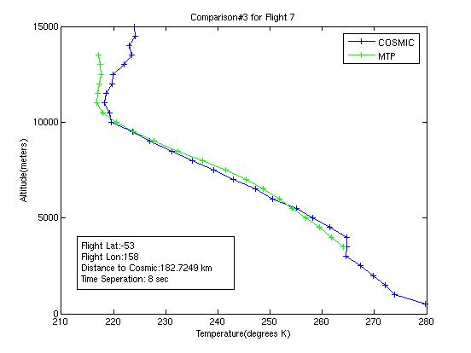
Comparison of Temperature Data from HIPPO-1 Flight Using COSMIC and Microwave Temperature Profiler
Kelly Schick ^{1,2,3} and Julie Haggerty ⁴
1 Monarch High School Class of 2010 2 Colorado State University Class of 2014 3 High School ASPIRE Program 4 EOL/ RAF
Background
Results
Discussion
One of the most essential measurements in atmospheric data collection is temperature. The most common form of atmospheric temperature profiling is the radio sonde. Radio sonde data is considered highly reliable, but coverage is limited over oceans and remote regions. Alternatives to radio sondes exist in the COSMIC GPS profiles and in the Microwave Temperature Profiler (MTP). COSMIC uses radio occultation (pic:radio occultation) from a system of six satellites to determine temperature by interpreting the delays and distortions of the signal. The MTP, mounted on an aircraft, monitors O2 radiation at a certain frequency. Taking measurements from its position on the aircraft wing (pic: mtp on airplane) at ten different angles in fifteen-second intervals allows the MTP to look at variations and determine a temperature profile. However a comparison between radio sonde data and the in-situ measurements revealed a discrepancy between temperature values that appears to vary with height. The purpose of this project is to compare the data from the COSMIC satellite to the MTP data from HIPPO-1 flights from January 9 to 30 of 2009 to determine if the COSMIC could be used for calibrations and correlations of the MTP.
Based on the results from the t-Test, the COSMIC profiles could be used for calibration and correlation of MTP data. The t-Stat given, the probability of the means being the same, stayed near .5(50%) most of the data. However, occasionally one source would pick up a feature that another would not. This disagreement could not always be isolated to separation in either space or time. These disagreements were less common in tropical latitudes and more common in the artic and antarctic regions. Based on this, the conclusion can be drawn that when within reasonable parameters both instruments agree. Reasonable parameters can be defined as less than 1000km in space and 7200 sec in time between 45 N and 45 S and less than 900 km in space and 7200 sec in time at latitudes above 45 N and below 45 S.
Data in more tropical latitudes showed higher correlation that was not as affected by separation in time and space, where as data the same relative distance apart in higher latitudes showed discrepancies.
Implications
A height profile with high t Stat.
Height profile with low t Stat
While the t-Test confirmed that there is a high probability of both sources of measurements being the same, there were still some instances that showed disagreements that could not be explained by either distance in space or time or by location. Further comparisons will be performed using radio sonde data as well. The data collected here is the start of a project on-going with all of the HIPPO flights.
Method
To determine the relationship between the COSMIC and the MTP data, first the COSMIC profiles nearest to the HIPPO-1 flight track of the MTP. The data was first isolated to only those within one hour before take-off and one hour after landing. After those profiles were located, the Great Circle distance was calculated. The profiles farther than 1000 km from the GPS track at the time of the profile were removed from consideration, leaving 20 data points. A further investigation of the points farther than 900km at higher latitudes (Artic and Antarctic) lead to any data points with a latitude above 45°N or below 45°S being removed from consideration due to a higher variance in atmospheric conditions. The data was then interpolated to give the temperatures from a series of altitudes from 500 m to 15000 m at increments of 500 m. Graphs of the temperatures were then created to show the shifting of the temperatures from one instrument to the next and where each instrument identified the height of the tropopause. A t-Test was then performed to compare the mean of each instruments data, giving the probability that the means of the two data sets illustrated the same measure.
Acknowledgements
This research was performed under the auspices of the UCAR High School Internship Program. The Program is managed and funded by the University Corporation of Atmospheric Research. A special thank you to :Nancy Wade and Kyle Ham, for all their support and understanding in this phenomenal opportunity; My mentor, Julie Haggerty, for graciously spending time getting me started and always including me whenever something cool happened to pop up; Sean Stroble for writing the interpolate program and being ever ready to revise it as we discovered something we had forgotten.
Height profiles with mid-range t Stats

