Slide 1


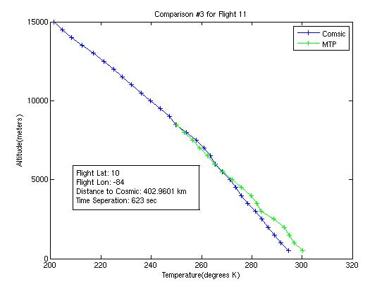
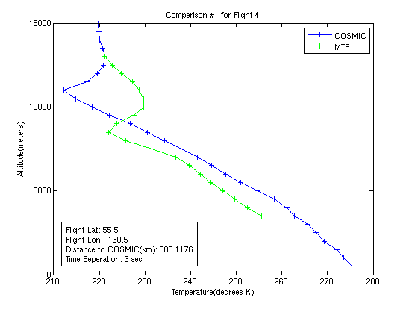
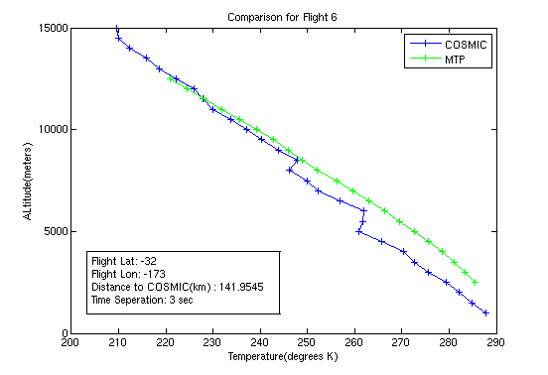
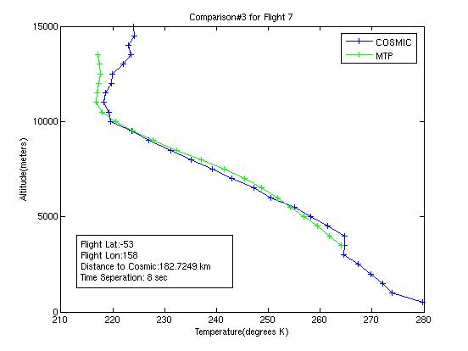
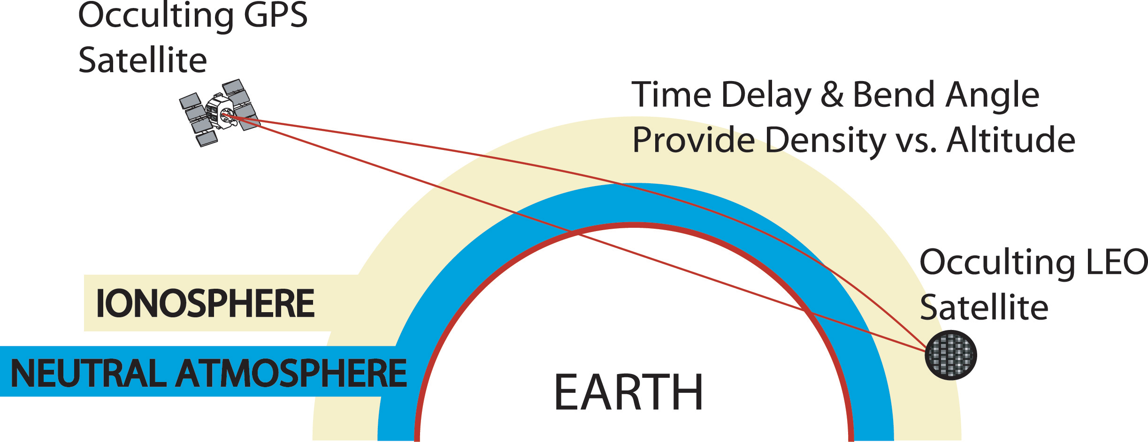
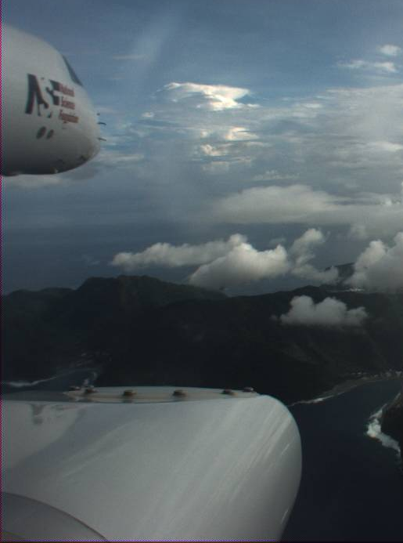
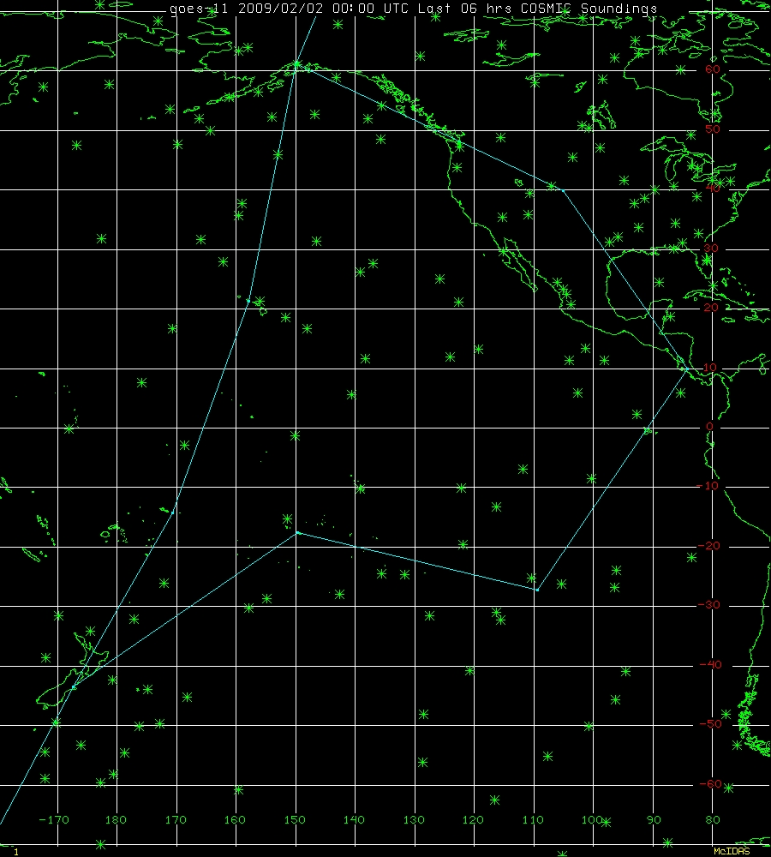
Comparison of temperature data from HIPPO-1 flights using COSMIC profiles and
Microwave Temperature Profiler.
Kelly Schick ^{1,2,3} and Julie Haggerty, Ph.D. ⁴
1 Monarch High School Class of 2010 2 Colorado State University Class of 2014 3 2010 HIRO Program 4 Earth Observing Laboratory/Research Aviation Facility
Background
Results
One of the most essential measurements in atmospheric data collection is temperature. The most common form of atmospheric temperature profiling is the radiosonde. Radiosonde data is considered reliable, but coverage is limited over oceans and remote regions. Alternatives to radiosondes exist in the COSMIC GPS profiles and in the Microwave Temperature Profiler (MTP). COSMIC uses radio occultation from a system of six satellites to determine temperature by interpreting the delays and distortions of the signal. The MTP, mounted on an aircraft, measures radiation emitted from oxygen molecules at three frequencies in the microwave portion of the electromagnetic spectrum. Taking measurements from its
position on the aircraft wing at ten different
angles allows the MTP to look at variations and
determine a temperature profile at 15-second
intervals. In order to retrieve the MTP
temperature profile, radiosonde data is required
for calibration. However, when flying over
oceanic or remote regions radiosonde data is
quite sparse. The purpose of this project is to
compare the data from the COSMIC satellite
to the MTP data from HIPPO-1 flights from
January 9 to 30,2009 to determine if the COSMIC
could be used for calibrations of the MTP instead of
radiosondes.
Fig. 1A
Fig. 1 B
The comparison in Flight 6 shows good agreement above 7500m, but in the lower altitudes COSMIC picks up some unusual inversions that the MTP does not.
This comparison in more Antarctic latitudes show a high agreement between the COSMIC and the MTP due to a relatively small distance apart.
Data in more tropical latitudes showed higher correlation that was not as affected by separation in time and space as shown in figure 1 A, where as data the same relative distance apart in higher latitudes showed discrepancies as in figure 1 B. In figure 1 B, COSMIC and the MTP resolved a temperature inversion at completely different altitudes.
Diagram showing how radio occultation works.
MTP on wing of G-V jet.
A paired data set at 10,000 m showing a high correspondence with the one to one line and a high t Stat.
A paired data set at 9500m showing a strong disagreement with the one to one line, but still a fairly linear agreement, resulting in a low t Stat.
Both the comparisons at 8000m and 4500m contain mid-range t-Stats of about .5. Both data sets follow the one to one line fairly well, with a few outliers.
Method
Discussion
Implications
To determine the relationship between the COSMIC and the MTP data, we first located the COSMIC profiles nearest to the HIPPO-1 flight track of the MTP. The data were first isolated to only those within one hour before take-off and one hour after landing. After those After the profiles were located, the Great Circle distance was calculated. The profiles farther than 1000 km from the GPS track at the time of the profile were removed from consideration, leaving 20 data points. A further investigation of the points farther than 900km at higher latitudes (arctic and Antarctic) lead to any data points with a latitude above 45°N or below 45°S being removed from consideration due to a higher variance in atmospheric conditions. The data were then interpolated to give the temperatures from a series of altitudes from 500 m to 15,000 m at increments of 500 m. Further review of the MTP data demonstrated too few samples to give an accurate comparison above 12,000 m. Graphs of the temperatures were then created to show the shifting of the temperatures from one instrument to the next as well as where each instrument identified the height of the tropopause. A t-Test was then performed to compare the mean of each instruments data, which results in the probability that the means of the two data sets illustrated the same measure. The t-Test was then reinforced by a scatter plot of the relationship of the two temperatures across the various heights.
Based on the results from the t-Test, the COSMIC profiles could be used for calibration of MTP data. The t-Stat given, the probability of the means being the same, stayed near or above .5 (50%) for most of the data; however, occasionally one source would pick up a feature that another would not. For example, in at least one case the COSMIC profile did not resolve a temperature inversion that was present in the MTP data and verified with a corresponding radiosonde profile. This disagreement could not always be attributed to separation in either space or time. Disagreements were less common in tropical latitudes and more common in the arctic and Antarctic regions. Based on this, the conclusion can be drawn that when within reasonable parameters both instruments agree. Reasonable parameters can be defined as less than 1000km in space and 7200 sec in time between 45 N and 45 S and less than 90
0 km in space and 7200 sec in time at latitudes above 45 N and below 45 S.
While the t-Test confirmed that there is a high probability of both sources of measurements being the same, there were still some instances that showed disagreements that could not be explained by either distance in space or time or by location. The project will continue with the available HIPPO data to create a larger sample size. Further comparisons need to be performed using radiosonde data as well, as a way to determine which instrument is correct.
The data collected here is the start of a project on-going with all of the HIPPO flights.
Acknowledgements
Map showing flight track and COSMIC profiles. Each asterisk represents a COSMIC sounding.
This work was performed under the auspices of the High School Internship and Research Opportunities (HIRO) program with funding from the University Corporation for Atmospheric Research (UCAR). A special thank you to :Nancy Wade and Kyle Ham, for all their support and understanding in this phenomenal opportunity; My mentor, Julie Haggerty, for graciously spending time getting me started and always including me whenever something cool happened to pop up; Sean Stroble for writing the interpolate program and being ever ready to revise it as we discovered something we had forgotten.

