Slide 1
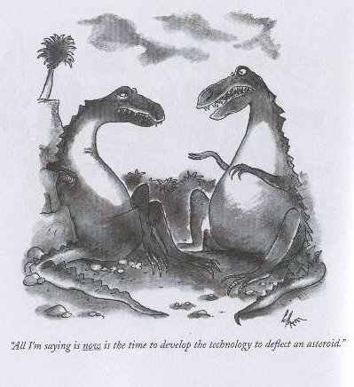
Interdisciplinary Science in Support of Climate Adaptation Initiatives
Kristen Averyt
Deputy Director,
Western Water Assessment.
NOAA, University of Colorado
kristen.averyt@noaa.gov

Slide 2
The Things I Like About My Job
Kristen Averyt
Deputy Director,
Western Water Assessment.
NOAA, University of Colorado
kristen.averyt@noaa.gov
Notes:
take the next few minutes and discuss a little more about my current work with the Western Water Assessment

Slide 3
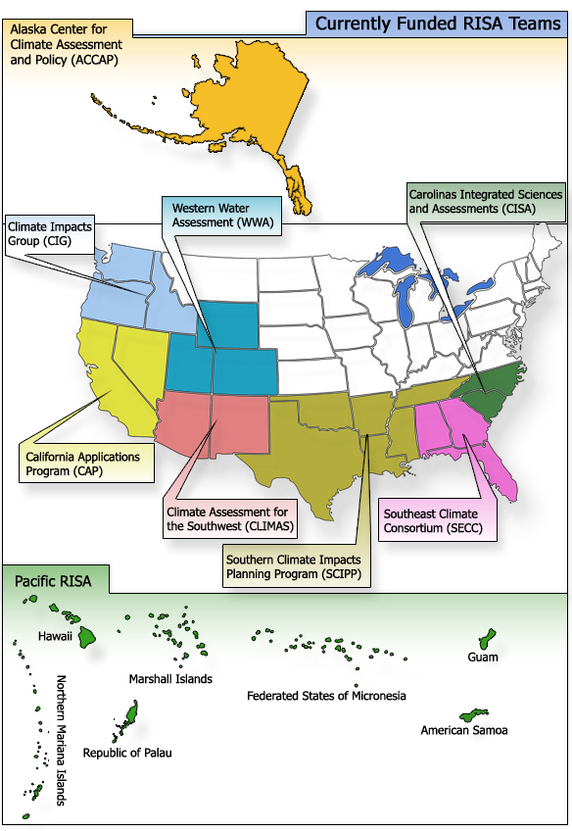
Western Water Assessment
NOAA Regional Integrated Sciences & Assessments (RISA) Program
Connect climate research with decision making
Now 12 RISA programs in US
WWA MISSION
“To identify and characterize regional vulnerabilities to, and impacts of, climate variability and change, and to develop information, products, and processes that assist decision-makers throughout Colorado, Utah, and Wyoming.”

Slide 4
Western Water Assessment
NOAA Regional Integrated Sciences & Assessments (RISA) Program
Connect climate research with decision making
Now 12 RISA programs in US
WWA MISSION
“To identify and characterize regional vulnerabilities to, and impacts of, climate variability and change, and to develop information, products, and processes that assist decision-makers throughout Colorado, Utah, and Wyoming.”
Source: Reclamation

Slide 5
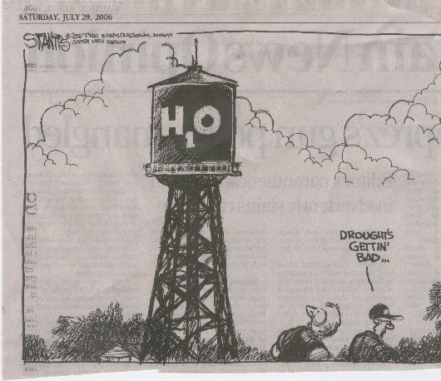
Regional Challenges
In the West, many impacts of climate change will be delivered through changes in the nature of water resources

Slide 6
Regional Challenges
Rapidly growing population
Social & environmental stresses
Highly variable
and complex
climate

Slide 7
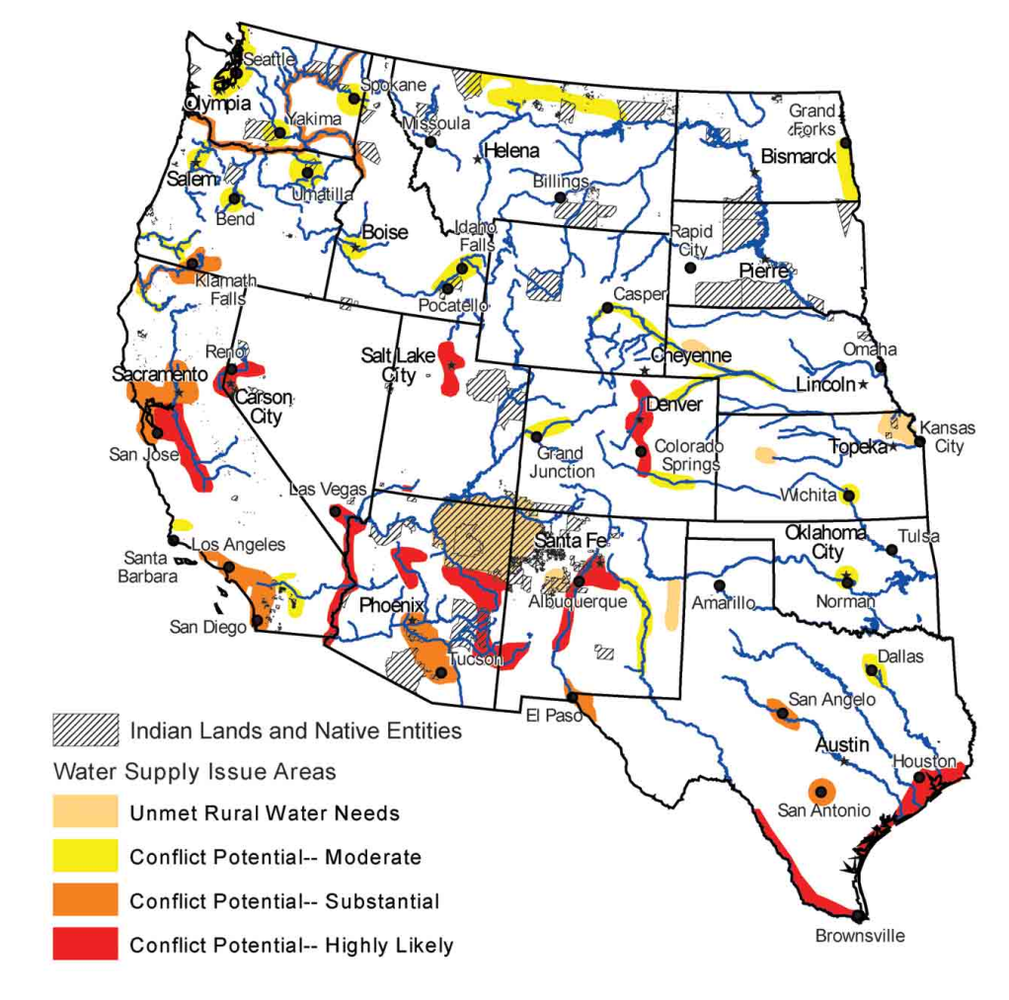
Regional Challenges
Rapidly growing population
Social & environmental stresses
Highly variable
and complex
climate
Water 2025, 2003

Slide 8
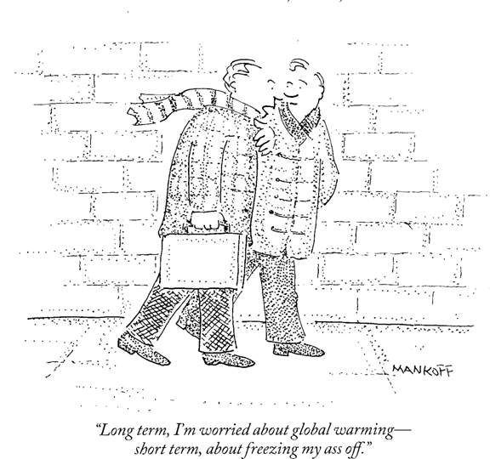
Regional Challenges
Rapidly growing population
Social & environmental stresses
Highly variable
and complex
climate

Slide 9
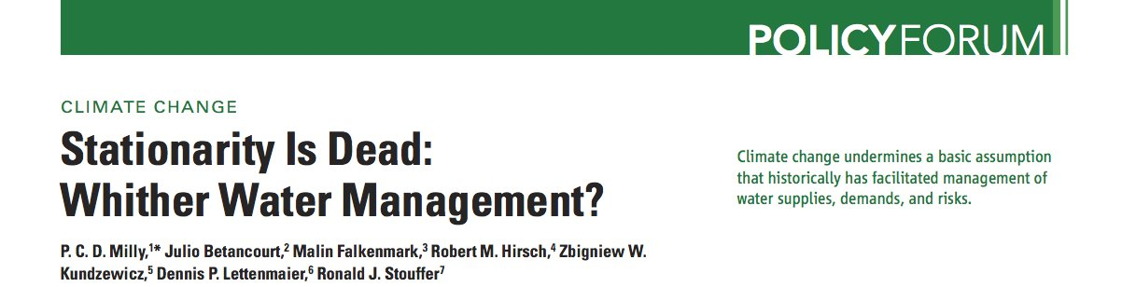
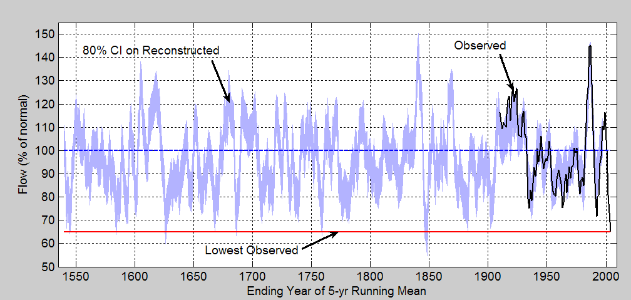
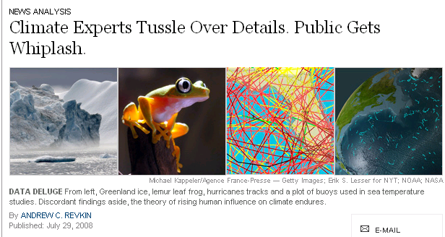
Regional Challenges
Source: CCSP SAP 5.1 2009
Within the water resources engineering community, the stationarity assumption is a fundamental element of professional training
Milly et al. 2007
Time scales of climate change exceed typical planning and infrastructure design horizons and are remote from human experience
Meko et al. 2007
Confusion in conceptually melding the burgeoning climate change impacts literature

Slide 10

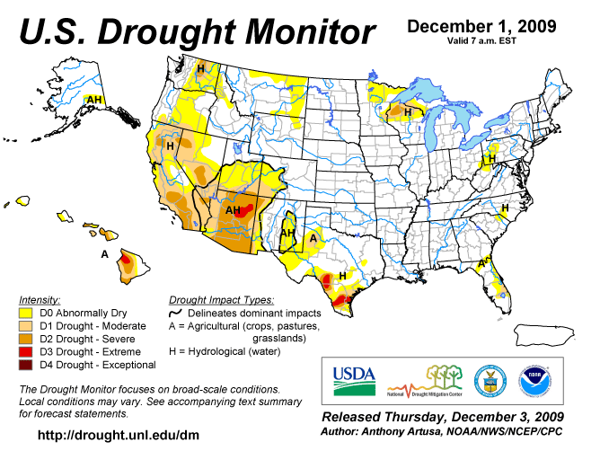
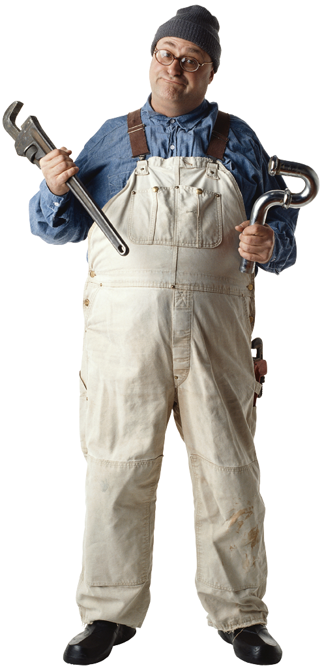
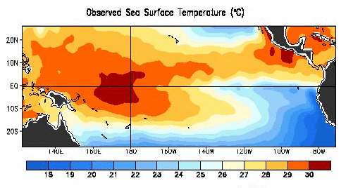


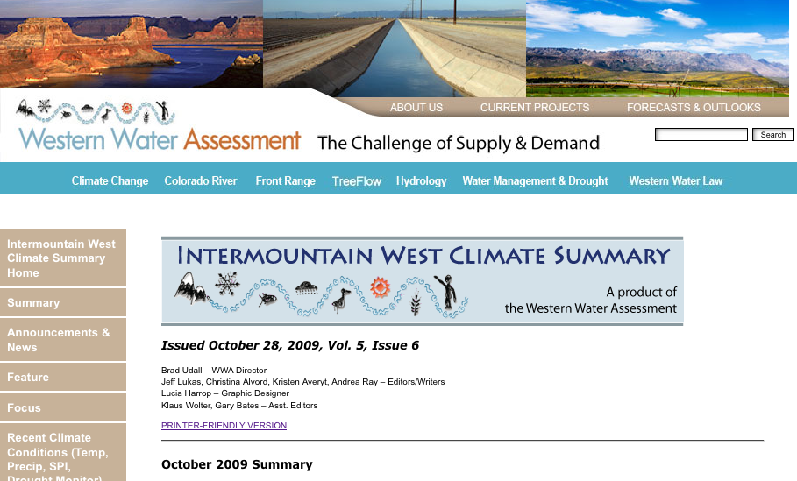
Integrated Research
Climate Services
Machine
START
Research & Data Collection
Better Climate Information & Informed Users
Users & Existing
Climate Information
Products
Information Providers
Tool & product Developers
Informed Users &
Better Climate Information
Outreach
Research
Notes:
Our last research theme, also less than a year old invovles high-risk, experimental work geared toward testing mechanisms for climate services
We have many initiatives focused in this directions, but they all pivot on our fundamental principle of climate services…
…which is neither the top down or bottom up models that many espouse, but is rather is a process that can best be described as both iterative and integrative
The mental model we use is that of a machine
I know this looks like a cuisinart or coffee grinder, but please bear with me.
The principle starts by entering a given set of user sand existing climate information into what we call the climate services machine
The machine represents the interactions among users, climate information, researchers, science, tools and product developers…
This interaction is some combinatin of workshops, evaluations, outreach, interviews.. And really a lot of social science methodologies
What we hope for after the interaction is a better informed user, and better climate information– either because the user understand the information and it is more useful or because the user has informed the developer about how to make a tool or product more useful
But the process doesn’t stop here… after the first iteraction, a user will change, and so will his/her perception of the informatin
Consequently, since perception is reality, the information will change,a nd so will how the user might use the information to make a decision
So we need to throw the users and the information back into the machine.
But the machine needs to adjust since th input is different…
We are currently testing this iterative idea with a suite of partners, and PSD/CIRES folks are intimately involved.
Our funded endeavours includes…
Most relevant to this crew is a series of workshops involving the River Basin Forecast Centers, where we are testing their tools and products with real users through workshops, and we are also using gaming devices (game theory) to test whether or not decision makers interpretation and use of information is resulting in the “best “ possible decisions

Slide 11
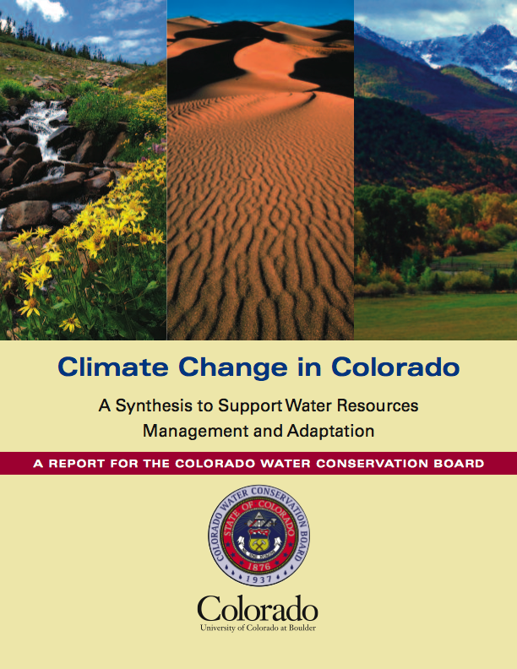




Climate Change in Colorado:
A Synthesis to Support Water Resources Management and Adaptation
Commissioned by Colorado Water Conservation Board, in support of Governor Ritter’s Colorado Climate Action Plan
Lead Authors
Andrea J. Ray^{1, 2}, Joseph J. Barsugli ³, Kristen B. Averyt ²
Authors
Klaus Wolter ³, Martin Hoerling¹, Nolan Doesken⁴,
Bradley Udall², Robert S. Webb¹
¹NOAA, Earth Systems Research Laboratory
²University of Colorado at Boulder, Western Water Assessment
³University of Colorado at Boulder, Climate Diagnostics Center
⁴Colorado State University
State of the science regarding the physical aspects of climate change that are important for evaluating impacts on Colorado and developing adaptation strategies out to the mid-21st century
www.cwcb.state.co.us

Slide 12
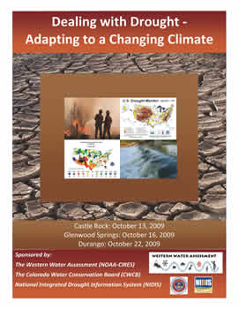
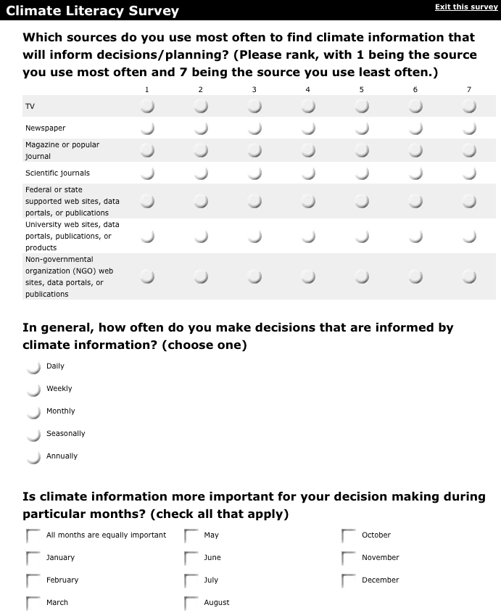
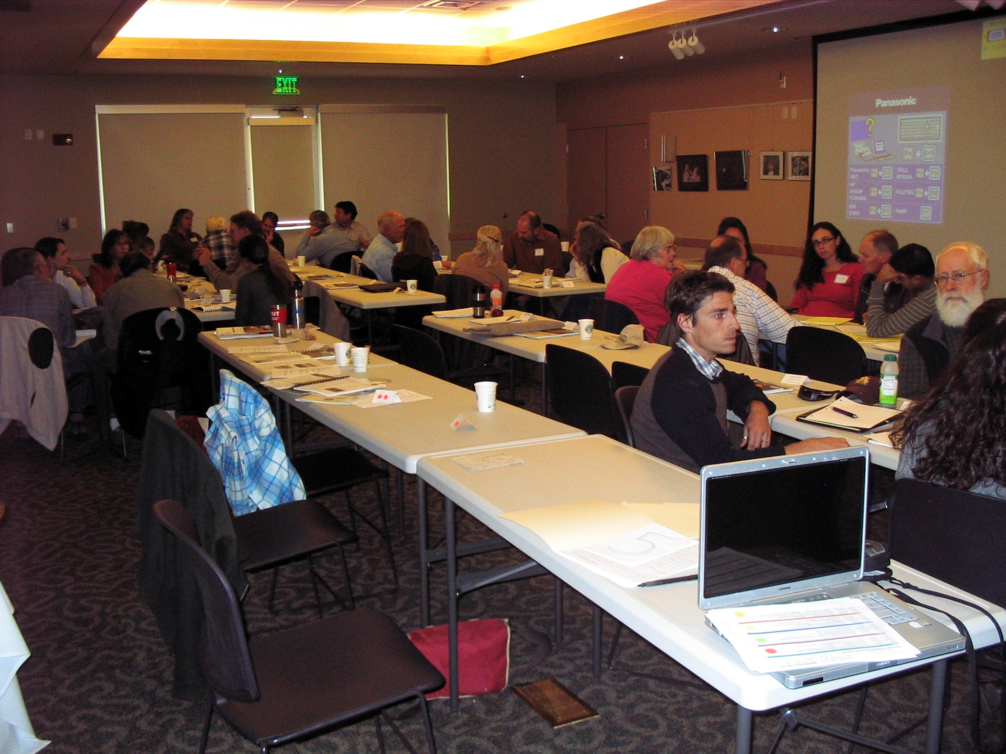
Colorado Climate & Drought Roadshow
Presentations: no death
by powerpoint
Small-group exercises
Breakout Sessions
Workshop Evaluation
  Part I: Survey of decision-making context, utility of climate info.
  Part 2: Climate literacy quiz
Notes:
Cover a couple specific examples:
In fall 2009, held a series of workshops designed to communicate climate information to the public and identify informational needs related to drought
These workshops are integration mechanism in the climate machine
Workshops: avoided death by ppt
Incorporated small groups exercise: example
Going to show you a couple examples of the type of information we got from the workshop participants

Slide 13
Colorado Climate & Drought Roadshow
CONCEPT BEING TESTED | BEFORE (%) | AFTER (%)
Scientific process | 71 | 75
Weather vs. climate | 79 | 82
Climate drivers | 46 | 62
Change vs. variability | 39 | 39
Greenhouse effect | 78 | 95
Historical global temperatures trends | 98 | 93
Anthropogenic Climate Change | 71 | 85
Recent Global Temperature Trends | 49 | 76
Emissions vs. concentrations | 95 | 100
Climate in Colorado and the West | 88 | 98
Regional vs. Global Climate Change | 95 | 93
ENSO | 73 | 81
Colorado Climate Observations | 23 | 74
ENSO and Colorado | 21 | 36
Paleoclimate | 92 | 98
Drought in Colorado | 62 | 72
Climate Models | 71 | 83
Global Climate Projections | 21 | 62
Colorado Climate Projections | 32 | 63
Major Misperceptions
Global warming is over because global average temperatures have declined in the past few years.
Annual precipitation in Colorado has decreased in the last 50 years.
Climate change has caused more frequent hurricanes.
Major declines in Colorado’s high elevation snowpack (>8000 ft) are expected by 2025.

Slide 14
Colorado Climate & Drought Roadshow
Don’t consult
Do consult
Where do participants access climate information?
BEFORE: Access information from a few federal resources
AFTER: Regional resources and clearinghouses
Notes:
Another example: we asked participants about where they access their climate information and we listed about 15 credible resources
Not going through this in details, but highlighted in yellow the most popular response: and we found that most folks hadn’t even heard of many of the climate resources developed by the research community.
During the workshop, we exposed participants to these resources, and I’ve indicated with a star those resources that folks indicated they would being consulting in the future
Interesting lesson here: there’s a lot of information out there, but people don’t know where to get it.

Slide 15
Colorado Climate & Drought Roadshow
Presentations: no death
by powerpoint
Small-group exercises
Breakout Sessions
Workshop Evaluation
  Part I: Survey of decision-making context, utility of climate info.
  Part 2: Climate literacy quiz
What we learned:
Aware of the impacts of climate change & variability
Believe they could use climate information to inform decisions
Unsure of what information they need, where it is, and how to use it
Further Efforts:
Tool Evaluation, Usability & Utility, Scenario & Gaming Exercise– HOW IS INFO USED & IS IT BEING USED PROPERLY?

Slide 16
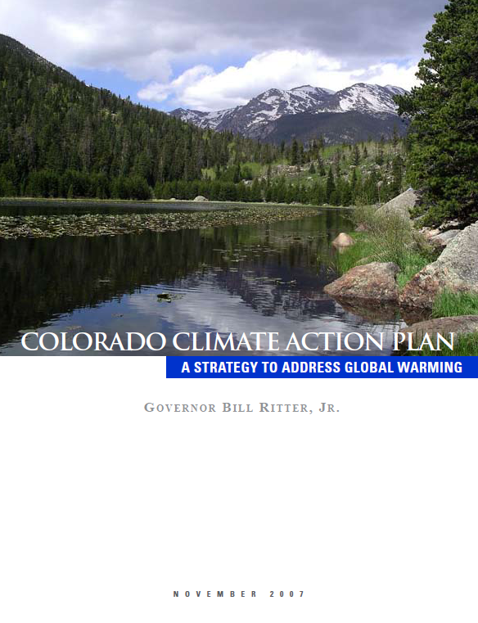
Colorado Climate Adaptation Project
Climate Preparedness in Colorado:
A Catalog for the Next Governor
Reconnaissance mission: Identify specific state adaptation initiatives and those that unintentionally reduce vulnerability and enhance resilience across multiple sectors
Framework born from demonstrated lack of knowledge about available resources
Structured interviews
Analysis of documents, meetings, workshops
6 mos. timeline

Slide 17
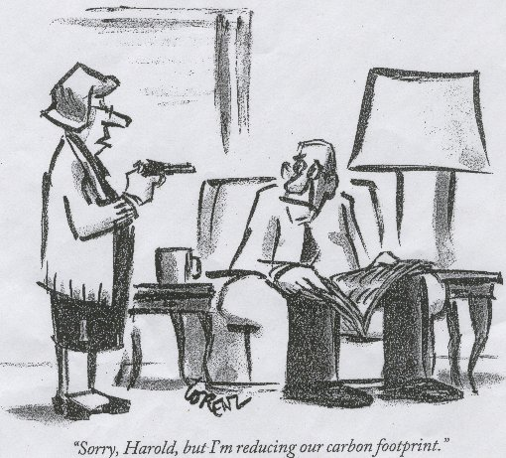

Slide 18
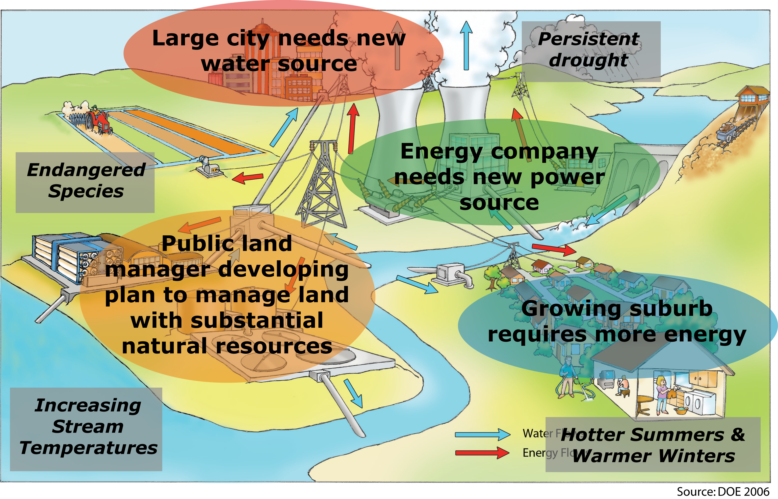
Example: Energy-Water-Climate Nexus

Slide 19
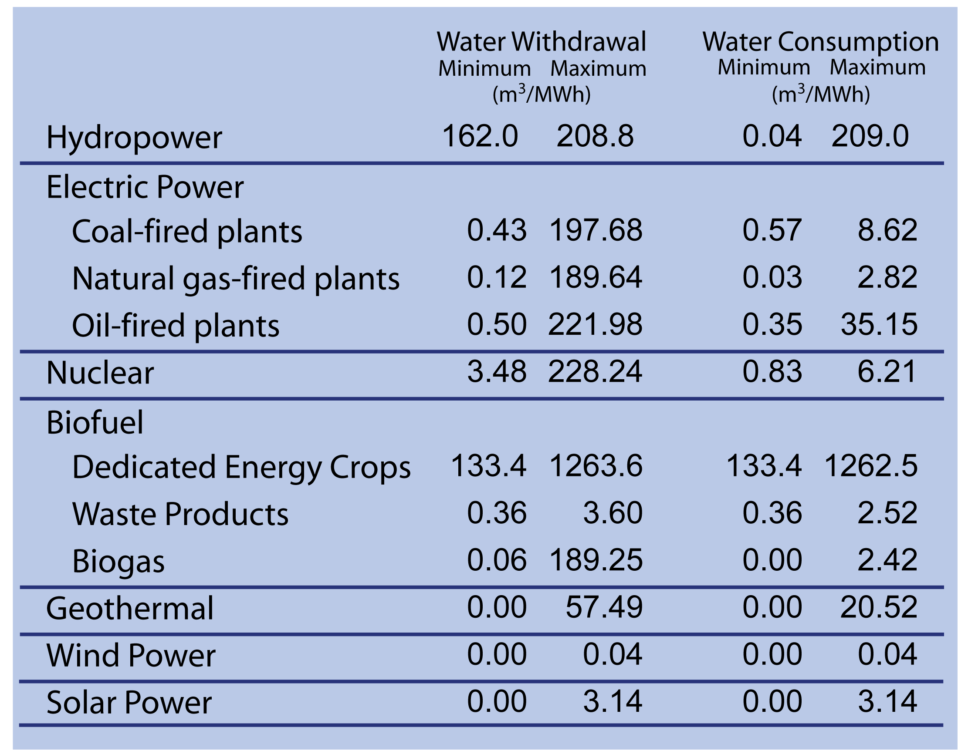
Water for Energy

Slide 20
Water for Energy
Solar-Thermal
Coal-Fired
 | wet-cooling (recirculating) | air-cooling | hybrid/ parallel
parabolic troughs | 3.028 | 0.295 | 0.378 to 0.946
linear Fresnal | 3.785 | no data | no data
power tower | 1.893 to 2.839 | 0.341 | 0.341 to 2.839
Stirling Engine | na | 0.076 | na
 | Withdrawal (m3/MWh) | Withdrawal (m3/MWh) | Consumptive (m3/MWh) | Consumptive (m3/MWh)
 | Low | High | Low | High
Conventional Pulverized Combustion - Once-Through Cooling | 76.086 | 189.834 | 1.761 | 1.980
Conventional Pulverized Combustion - Direct Dry Cooling | 0.481 | 0.811 | 0.716 | 1.052
Conventional Pulverized Combustion - Indirect Dry Cooling | 0.481 | 0.811 | 0.719 | 1.053
Conventional Pulverized Combustion - Hybrid Wet-Dry Cooling | 0.481 | 0.811 | 0.719 | 1.053
Conventional Pulverized Combustion - Pond Cooling | 80.931 | 196.265 | 6.605 | 7.505
Conventional Pulverized Combustion - Wet Cooling | 4.095 | 4.744 | 4.334 | 4.553
Gasification - Once-Through Cooling | 49.534 | 123.640 | 1.219 | 1.396
Gasification - Direct Dry Cooling | 0.390 | 0.774 | 0.540 | 0.793
Gasification - Indirect Dry Cooling | 0.390 | 0.774 | 0.542 | 0.793
Gasification - Hybrid Wet-Dry Cooling | 0.575 | 2.989 | 0.717 | 2.823
Gasification - Cooling Pond | 1.067 | 2.103 | 1.219 | 1.838
Gasification - Wet Cooling | 2.625 | 3.419 | 2.777 | 3.450
Water withdrawals and consumption depend on the technology & particularly cooling method
Adapted from Wilkinson et al., pers com.

Slide 21
Energy-Water-Climate Nexus: Recent Work
Identified coal-fired & solar-thermal power plants in operation and planned that would likely be drawing water from the CO River Basin
PROPOSED CAPACITY:
Coal-Fired: 8000 MW
Solar Thermal: 8000 MW
Water Consumed (thousand acre-ft per year)
 | Coal-Fired |  | Solar Thermal
 | MIN | MAX | MIN | MAX
Currently Operational | 574 | 674 | 0 | 3
Proposed | 196 | 206 | 30 | 31
TOTAL | 770 | 880 | 30 | 34

