Slide 1
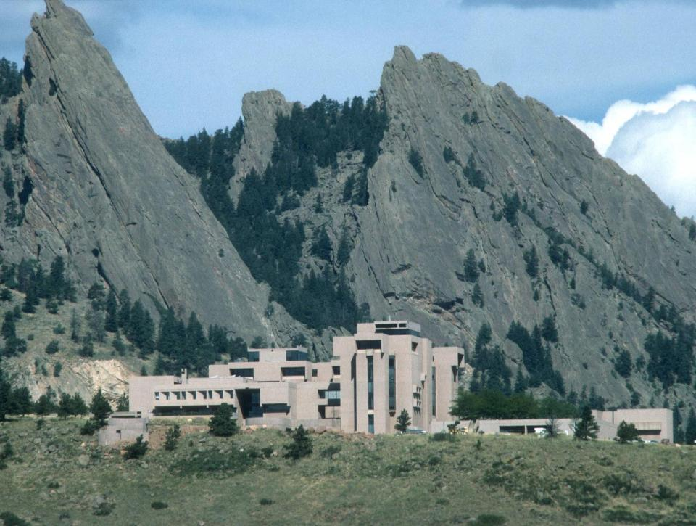
Water Resource Planning Options for Climate Change
David Yates and Kathleen Miller
NCAR – Boulder, CO
JFF 13 Jul 2010
“Science exists to serve human welfare. It’s wonderful to have the opportunity given us by society to do basic research, but in return, we have a very important moral responsibility to apply that research to benefiting humanity.” Dr. Walter Orr Roberts (NCAR founder)
Notes:
“I have a very strong feeling that science exists to serve human welfare. It’s wonderful to have the opportunity given us by society to do basic research, but in return, we have a very important moral responsibility to apply that research to benefiting humanity.”
Walter Orr Roberts

Slide 2
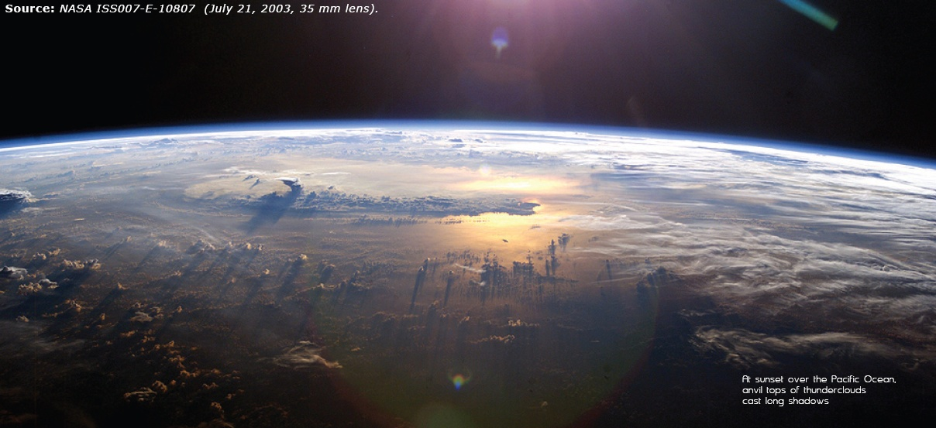
Notes:
Discussion About greenhouse gases and CO2
Preponderance of evidence..
The team first confirmed a theory that the slight increase in solar energy during the peak production of sunspots is absorbed by stratospheric ozone. The energy warms the air in the stratosphere over the tropics, where sunlight is most intense, while also stimulating the production of additional ozone there that absorbs even more solar energy. Since the stratosphere warms unevenly, with the most pronounced warming occurring at lower latitudes, stratospheric winds are altered and, through a chain of interconnected processes, end up strengthening tropical precipitation.
At the same time, the increased sunlight at solar maximum causes a slight warming of ocean surface waters across the subtropical Pacific, where Sun-blocking clouds are normally scarce. That small amount of extra heat leads to more evaporation, producing additional water vapor. In turn, the moisture is carried by trade winds to the normally rainy areas of the western tropical Pacific, fueling heavier rains and reinforcing the effects of the stratospheric mechanism.

Slide 3
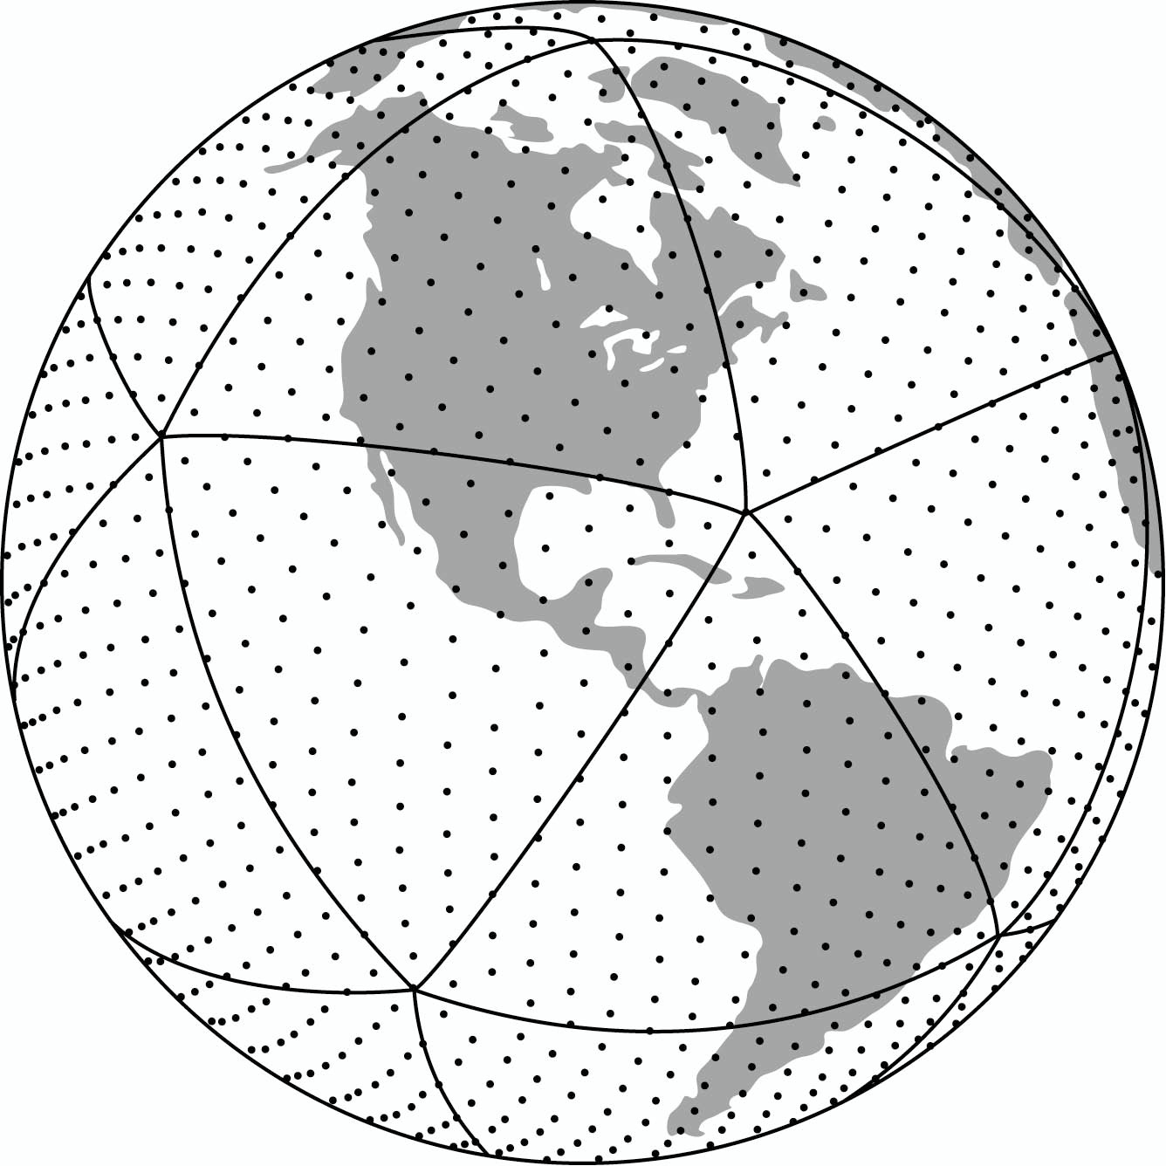
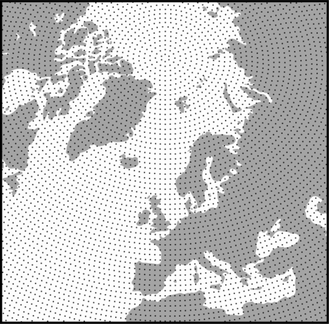
GCM’s – A Grid of Points over Earth
(Precipitation is the most difficult modeled variable)
Typical global climate model has 1-2 million calculation points

Slide 4
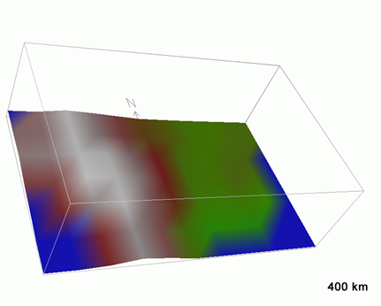
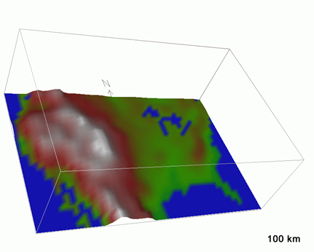
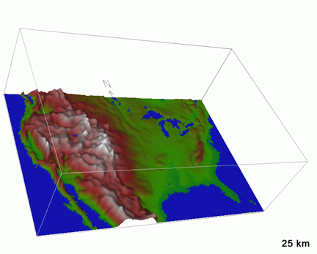
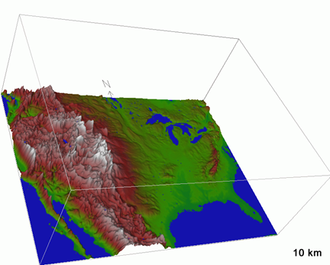
Climate Models circa early 1990s
Global coupled climate models in 2006
Global models in 5-10 yrs?
Regional models

Slide 5
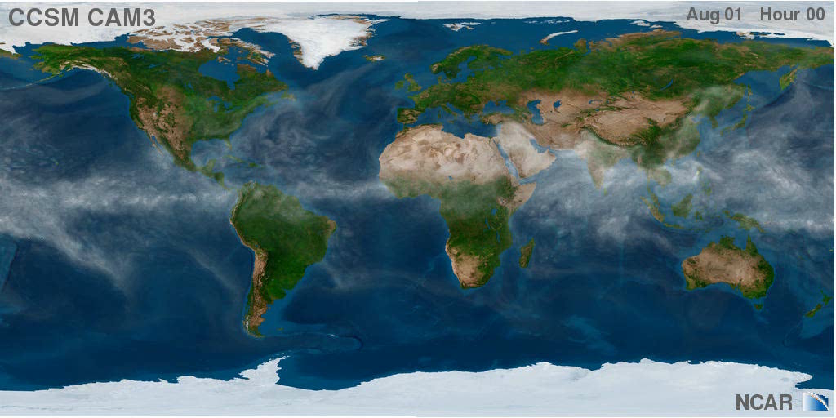

Slide 6
Need “Actionable Information”
David Behar, Water Utility Climate Alliance, “We need actionable
information to make changes or additions to capital investments..”,
San Francisco Public Utilities
Marc Wagee, Manager of Water Supply, Denver Water, “Surprisingly,
we haven’t dealt well with uncertainty.. Climate change is a wake-up
to this fact”

Slide 7
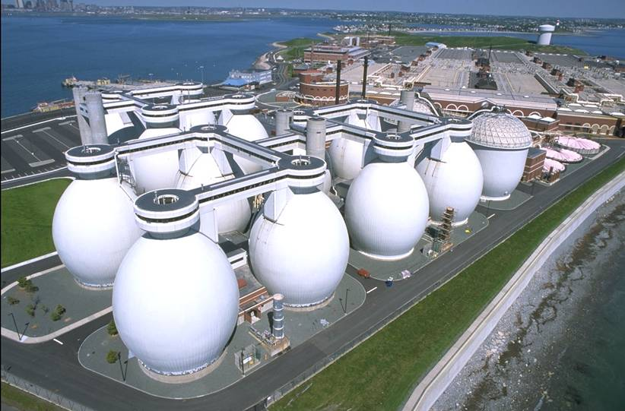
MWRA and the “Boston Harbor Cleanup”,

Slide 8

Study Approach
  Developing Decision Analysis tools that incorporate climate change information
  Risk-management approach to decision-making
  Worked with a set of water utility partners from the very start
Portland
MWRA
CO SPRINGS
IEUA
PALM BEACH COUNTY

Slide 9
Partnership Design and Decision Tools
Industry Research – AwwaRF
Utility Partners
Project Team
NCAR, consultants
Structured Process & Decision Tools
Climate Research – NCAR; Universities; Federal Agencies

Slide 10
Partnership Design and Decision Tools
Problem Structuring
  Problem Structuring
  Goals
Industry Research – AwwaRF
Colo
Springs
Utilities
Project Team
NCAR, MWH
WEAP, MODSIM
Climate Research – NCAR; NOAA, U. of Colo

Slide 11
Problem Structuring- Goals and Objectives
Problem Structuring
  Problem Structuring
  Goals
Inland Empire Utility Agency
  Focus on enhancing local supplies or rely on imports?
Colorado Springs Utilities
  Integrated Resource Plan… how to link to current safe yield analysis?
MWRA
  Safe Yield Analysis- What level of demand meets Quabbin storage targets under climate change
Palm Beach County
  IRP in the face of major changes (Lake Okeechobee, future demand, environ interests, sea level rise, climate change, etc.)

Slide 12
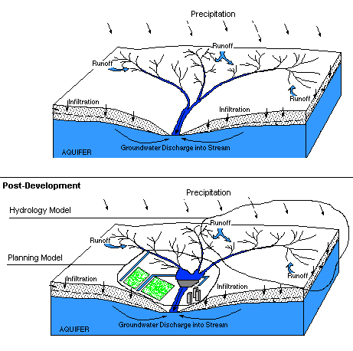
Need for An Integrating Model Framework
Deterministic Formulation
  Decision Model
  Sensitivity Analysis
Pre-development
Temp, rh, wind
Natural Watershed
Developed Watershed
Water imports

Slide 13
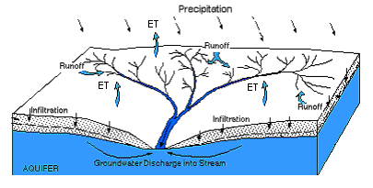
Hydrology Model
Deterministic Formulation
  Decision Model
  Sensitivity Analysis
Critical question: How does rainfall on a catchment translate into flow in a river?
Critical question: What pathways does water follow as it moves through a catchment? Runoff? Infiltration? ET? Seepage?
Critical question: How does movement along these pathways impact the magnitude, timing, duration and frequency of river flows?
Notes:
Physical hydrology models describe the water cycle of the watershed.. The “natural” processes…

Slide 14
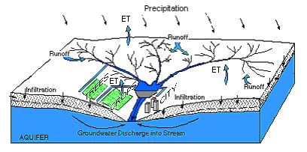
Planning Model
Deterministic Formulation
  Decision Model
  Sensitivity Analysis
Critical question: How operations be optimized to protect the services provided by the river?
Critical question: How should infrastructure (e.g. dams, diversion works, etc) be operated to achieve maximum benefit? How should water be allocated in shortage?
Critical question: How will allocation, operations and operating constraints change if new management strategies are introduced into the system?
Notes:
But in MANY places, humans have altered this natural, hydrologic cycle for beneficial use.
This use typically quite complex, in terms of its governance and regulation.
Water Planning: Water resource planning models ask the questions in the slide. Importantly,
Most water resource planning models do not directly use climate information, but use
Climate proxies, typically in the form of historical records of streamflow.

Slide 15
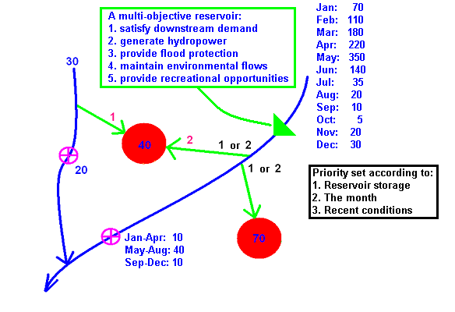
Water Management Can Get Complicated
Notes:
We need a collection of computer logic assembled in a manner that describes how water moves through this watershed.

Slide 16
Case Studies
    Colorado Springs, CO
    Palm Beach County, FL
    Boston, MA
    Inland Empire of Southern CA
    Portland, OR
    Durham
    El Dorado Irr District
Portland
MWRA
EID
CO SPRINGS
IEUA
Durham
PALM BEACH COUNTY

Slide 17
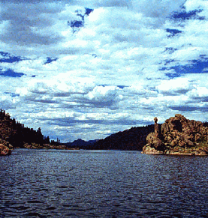
CSU’s Water System
75% of our water comes from reservoirs near the Continental Divide, over 200 miles away
25% of our water comes from Pikes Peak and the Arkansas River
Winter snows provide a continuous fresh water source for the citizens of Colorado Springs

Slide 18
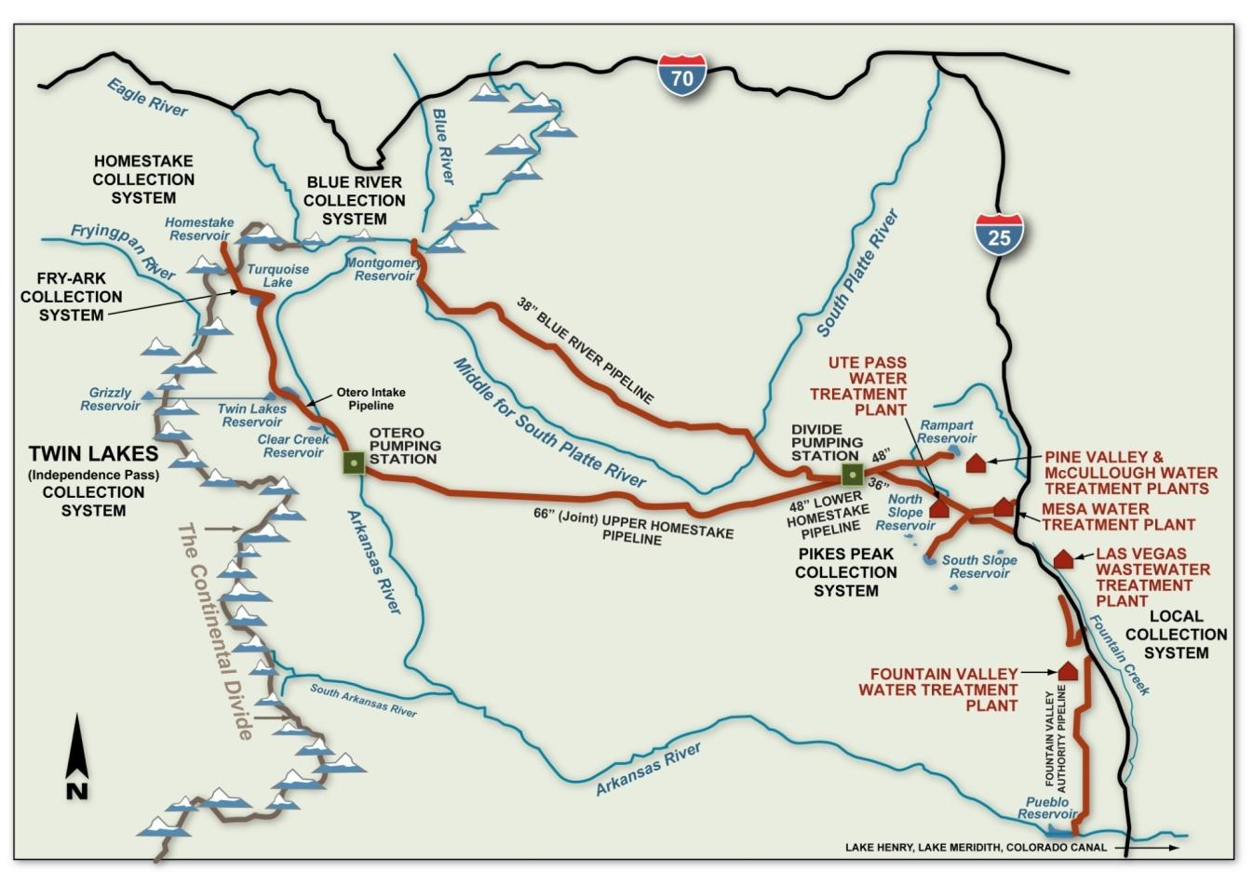
75% from West Slope
25% from East Side
Diversion Rights are Largely Controlled by Senior Rights on Colo River at Cameo and Shosone
18
Notes:
Not located near a major water source, so supplying our city with water has been a major challenge throughout our history. Pikes Peak system developed in first half of 20th century, Blue River System 1950’s, Homestake in 1960’s, and Fountain Valley Authority in 1970’s. Today we are living off the legacy of those who developed these systems.
As earlier generations have stepped up to meet this challenge, SDS is our legacy for this and future generations.
Have water rights to meet needs, SDS enables us to get it to Colorado Springs. Also will provide redundancy to delivery systems that were built many decades ago.
It is also important to our project partners – city of Fountain, Security and Pueblo West.
Pleased we’ve been able to collaborate with these other communities on this project.
18

Slide 19
Characterization of Watersheds and Sub-Watersheds
Deterministic Formulation
  Decision Model
  Sensitivity Analysis

Slide 20
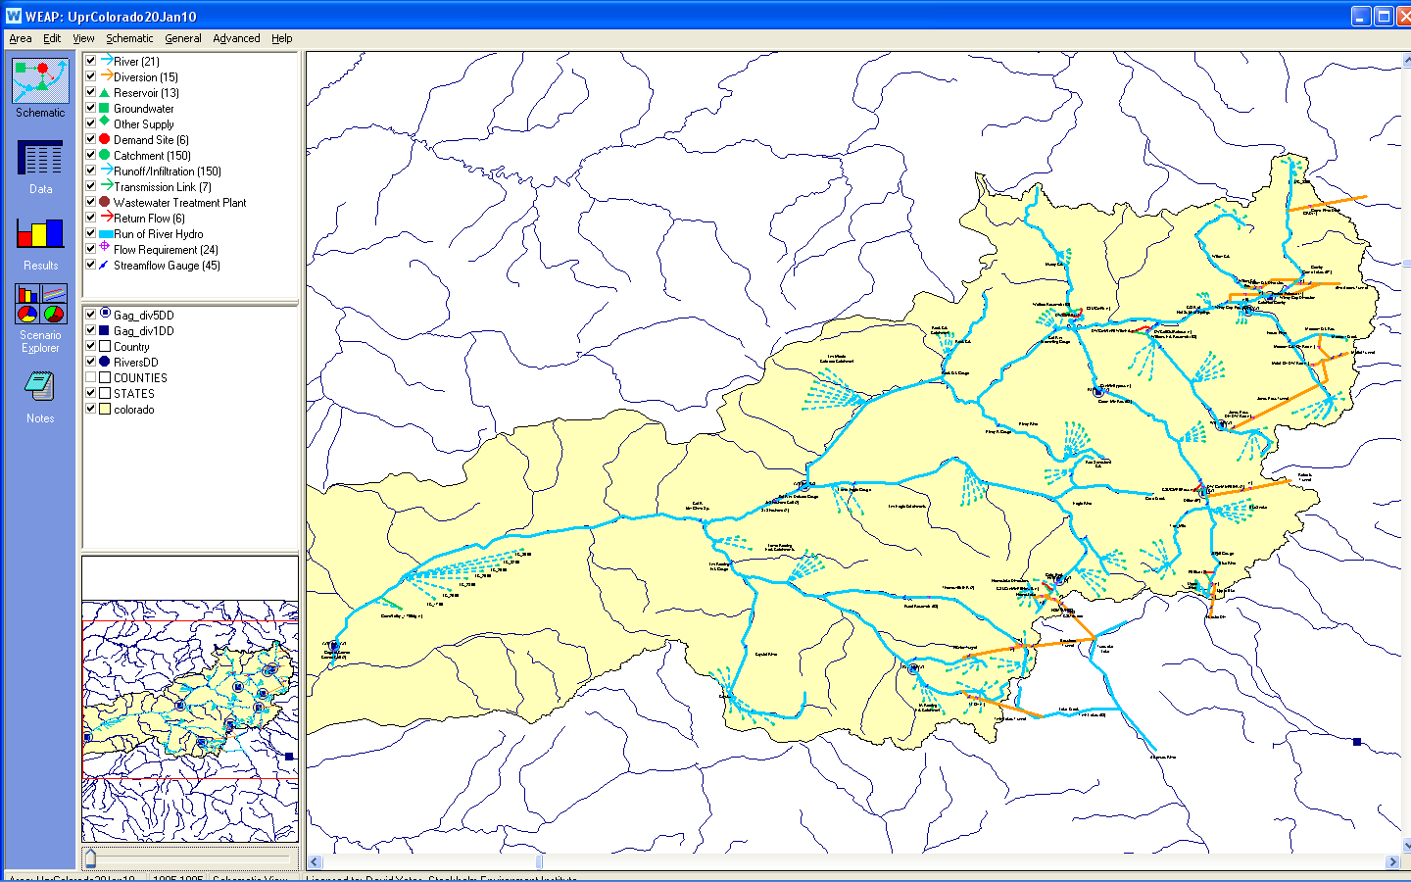
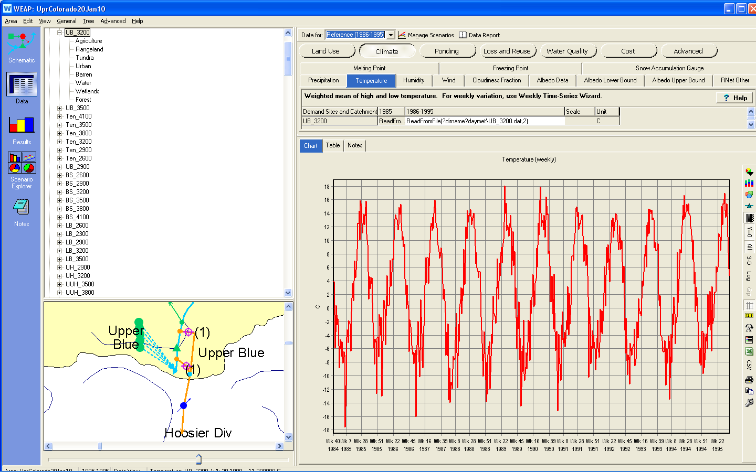
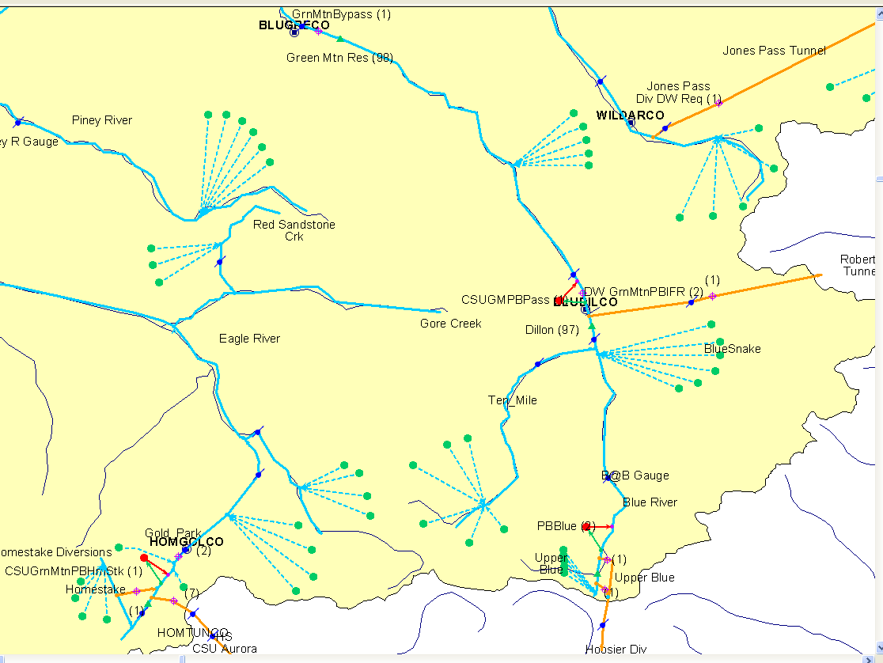
NCAR and CSU built a WEAP Application of West Slope Supply
Watersheds are defined according to Elevation Bands
with a unique climate forcing dataset.

Slide 21
The WEAP Application-Some Details
Rivers and Creek (11+)
  Blue, Ten Mile, Eagle, Homestake, Williams Fork, Fraser, Willow, Roaring Fork, Frying Pan, Muddy, Arkansas
Reservoirs (10)
  Granby/Grand, Dillon, Green Mountain, Homestake, Meadow Crk, Ruedi, Upper Blue, Williams Frk, Windy Gap, Wolford
Diversions and Rights (12)
  Grand River, CBT, Windy Gap, Willow Crk, Moffatt, Jones Pass, Roberts, Hoosier, Homestake, Boustead, Hunter, and Twin
Major Diversion Rights which Influence CSU
  Hoosier, Homestake, and Fry Ark. These are controlled by the Shoshone and Cameo Calls.
  Green Mountain Payback
  Representation of CBT and Denver Water’s “Rights”

Slide 22
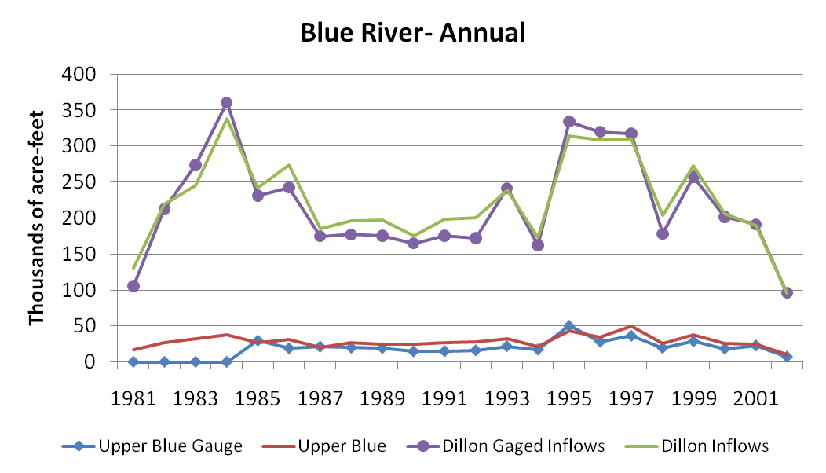
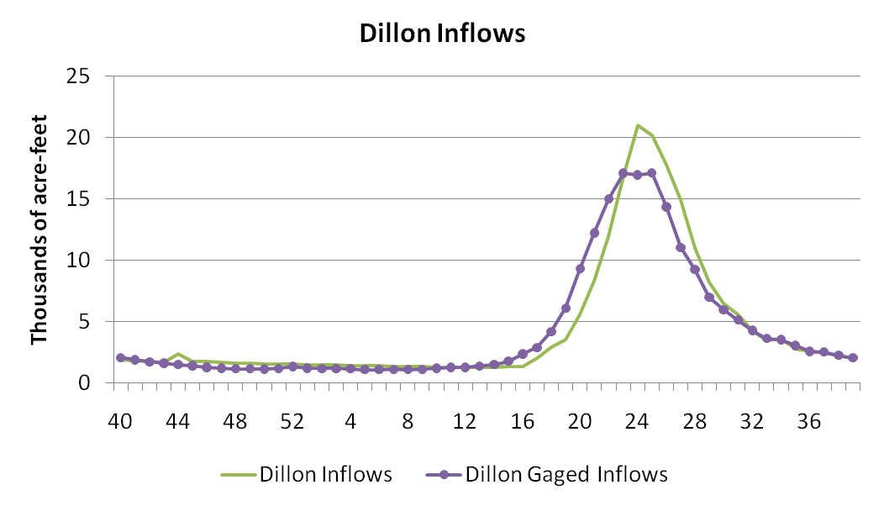
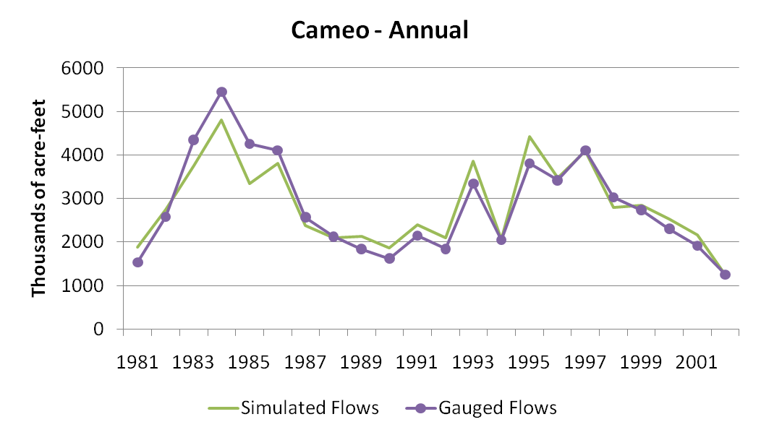
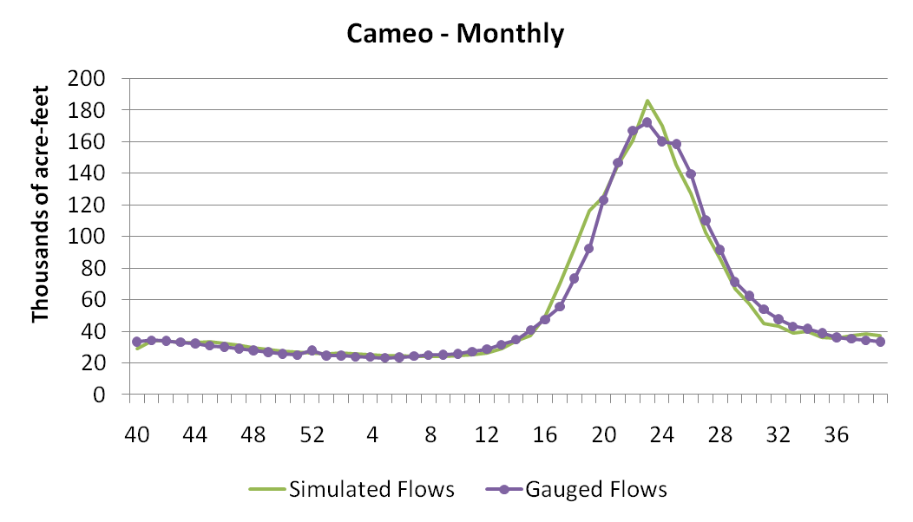
Calibration Objectives: Re-create observed flow, storage, and delivery for historic period
Streamflow
Cameo Weekly Avg flow
* Statistical evaluation will be available in Water Research Foundation Report

Slide 23
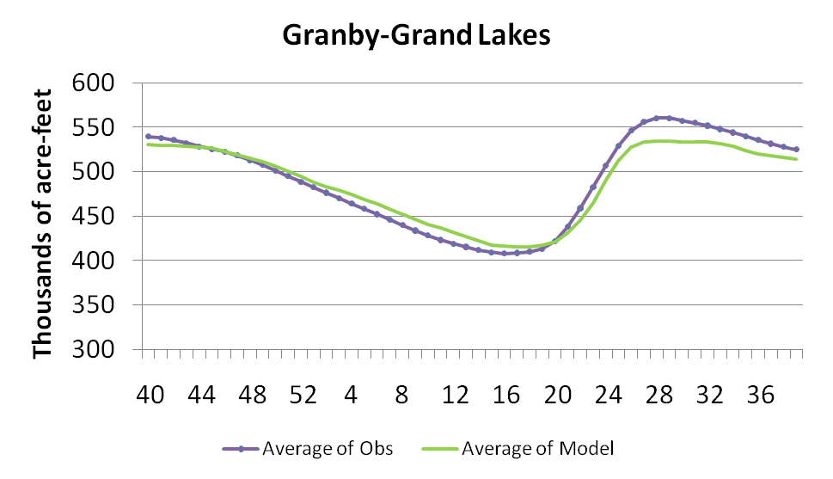
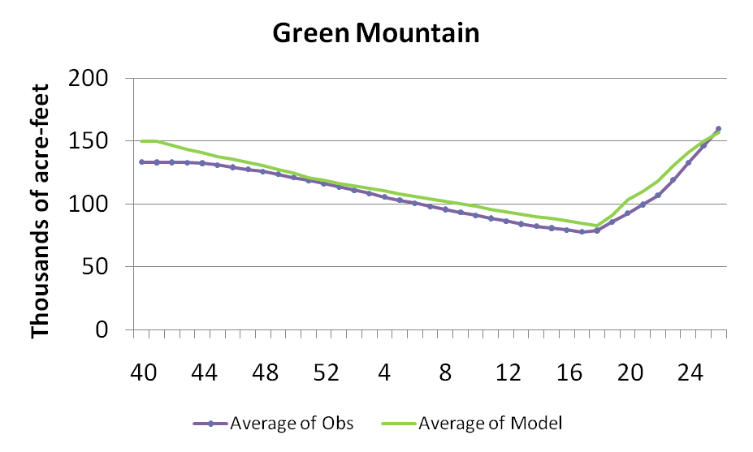
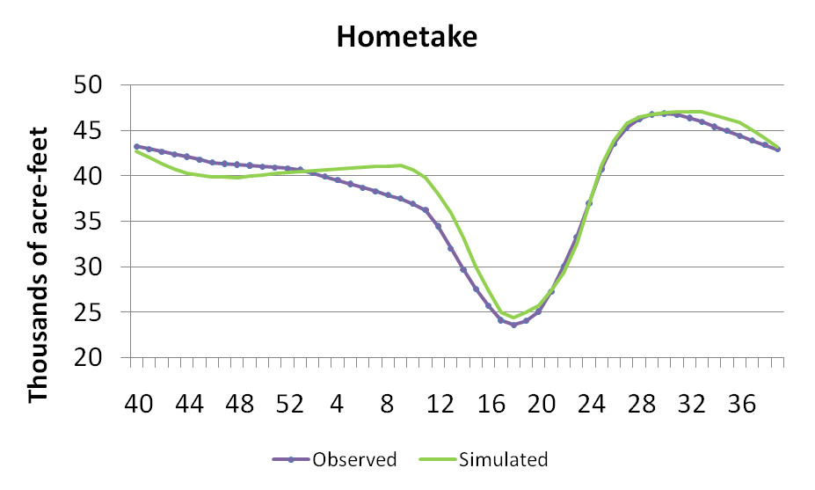
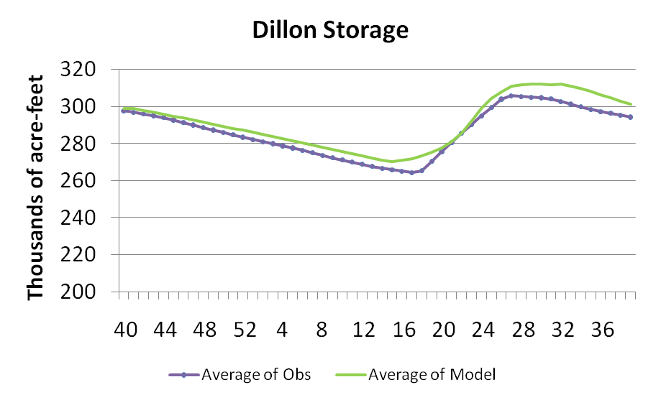
Monthly Average Storage
* Statistical evaluation will be available in Water Research Foundation Report

Slide 24
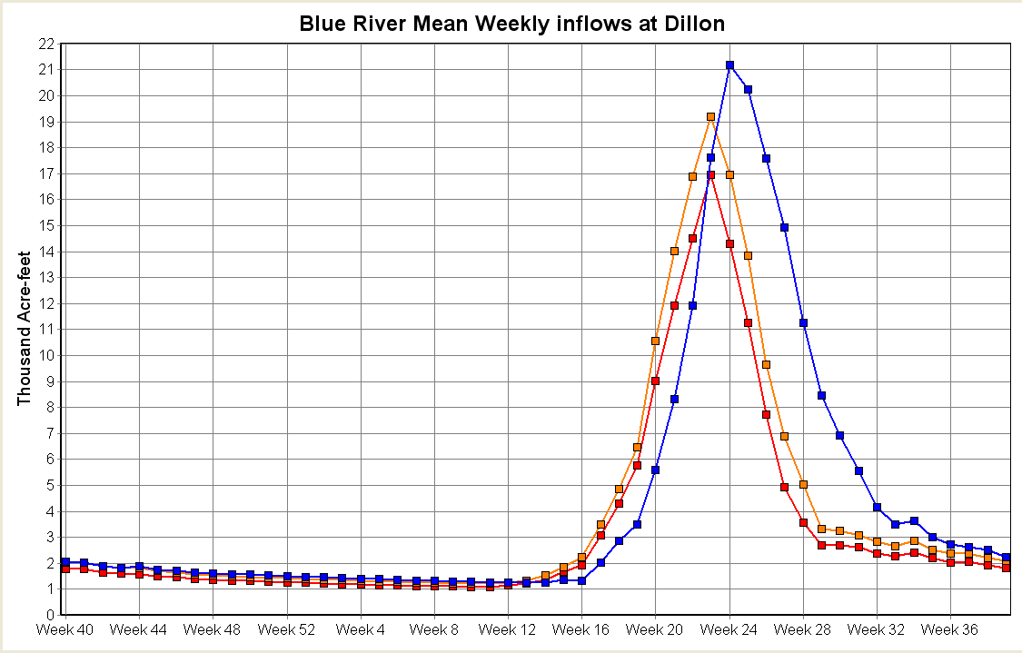
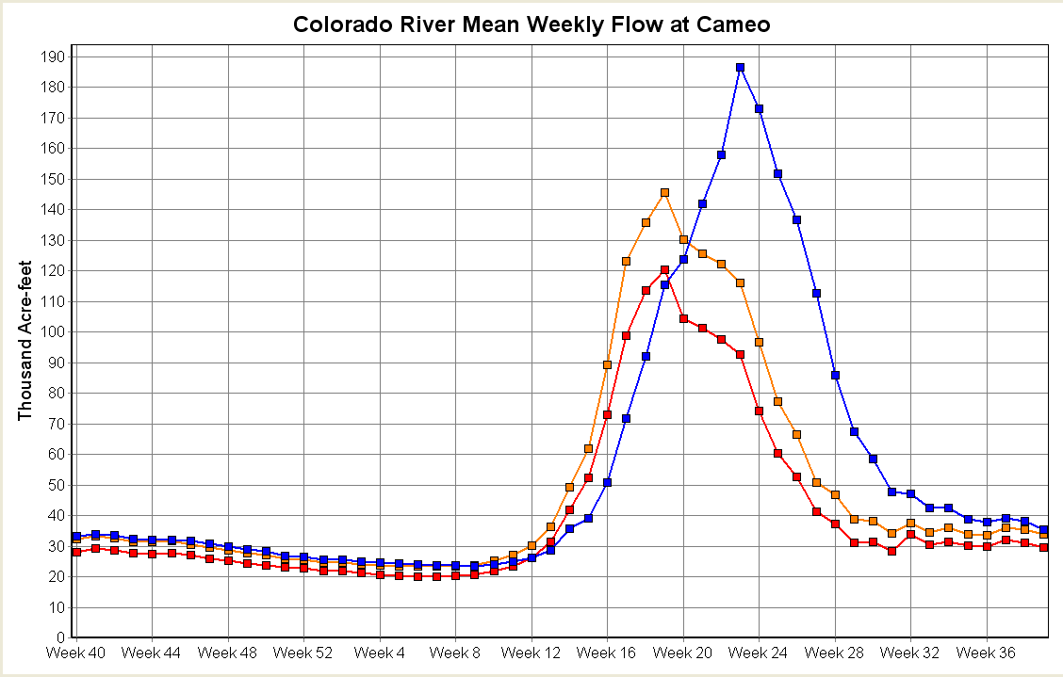
Only Simple Climate Sensitivity thus far
Add 2.8ºC to complete historic temperature- DT2.8
Add 2.8ºC and reduce precip. By 10% - DT2.8-10%
Blue River inflow to Dillon
Colorado at Cameo
*28-year monthly mean, (1000’s a-f)

Slide 25
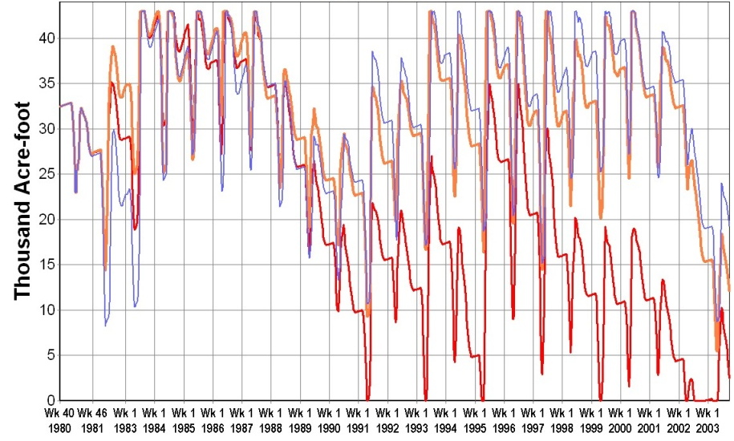
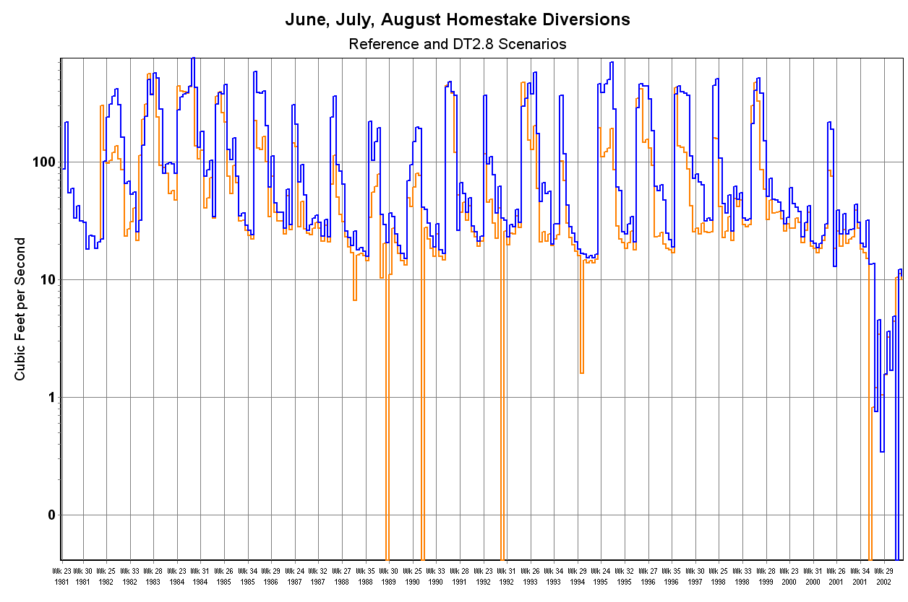
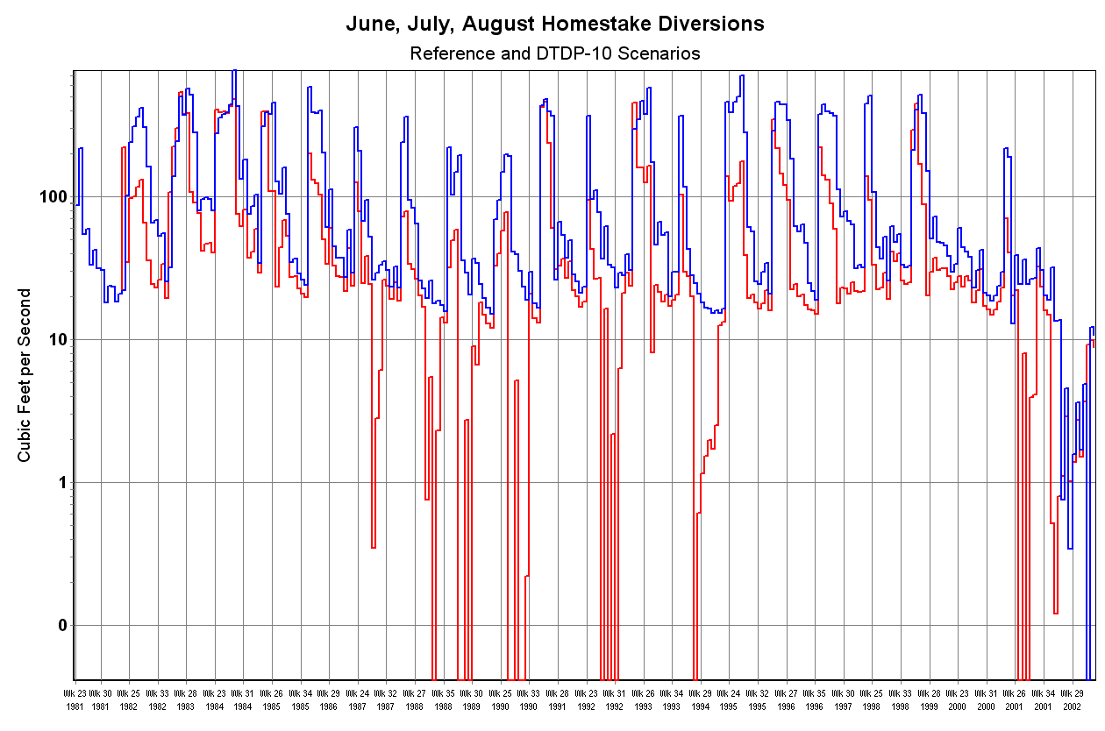
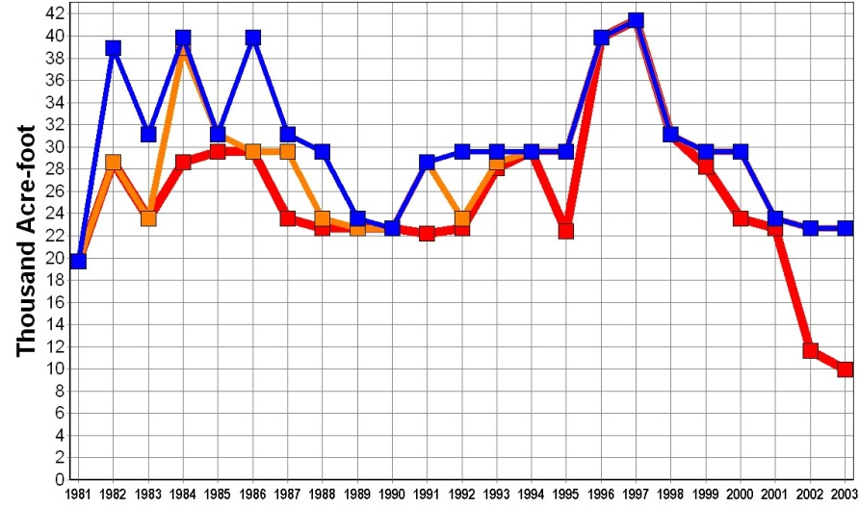
Storage, Delivery and Diversion: Homestake
Storage (weekly average, 1000’s a-f)
Delivery
Homestake Diversions (weeks)
June, July, August
DT2.8
June, July, August
DT2.8-10

Slide 26

http://www.isse.ucar.edu/awwarf/
http://waterresearchfoundation.org/
http://sei-us.org
http://weap21.org
David Yates yates@ucar.edu
Kathleen Miller kathleen@ucar.edu

