Slide 1



The Network Enabled Verification Service (NEVS) in Support of
NNEW Capability Evaluation
Sean Madine
ESRL/GSD/FVS
15 September 2010

Slide 2
Take Home Points
Weather forecast quality information will play an important role in the success of NextGen
NEVS is designed to work within the framework of NNEW, and incorporate concepts to support effective air traffic management
FY10: NEVS demonstrates interoperability with NNEW services in context of NAS strategic planning
FY11: NEVS, a unique consumer, could:
  Provide quality baseline of weather data in 4-D Cube/SAS
  Perform diagnostic tests of NNEW
  Expand service concepts/implementation

Slide 3
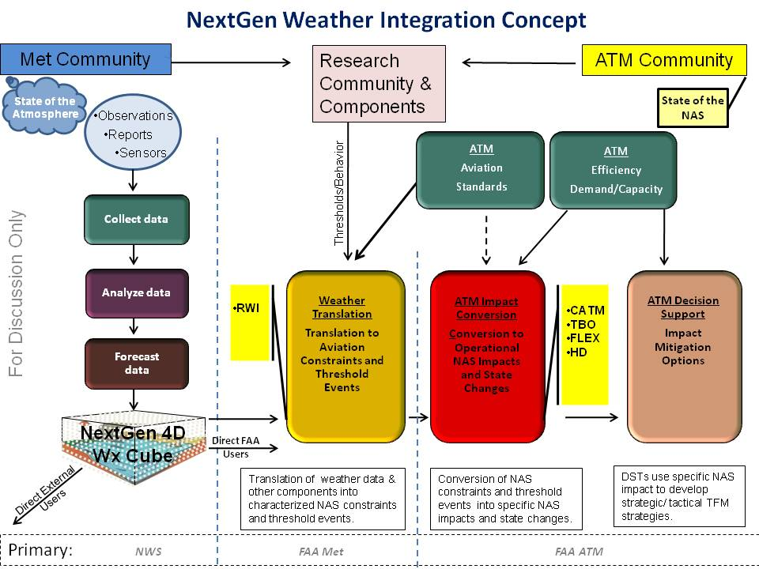
Weather Integration Plan

Slide 4
What is NEVS?
Network-Enabled Verification Service
Utilizes advanced quality assessment techniques integrated with key aviation decision criteria to provide meteorological forecast quality of aviation weather products in the context of aviation
  Measures value of products to planning processes
Adds value to air traffic management with specific capabilities
  Support of synthesis of weather forecasts into the SAS
  Real-time 4-D Cube weather forecast quality
  QMS : Historical performance record of weather and translated weather
  Alert to other services when quality tolerances exceeded
  Research to Operations (RTO) evaluations
Designed to conform to NNEW standards

Slide 5
NEVS in Weather Integration
NextGen
Weather Translation
and
ATM Decision Support
Translation of Weather for use in Aviation Operations
4D Wx
SAS Forecast
SAS
Performance Feedback
Performance
Feedback
4D Cube and SAS Weather
Translated Weather
Performance
Feedback of
Cube Elements
Performance
Feedback of
Translated Weather
NEVS
Quality of Wx
Quality of Translated Wx
Information
Exchange

Slide 6
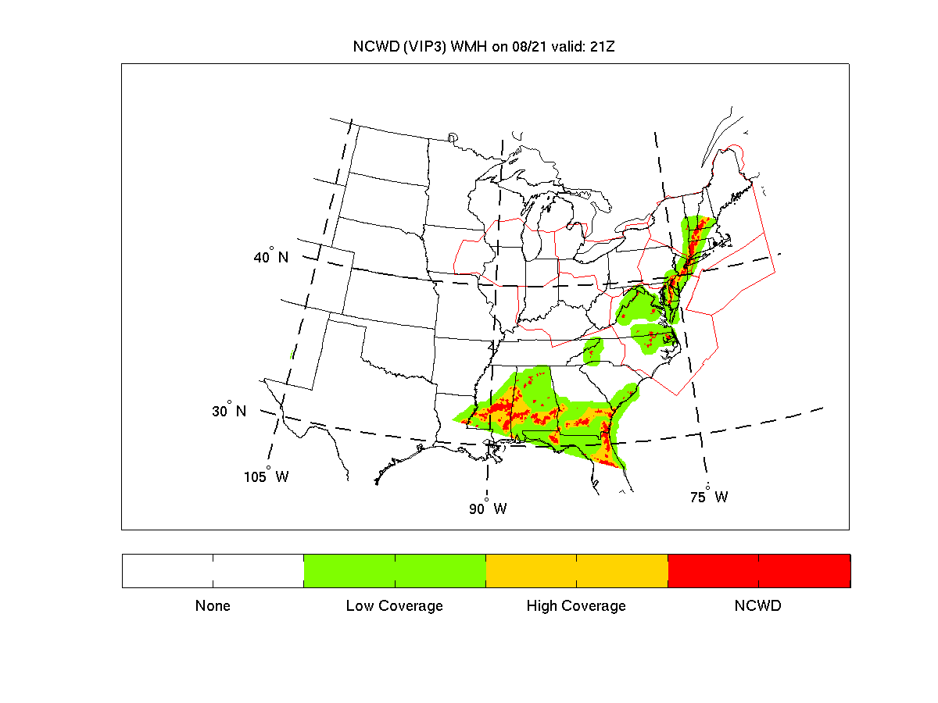
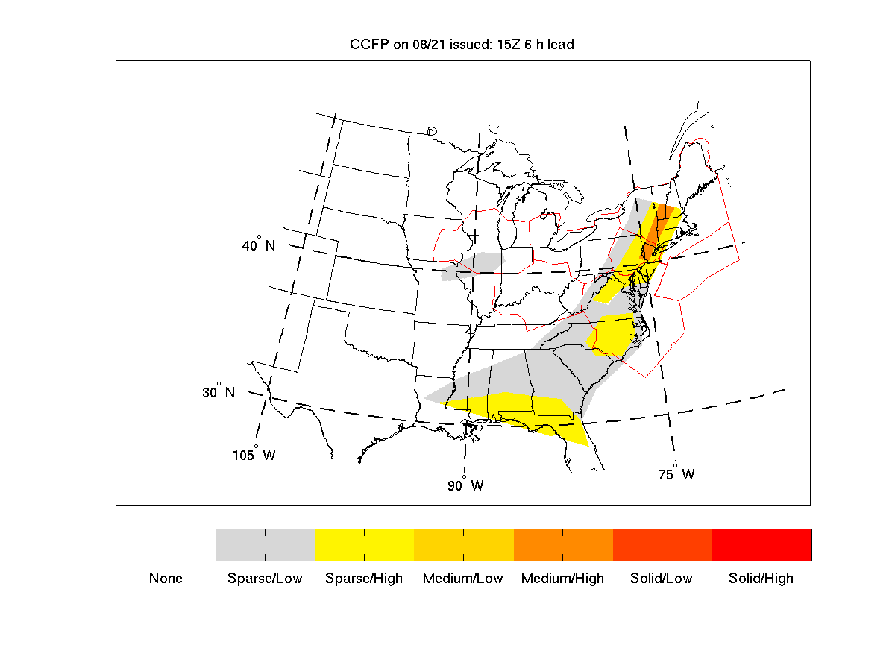
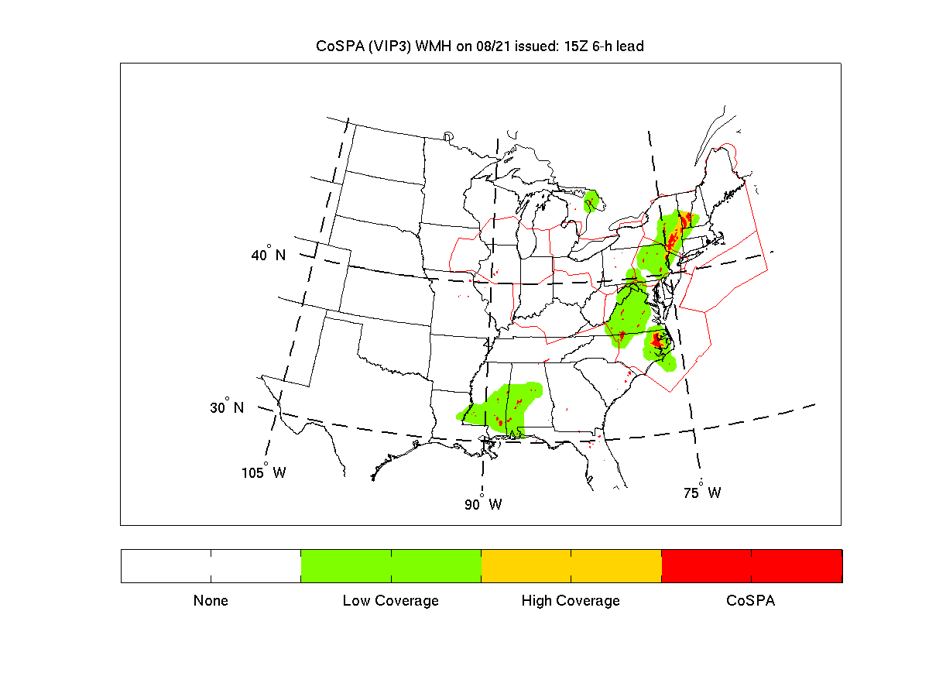
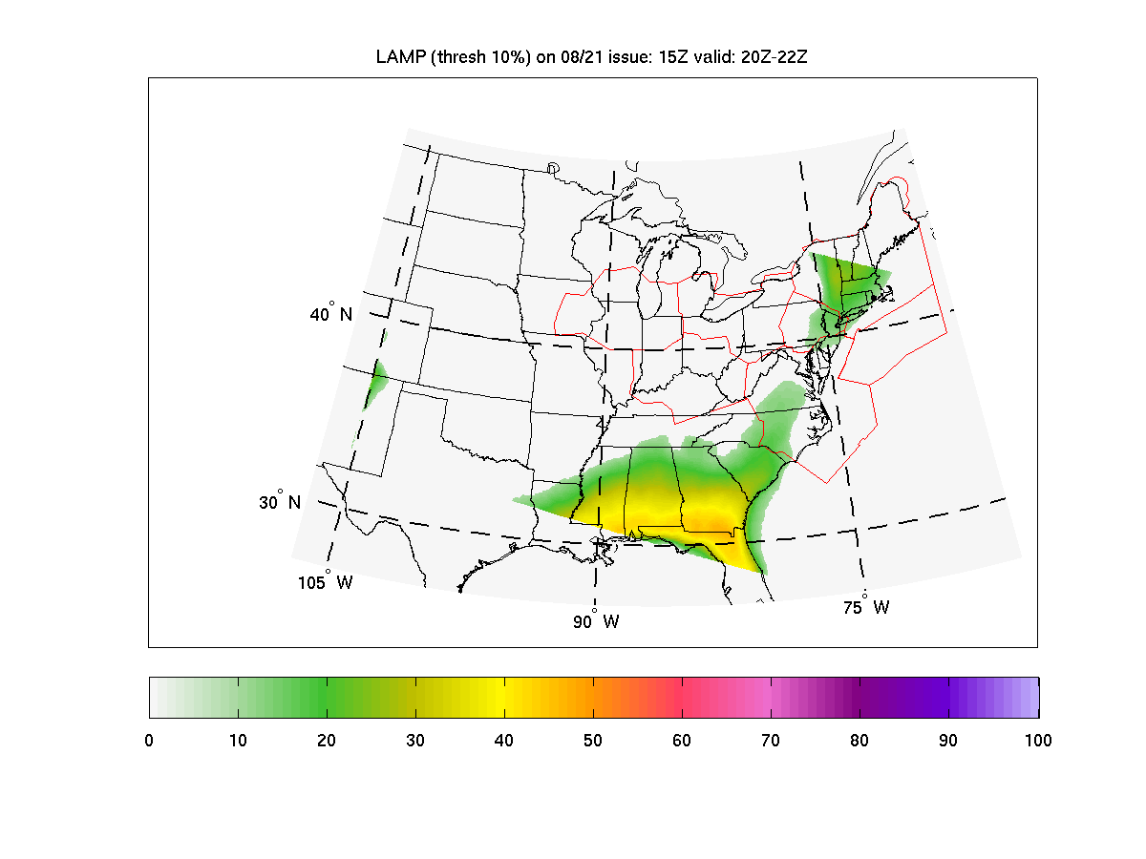
Planning Scenario #1
8/21 15Z 6-h lead

Slide 7
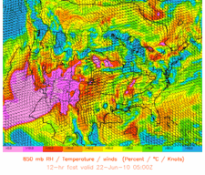
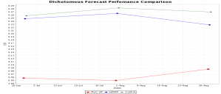
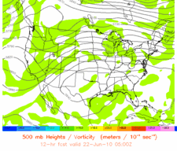
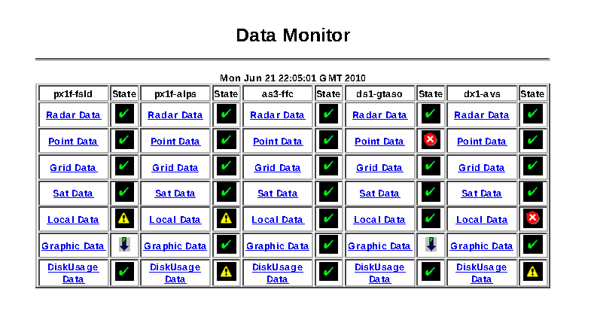
NEVS Relationships in NextGen
QMS
4D Wx Cube
RTO
Integration
JPDO
Policy
NEVS
Services
Synthesis
Input
Alert
4D Cube
QMS
Drives
Verification Core
Supports
Infrastructure

Slide 8
Weather Performance Information is Different
Weather forecast data is valid for a short period of time, then replaced with the next forecast
Performance information requires an appropriate long-term, stratified history of the forecast data for computing useful metrics

Slide 9
NEVS: A Unique Weather Information Consumer
Production of performance information requires:
  Sophisticated data management strategy/implementation
  Integration of operational criteria with performance information
  Effective distribution of the performance information
NEVS provides stress test for the NNEW services
  Volume and variety of weather data
  Data latency, aggregation of forecasts and observations
  Output data to consumers of performance information

Slide 10
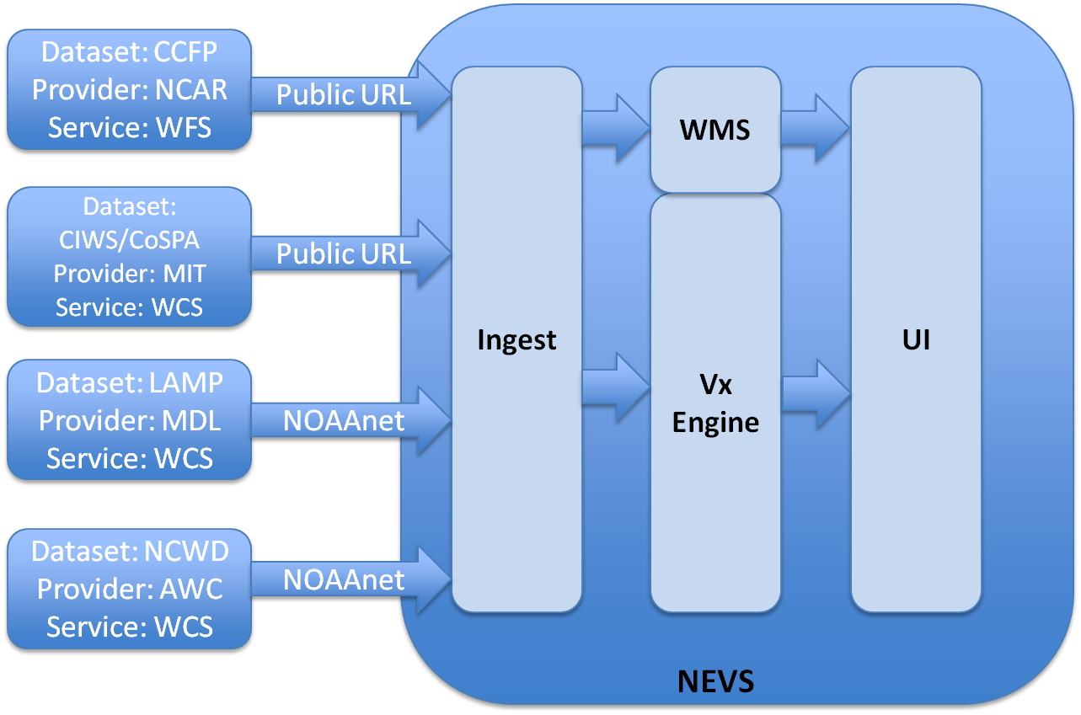
NEVS in the FY10 Capability Evaluation
Planned Configuration
Consume weather information from NNEW services, and show resulting value through web user interface.

Slide 11
NEVS in the FY10 Capability Evaluation
Actual Configuration
WFS and WCS successful ingest via public URL access. NOAAnet connections unavailable to GSD/FVS until 9/14. Offline access (getCapabilities) successful.

Slide 12
Demonstration Setup
Scenario: Verification support for strategic planning in NAS, with respect to convection
Produce depictions, statistics, and diagnostics for weather and weather translation
Specifically, convection translated via the Mincut bottleneck approach, currently under consideration for NextGen ATM planning

Slide 13
Strategic Planning
Planners need forecasts that provide the following weather attributes relatively broad scales (ARTCC) over CONUS:
  Structure, amount, location of convection
Implemented with the current set of management tools
  Airspace Flow Programs, Ground Delay Programs, etc.
Primarily occurs during morning, with forecasts out to 6-hours
  Key planning points: telcons at 11z, 13z, 15z
  Typically before any significant convective initiation
Strategic planners need significant confidence to commit to a convective impact mitigation plan (“go out on a limb”)
  Probabilistic forecasts

Slide 14
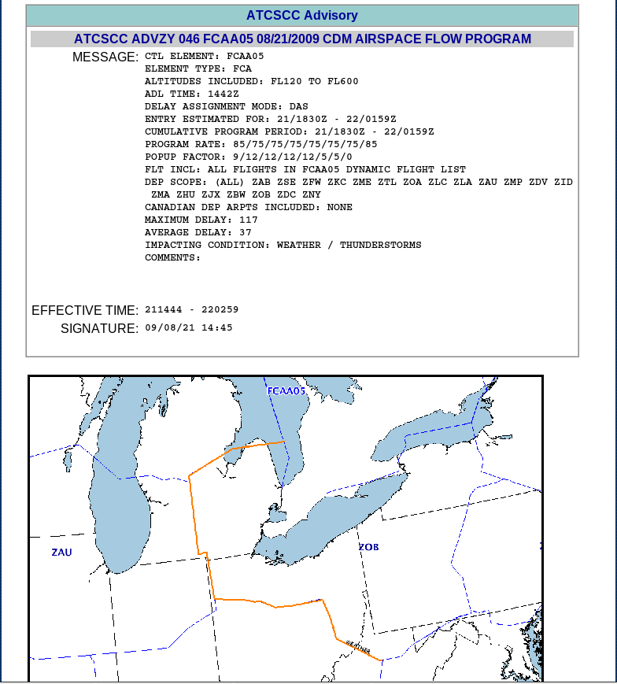
21 August 2009 AFP- ZOB

Slide 15
Mincut Bottleneck Technique
Jetway
Sector
Hazard
Corridor
Bottleneck
Blockage Potential 0.5

Slide 16
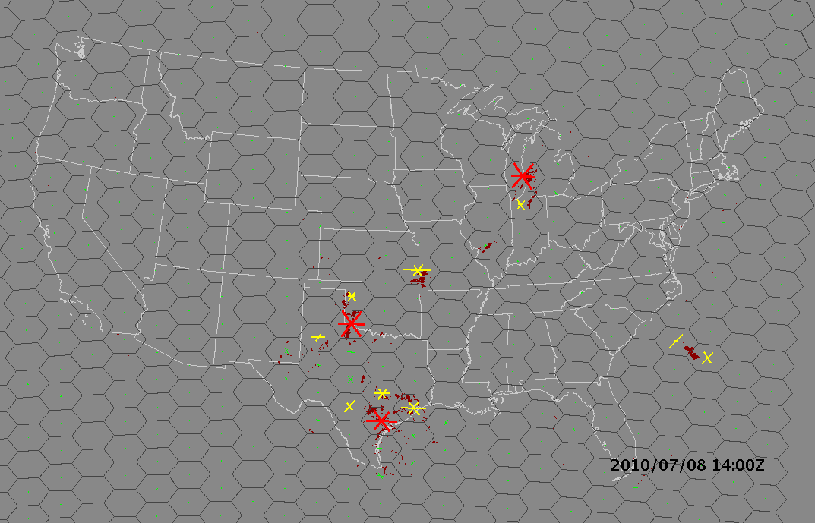

Slide 17
NEVS Demonstration
http://esrl.noaa.gov/nevs/demo/

Slide 18
NNEW and NEVS in FY11
Provide quality baseline of weather data
Perform diagnostic tests of NNEW from consumer perspective
Expand service concepts/implementation
  Lessons learned in FY10
  NEVS input needs
  NEVS output needs

Slide 19
Appendix

Slide 20
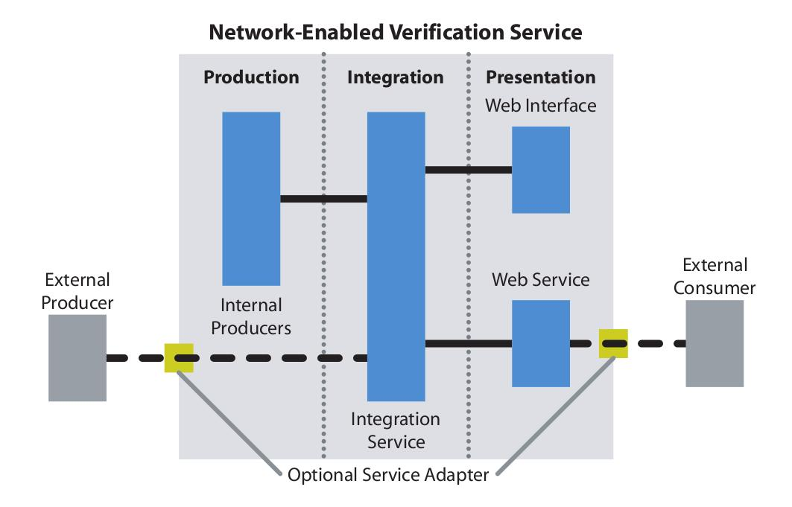
NEVS Architecture
20

Slide 21
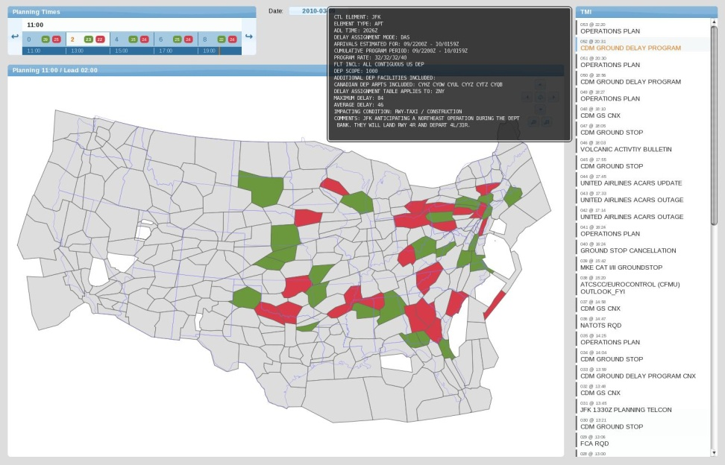
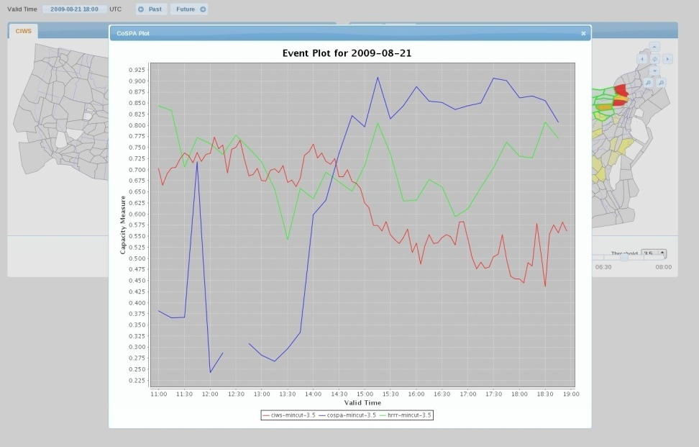
Tolerance Alert Scenario #1
A strategic plan based upon ARTCC capacity estimates has been made for New York and DC
A change in capacity beyond a certain tolerance will require reconfiguration
tolerance
exceeded
Plan view
Tolerance for
sector of interest
Working NEVS Prototype
Example of Dashboard for FY10 Demo
(capacity estimates based upon
sector min-cut bottleneck algorithm)

